Slide 1
History of Computer Art
URL: http://iasl.uni-muenchen.de/links/GCA_Indexe.html
Part II: Cybernetic Sculptures
Seminar, 28nd April 2014
Danube University Krems
Department for Arts and Image Science
MediaArtHistories: Masters of Art
Thomas Dreher
URL: http://dreher.netzliteratur.net

Slide 2
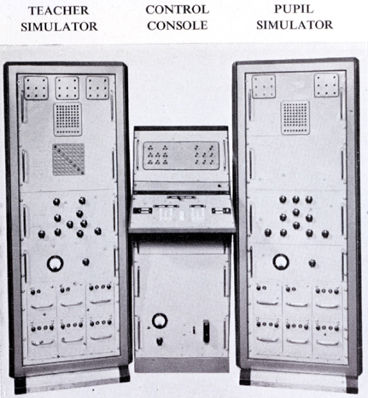
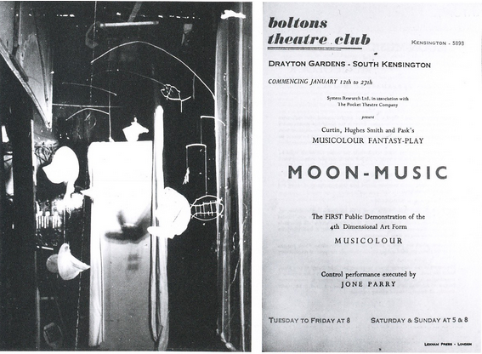
Gordon Pask: Early Works
Solartron EUCRATES II, ca. 1956 (Pask: Approach 1961, pl.I 8(i)).
Musicolour, Boltons Theatre Club, South Kensington 1954.
Left: Stage with a projection screen for Musicolour.
Right: Moon-Music, playbill (Rosen: Control 2008, p.139).

Slide 3
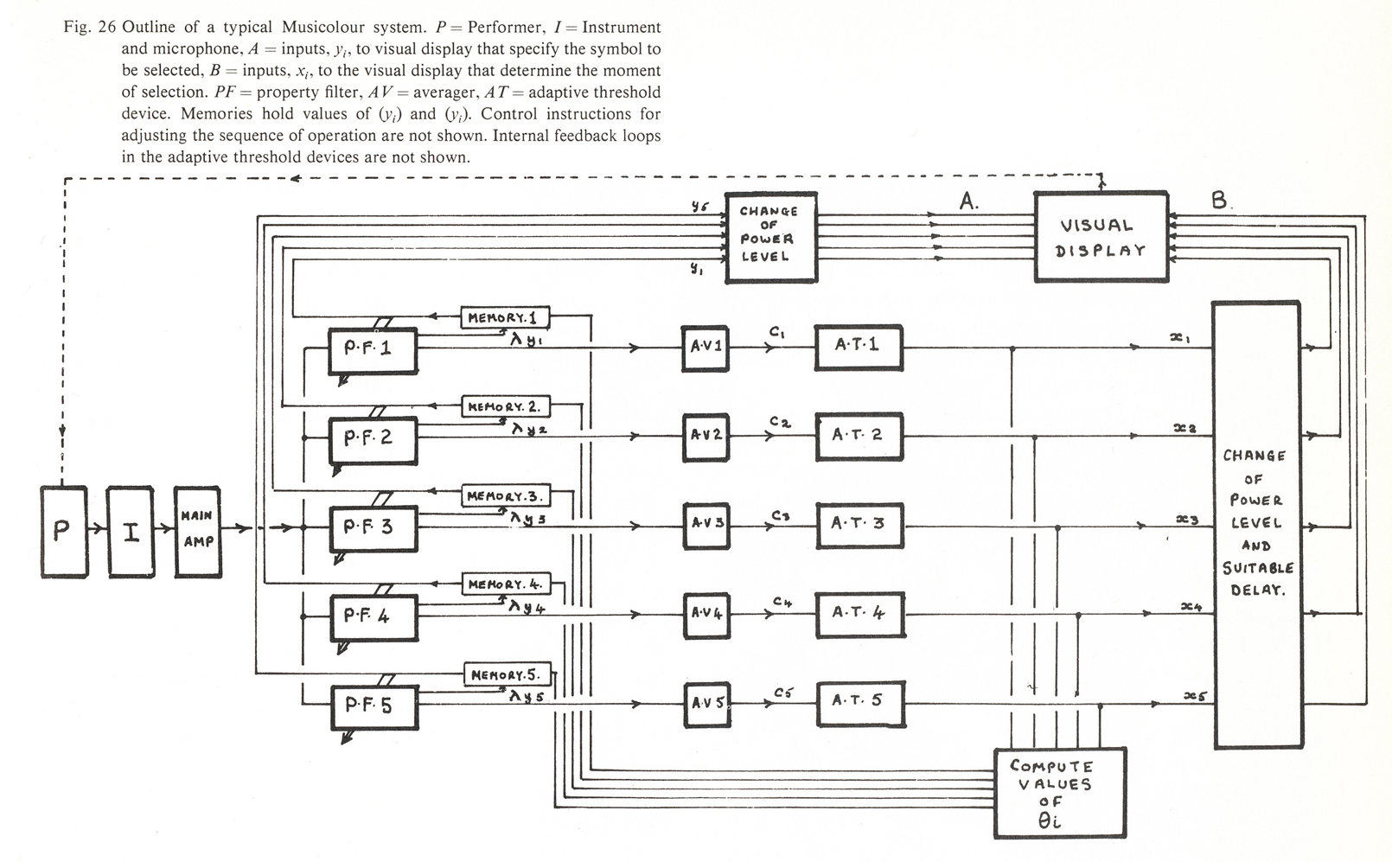
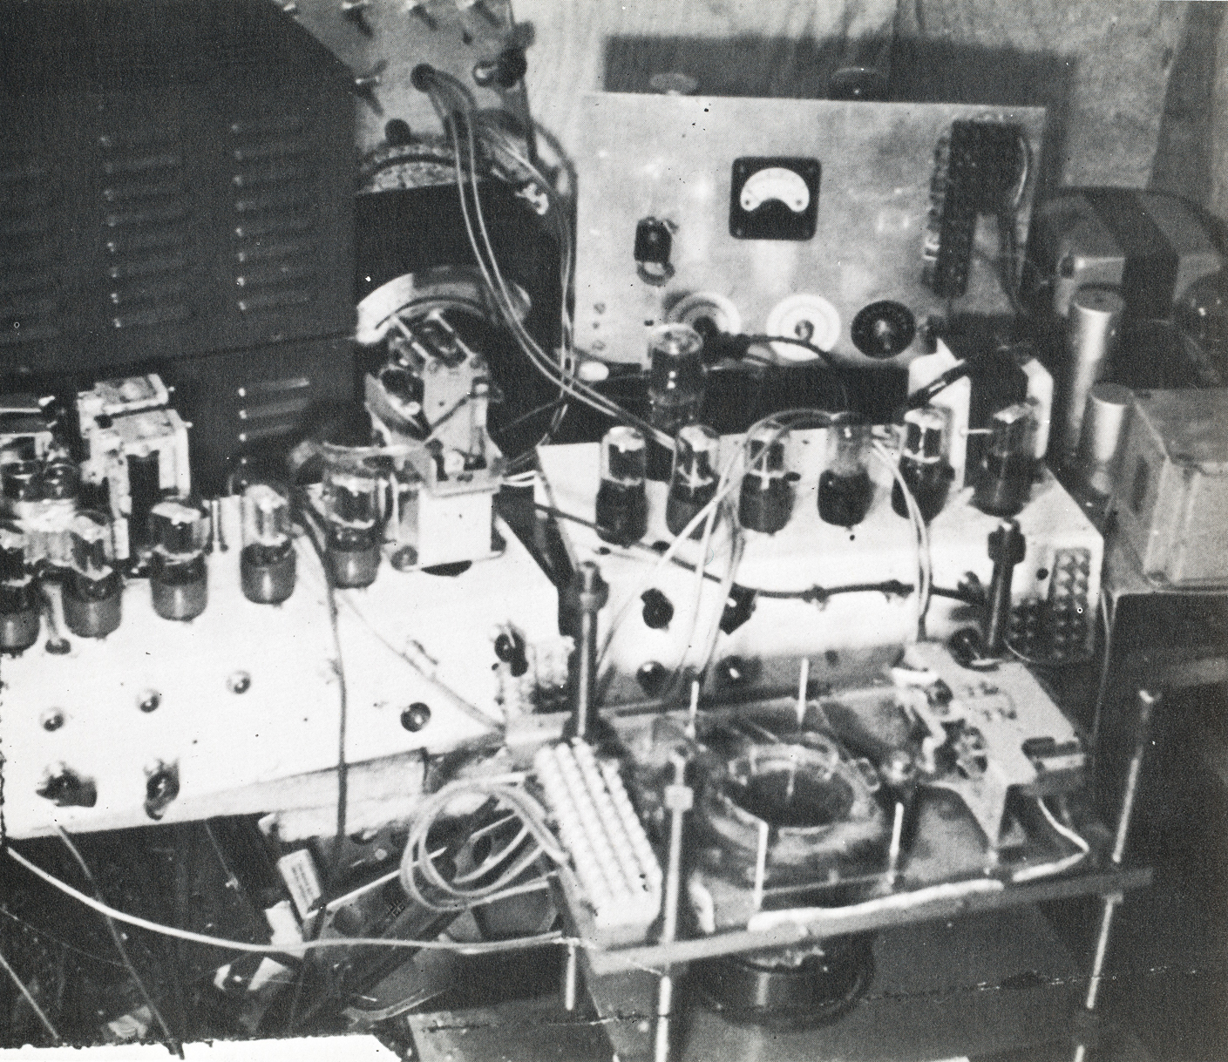
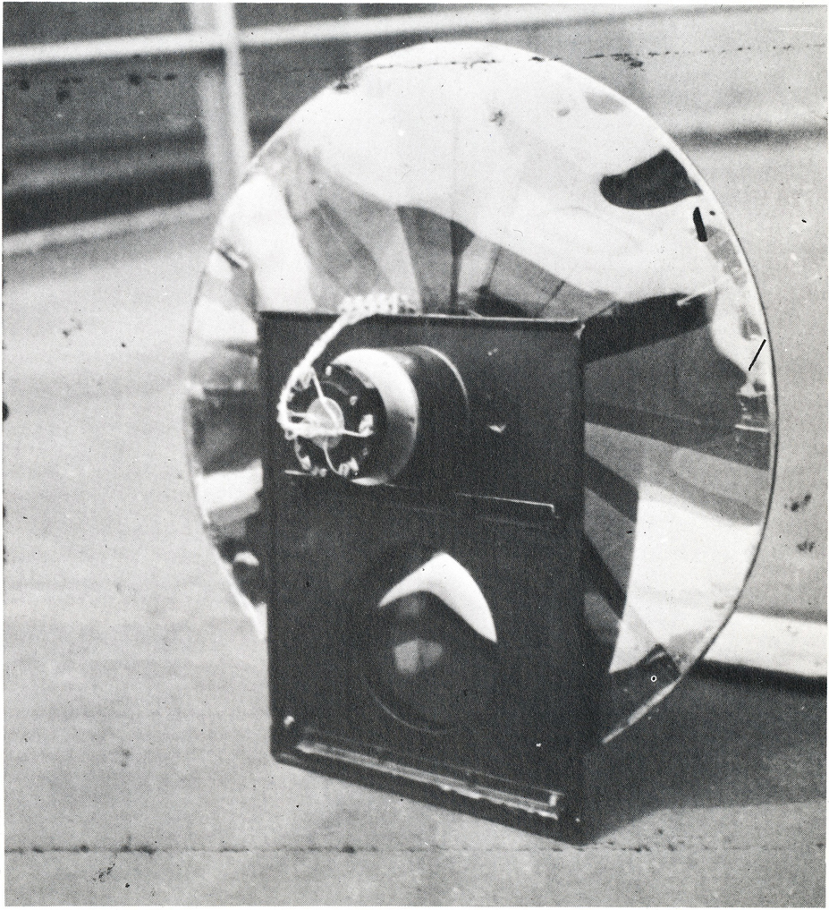
Gordon Pask: Musicolour 1953-57
Circuit diagram (Pask: Comment 1971, p.79, fig. 26).
Electrochemic system (Pask: Comment 1971, p.85, fig.31).
Projection wheel controlled by a servomechanism (Pask: Comment 1971, p.81, fig.27).

Slide 4
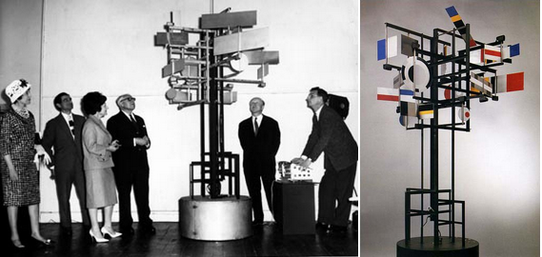
Nicolas Schöffer: CYSP 1, 1956
Left: exhibition, Institute of Contemporary Arts, London 1960.
Image source: URL: http://www.olats.org/schoffer/img/cyspica2.jpg
Image Source: http://www.thecentreofattention.org/exhibitions/feCYSP1sm.jpg
UR

Slide 5
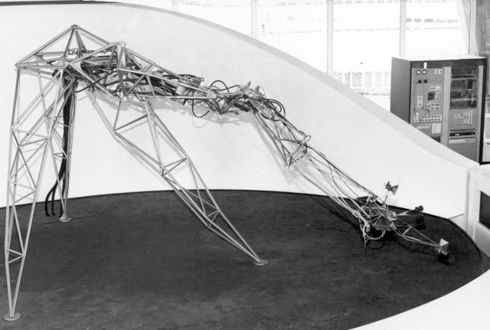
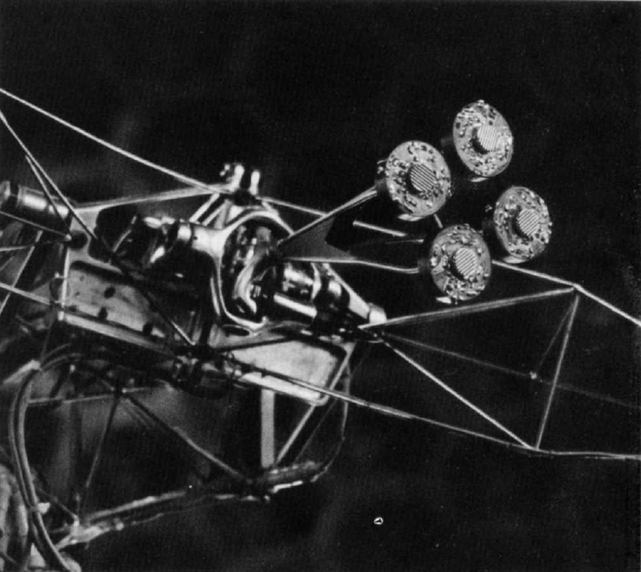
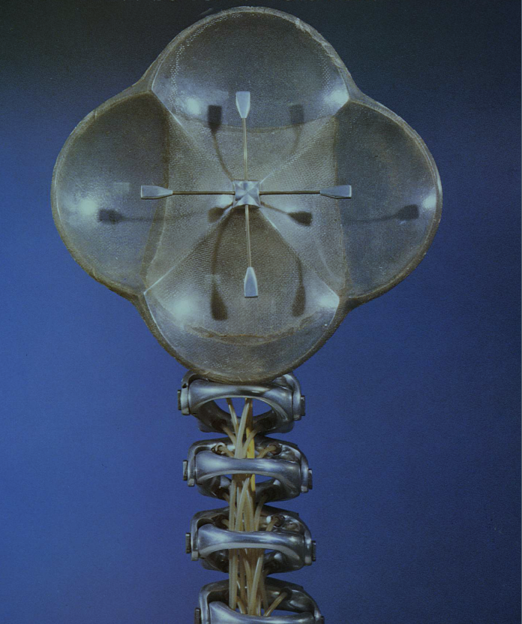
Edward Ihnatowicz
Top Left: The Senster, 1970, in Evoluon, Eindhoven.
Image source: URL: http://www.dse.nl/~evoluon/senster3k.jpg
Top Right: The Senster, 1970, four microphones.
Bottom Right: SAM, 1968 (Ihnatowicz: Cybernetic Art 1986, Cover).

Slide 6
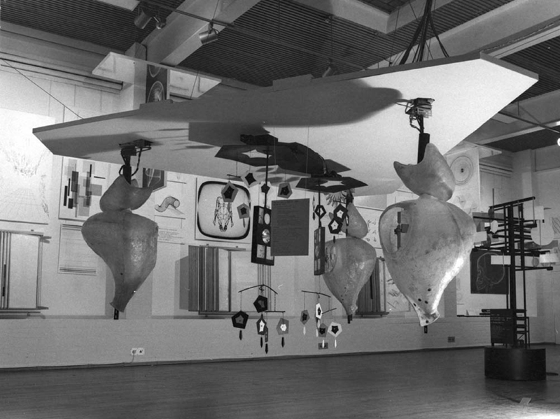
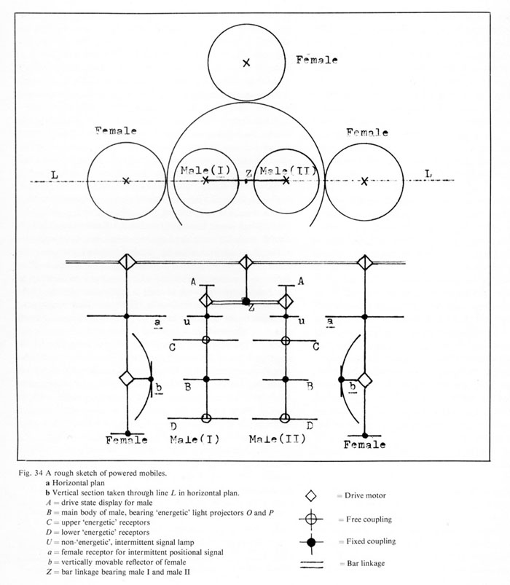
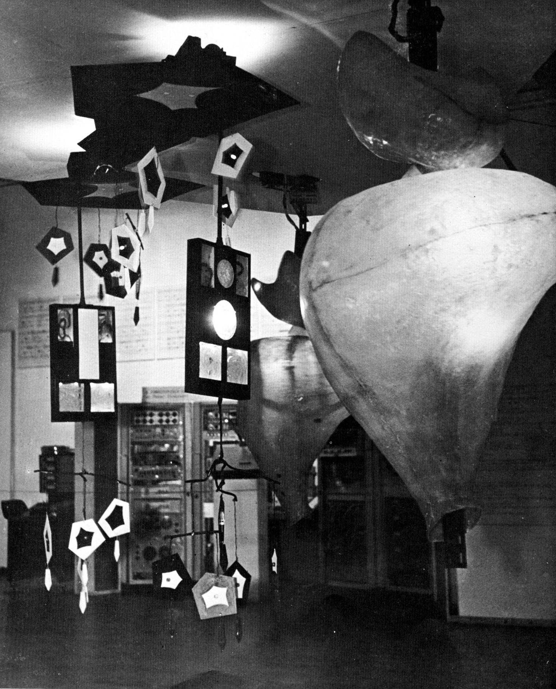
Reactive Installations with Computing Processes (II)
Pask, Gordon: Colloquy of Mobiles, 1968 (installed at “Cybernetic Serendipity”, Institute of Contemporary Art, London 1968. Pask: Comment 1971, p.90,97, fig. 34,40).

Slide 7
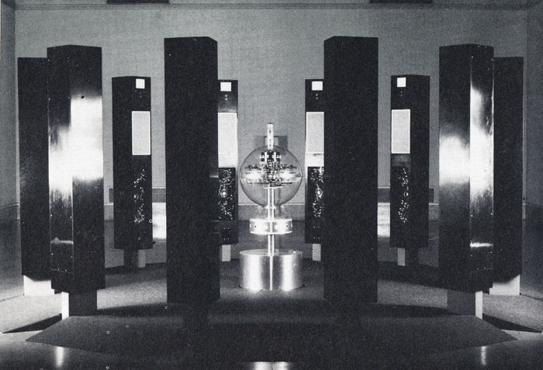
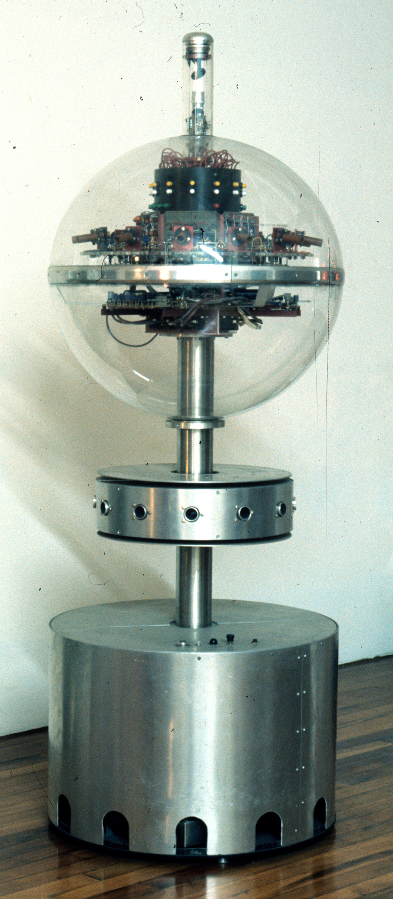
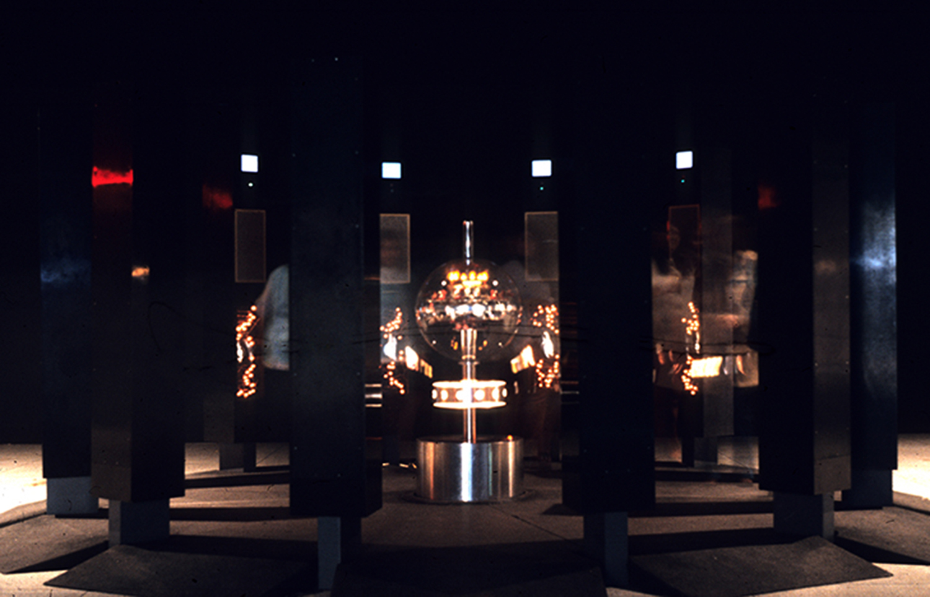
James Seawright: Electronic Peristyle, 1968
Right: "central unit" removed from the installation. The transparent "plastic sphere" is divided by a "metal band". In the lower half "the circuitry of the sound synthesizer" is visibly installed. Above the "metal band" the 12 photocells are recognisable, "looking a bit like little cannons". The "black metal drum" contains the lamps indicating states of the "shift register" and the "audio synthesizer modules". Above the "metal drum" are the cables of the "patch panel". The "rotating scanner" is located on top of the "plastic sphere" (photo and quotes: James Seawright).
Left, top and bottom: exhibition "The Magic Theatre", William Rockhill Nelson Gallery of Art, Kansas City/Missouri 1968. Photo above: Larry B. Nicholson (Davis: Experiment 1975, p.96). Photo below: James Seawright.

Slide 8
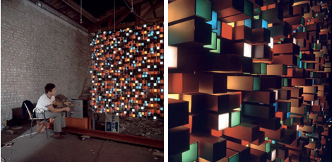
Victor Bonacic: G.F.E. (16,4), 1969-71.
Computer-controlled light and sound installation.
Left and right: Image Source: http://www.darkofritz.net/text/bonacic.html
UR

Slide 9
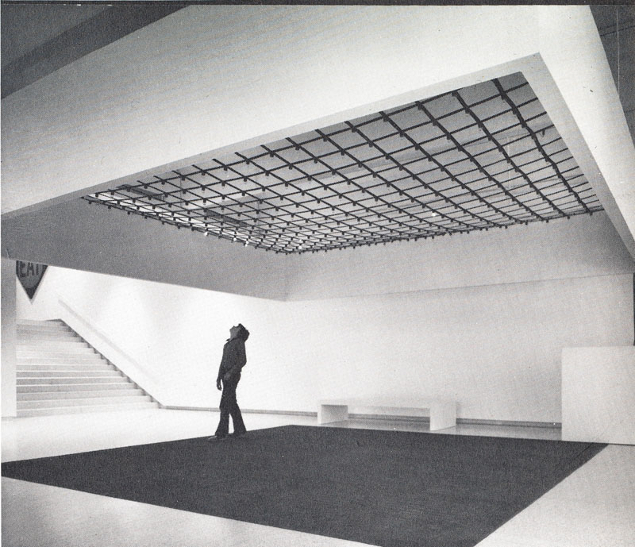
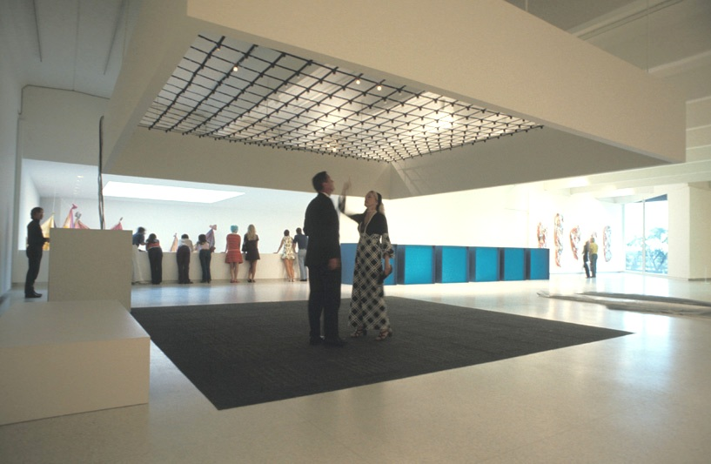
James Seawright: Network III, 1971
Seawright, James: Network III, 1971, Walker Art Center, Minneapolis 1971.
Left: Davis: Experiment 1975, p.195. Photo: Eric Sutherland.
Right: Image source: URL: http://blogs.walkerart.org/visualarts/files/2011/12/ex1971wns_ins_027.jpg

Slide 10
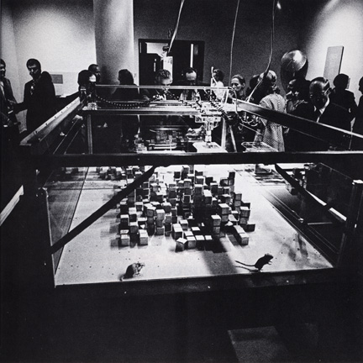
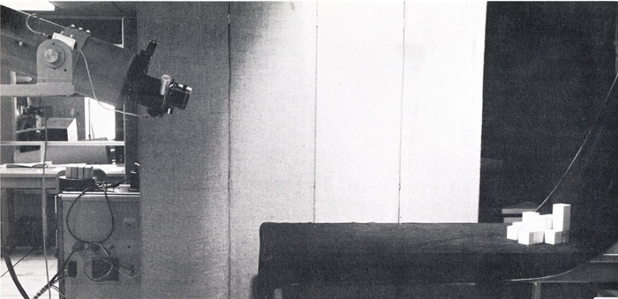
Nicolas Negroponte and the Architecture Machine Group
The Architecture Machine Group: Urban 5, 1967.
Minsky/Papert Eye, M.I.T. (Negroponte: The Architecture Machine 1970, p.106).
The Architecture Machine Group: Seek, 1970, exhibition "Software", The Jewish Museum, New York 1970 (Negroponte: Architecture 1975, p.46, fig.1).

Slide 11
Literatur
Bibliography with informations about the abbreviations used in the captions:
Dreher, Thomas: History of Computer Art. Chap. Bibliography. In: URL: http://iasl.uni-muenchen.de/links/GCA-IXe.html
8

