Slide 1
History of Computer Art
URL: http://iasl.uni-muenchen.de/links/GCA_Indexe.html
Part III: Information Aesthetics
Seminar, 28nd April 2014
Danube University Krems
Department for Arts and Image Science
MediaArtHistories: Masters of Art
Thomas Dreher
URL: http://dreher.netzliteratur.net

Slide 2
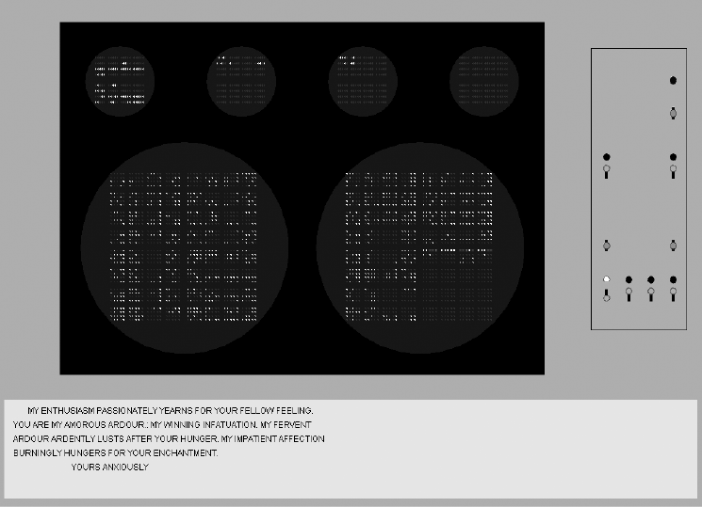
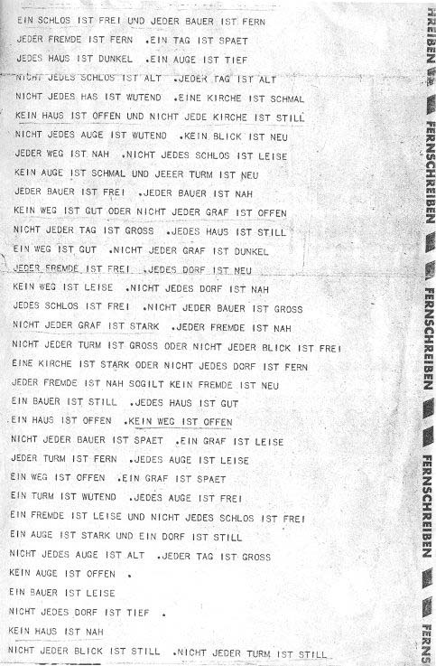
Word Processing
Left: Link, David: Ferranti Mark I Emulator with a reconstruction of Christopher Strachey´s "Love-letters" 1952 (Link: Angel 2006, p.16, fig.1).
Right: Lutz, Theo: Stochastic Text, Zuse Z22, teleprinter output, 1959.

Slide 3
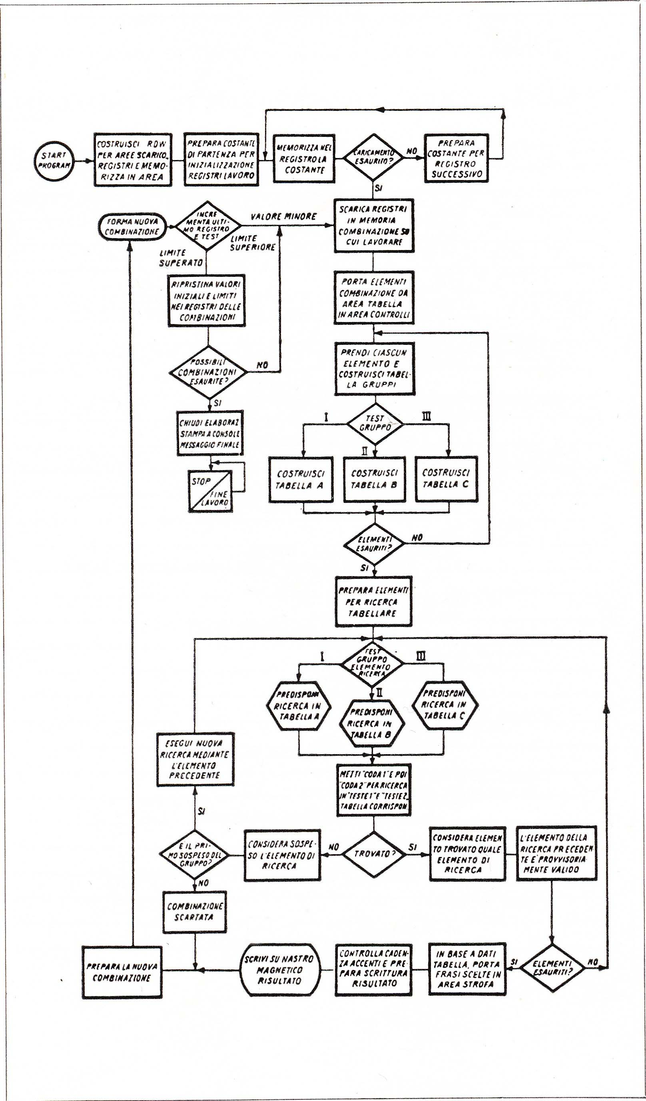
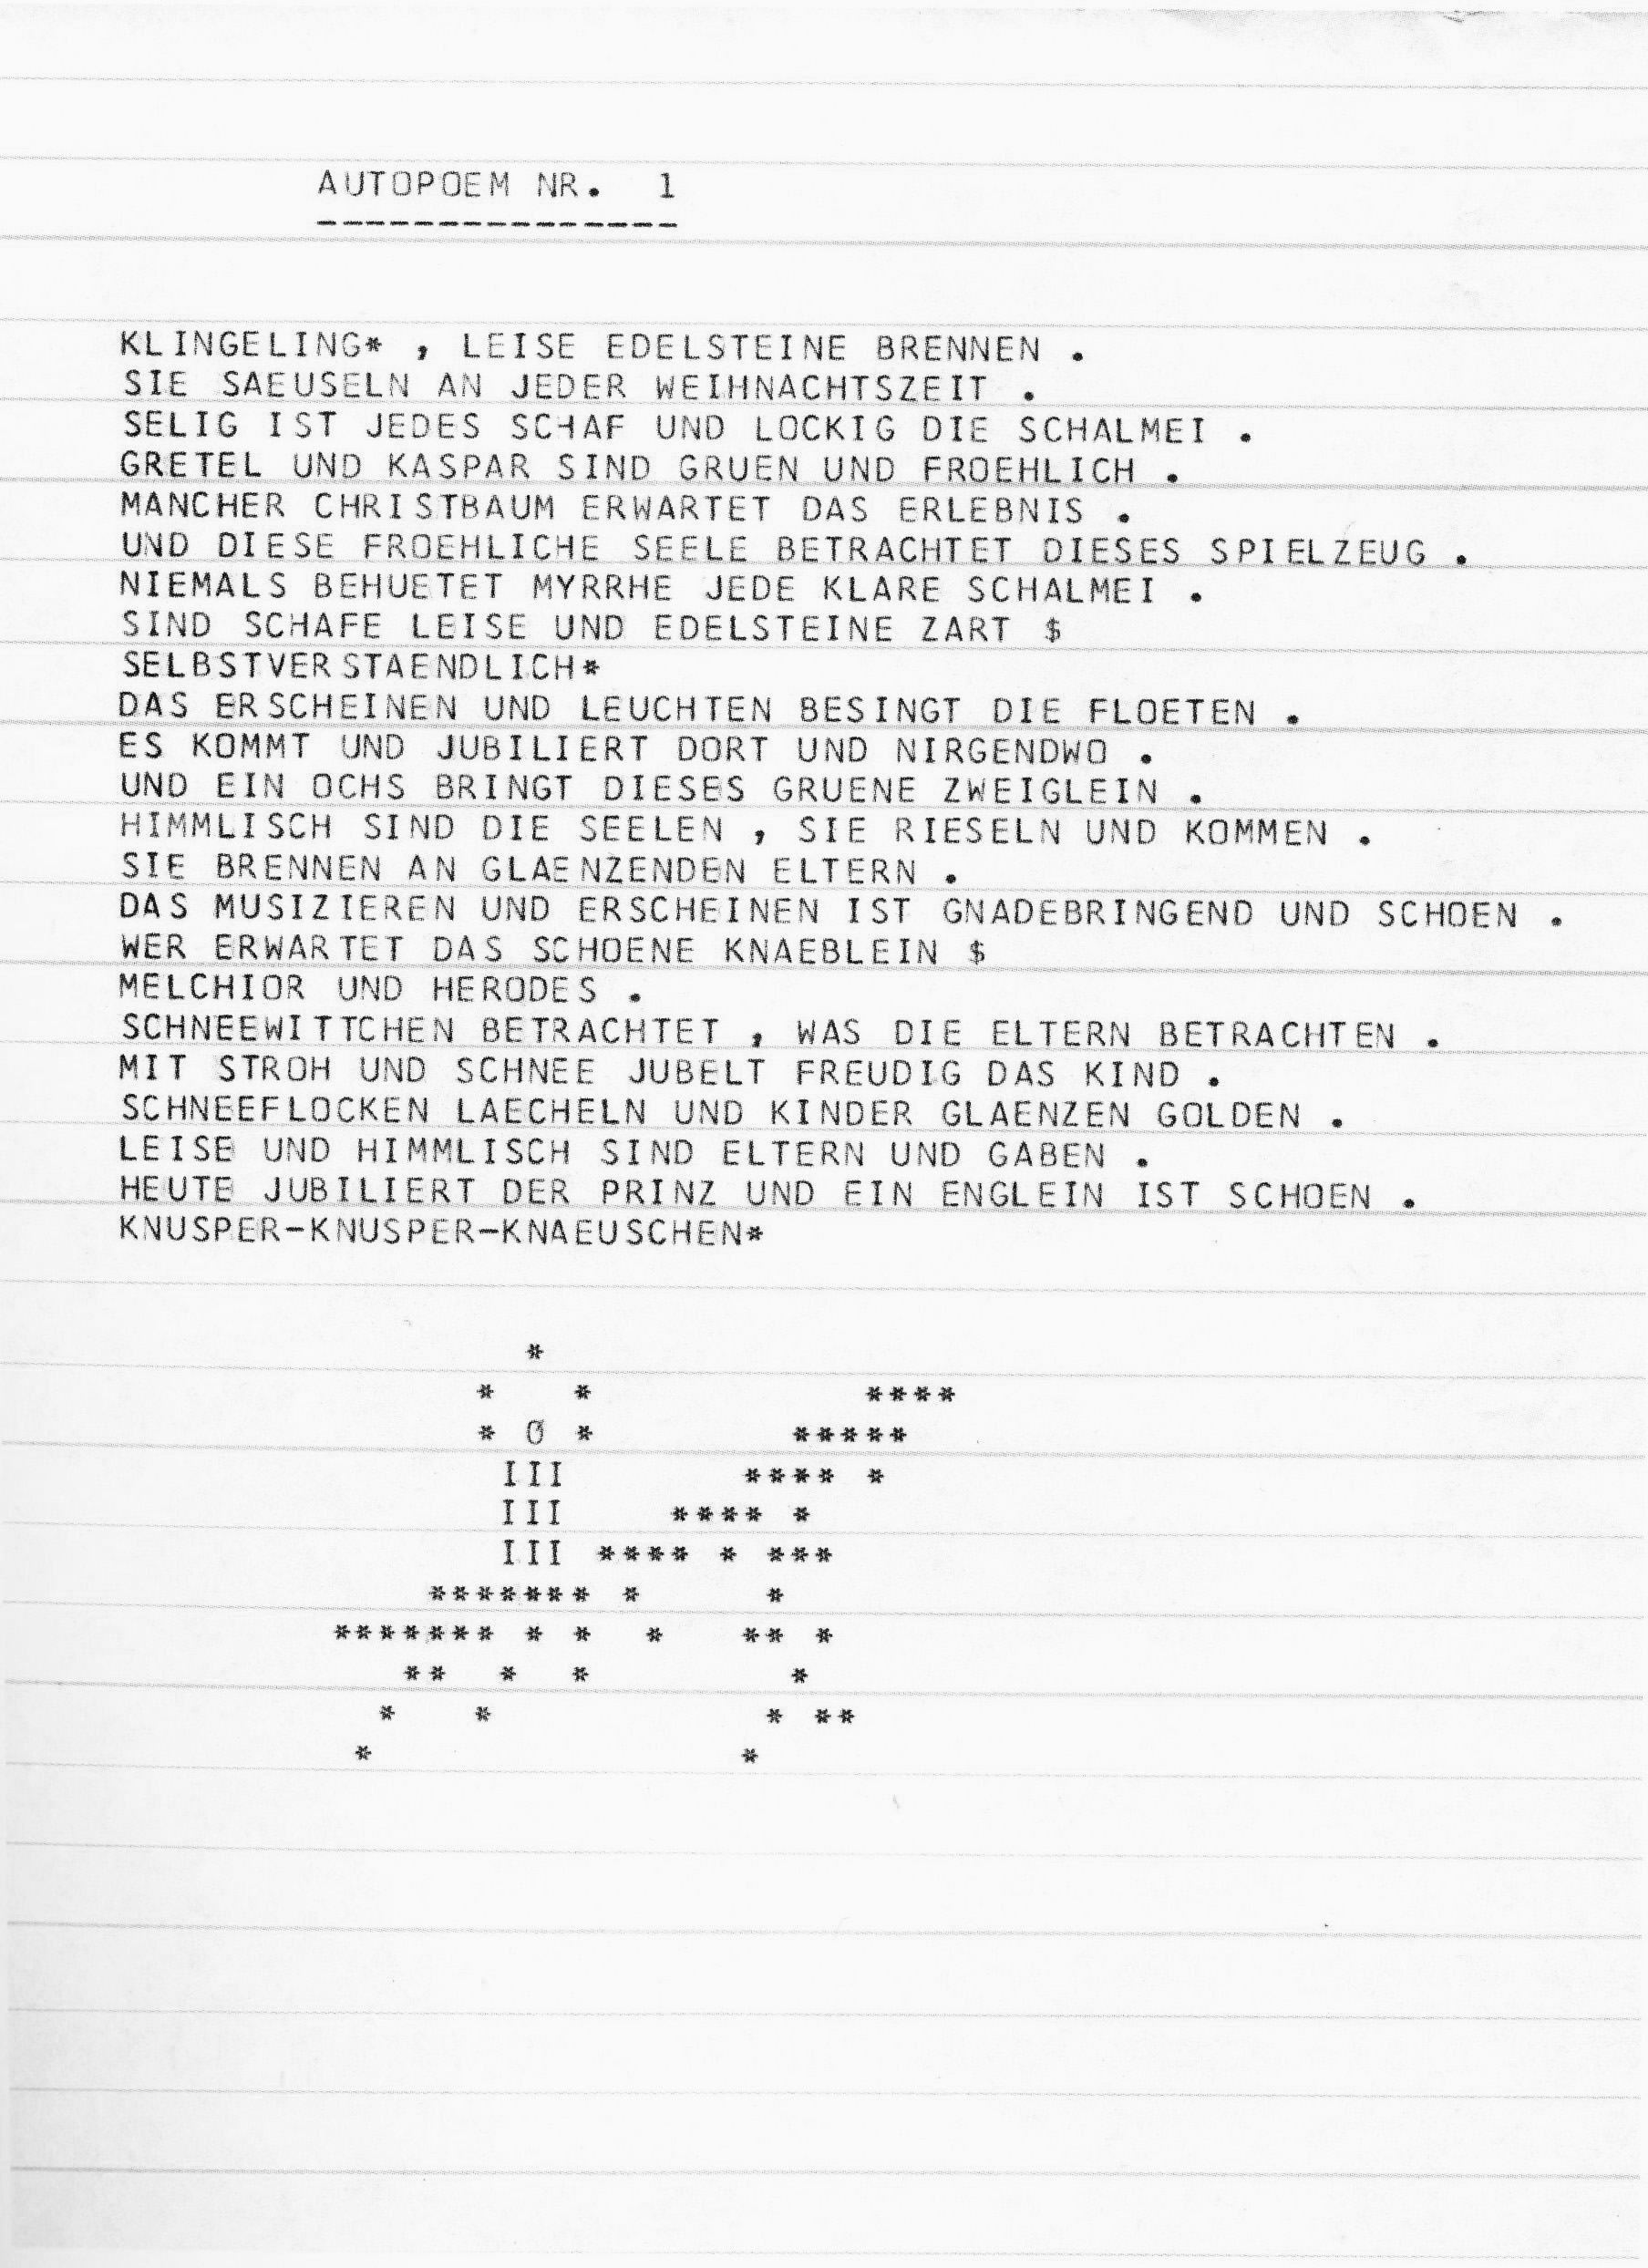
Computer-Generated Literature
Gysin, Brion: I Am That I Am, 1960 (Per-mutation pro-gram by Ian Somerville).
Stickel, Gerhard: Autopoem No.1, 1965 (Herzogenrath/Nierhoff-Wielk: Machina 2007, p.159).
Balestrini, Nanni: Tape Mark I, Flow Chart, 1961 (Reichardt: Serendipity 1968, p.65).
Source: URL: http://glia.ca/conu/digitalPoetics/prehistoric-blog/2008/07/16/1960-brion-gysin-i-am-that-i-am/

Slide 4
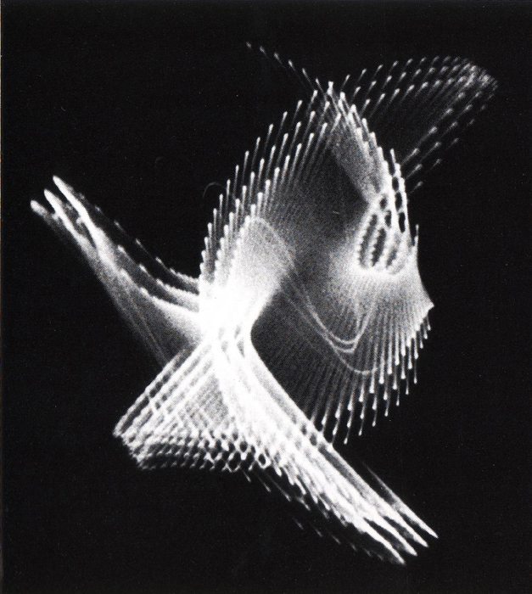
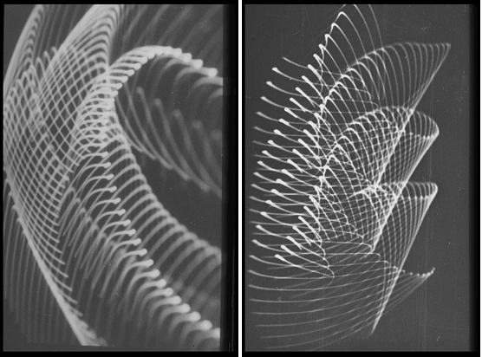
Analog Graphics (I)
Franke, Herbert W.: Oscillograms, 1956, photos of an oscillograph´s screen.
Laposky, Benjamin Francis: Oscillon Number Four, 1950, photo of an oscillograph´s screen.
Image source: URL: http://translab.burundi.sk/code/vzx/1952-6.BenLaposky.ElectronicAbstraction.4.jpg
Image Source: URL: http://www.zi.biologie.uni-muenchen.de/~franke/Kunst1.htm
UR

Slide 5
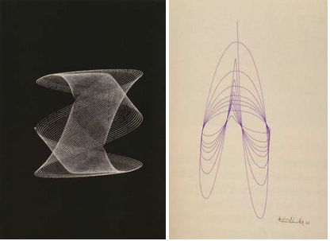
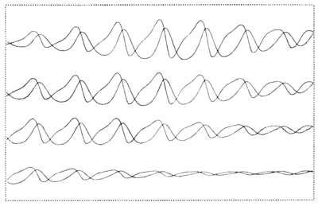
Analog Graphics (II)
Alsleben, Kurd/Passow, Cord: Computergrafik 4, 1960, plotter drawing.
Image Source: URL: http://dada.compart-bremen.de/item/artwork/157
Fuchshuber, Roland K.: Left: Rocker, 1960, plotter drawing.
Right: Polstelle, 1960, plotter drawing.
Image Source: URL: http://dada.compart-bremen.de/item/agent/634

Slide 6
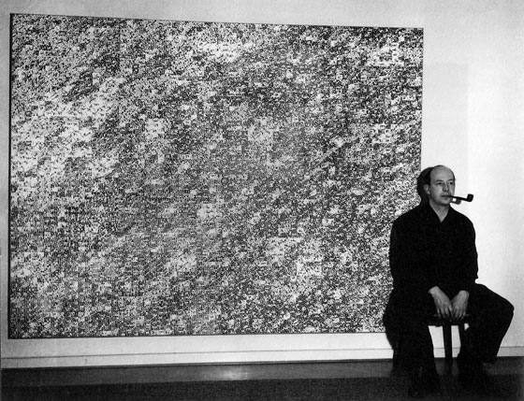
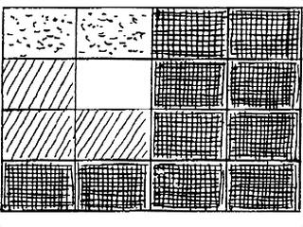
Karl Otto Götz: Densities, 1959-61
Right, top: Density 10:3:2:1, sketch, 1961, division of the image´s surface in super zones with four density degrees (Götz: Malerei 1961, p.14).
Left, top: Karl Otto Götz before Density 10:3:2:1, 1961, felt pen and tusche on Bristol cardboards, mounted on canvas (Götz: Erinnerungen 1983, p.900, ill.1016).
Left, bottom: Statistic-metric Trial 4:2:2:1, concept Summer 1959, realisation with pencil and felt pen on cardboard 1960. Photo: Kukulies. Collection Etzold. Städtisches Museum Abteiberg. Mönchengladbach (Kersting: Sammlung Etzold 1986, p.206).
Right, bottom: Density 10:3:2:1, sketch, 1961, little zones with four denstiy degrees: D = dark, M = middle density, H = low density, sH = very bright (Götz: Malerei 1961, p.23).

Slide 7
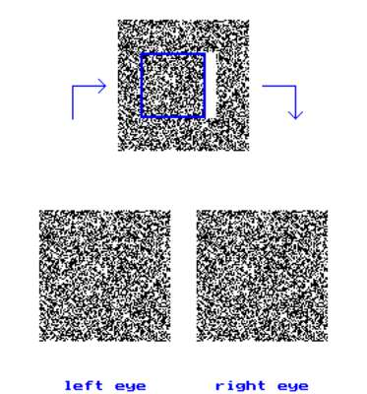
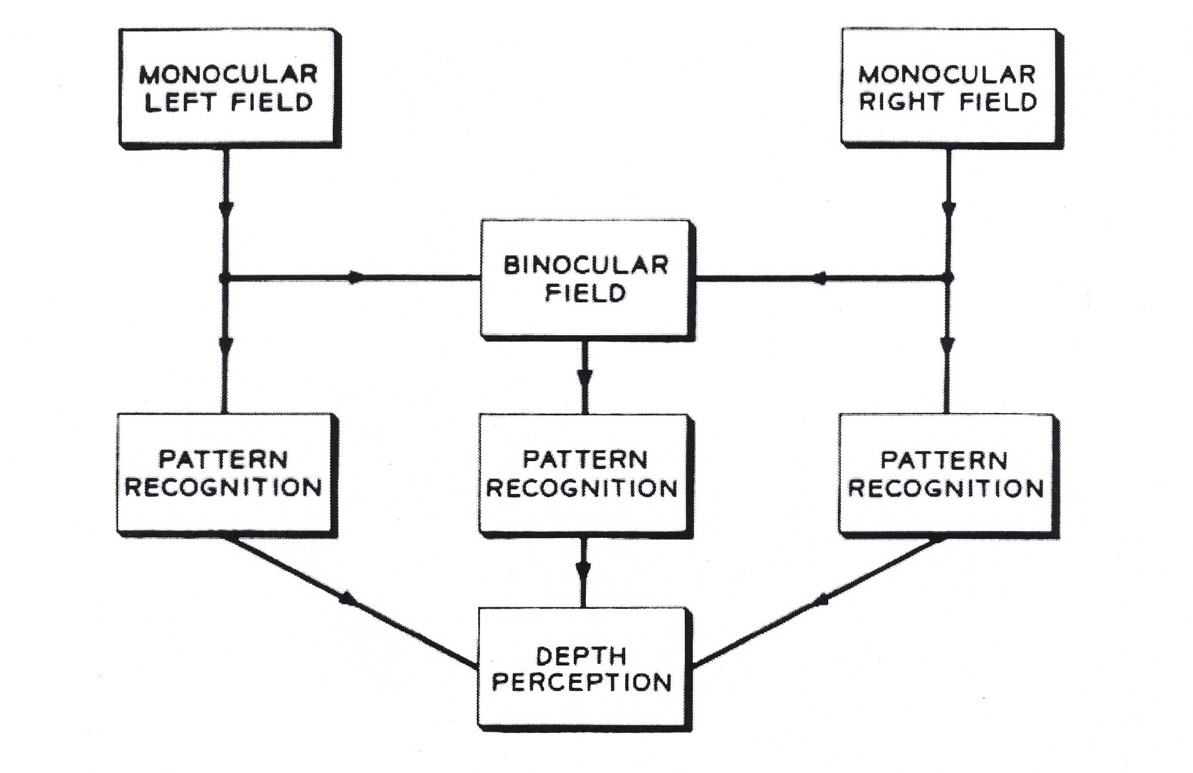
Béla Julesz: Binocular Depth Perception
Right: Depth perception by monocular and binocular pattern recognition, 1960 (Julesz: Depth Perception 1960, p.1128, fig.3).
Left: Stereopsis, 1959, plotter drawing.

Slide 8
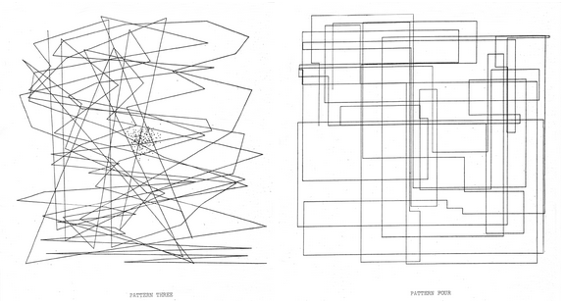
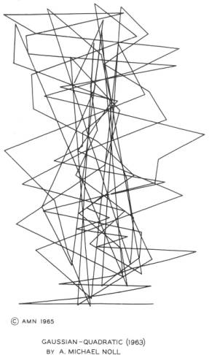
Michael A. Noll: Patterns
Noll, A. Michael: Left: Pattern Three, 1962, photo print.
Right: Pattern Four, 1962, photo print (Noll: Patterns 1962, unpaginated).
Right: Gaussian Quadratic, 1962/63, photo print.
Image Source: URL: http://noll.uscannenberg.org/CompArtExamplesfiles/IMAGE004.jpg

Slide 9
Georg Nees: Computer Graphics
23-Ecke, 1964, plotter drawing (Nees: Grundlagenstudien 1964, p.124, ill. 2).
Untitled (Micro Innovation), 1967, plotter drawing (Nees: Computergraphik 2006, p.222, ill. 31).

Slide 10
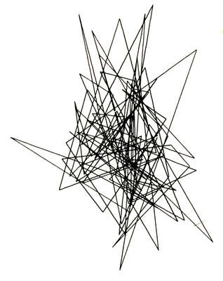
Computer Graphics: Random Polygon Moves
Nake, Frieder: Random Polygon Move, 1963, plotter drawing, 10 x 10 cm (Nake: Ästhetik 1974, p.19, ill.5.2-7)/1964, plotter drawing, 15,5 x 11,5 cm (Herzogenrath/Nierhoff-Wielk: Machina 2007, p.424, nr.259).
Noll, Michael A.: Gaussian Quadratic, 1962/63, photo print.
Image Source: URL: http://noll.uscannenberg.org/CompArtExamplesfiles/IMAGE004.jpg.

Slide 11
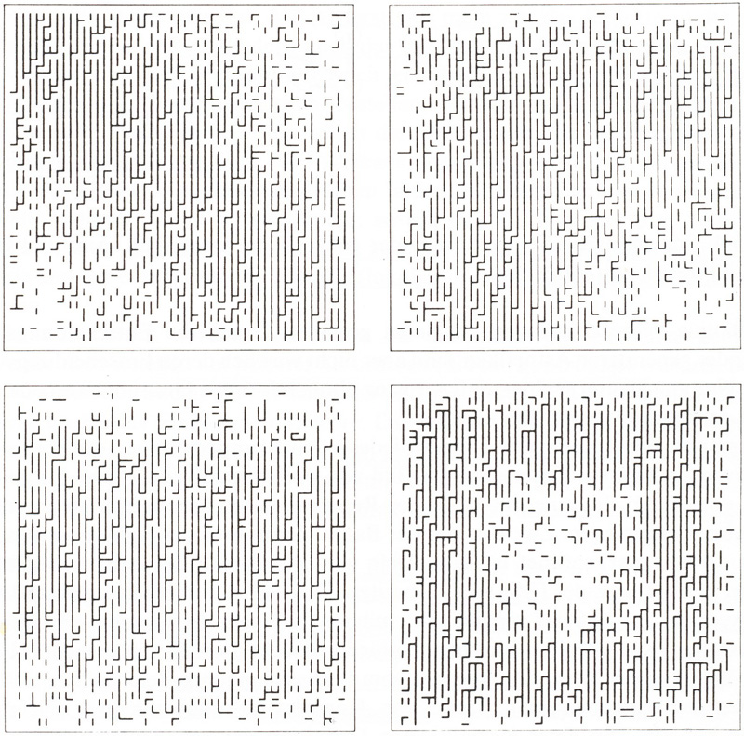
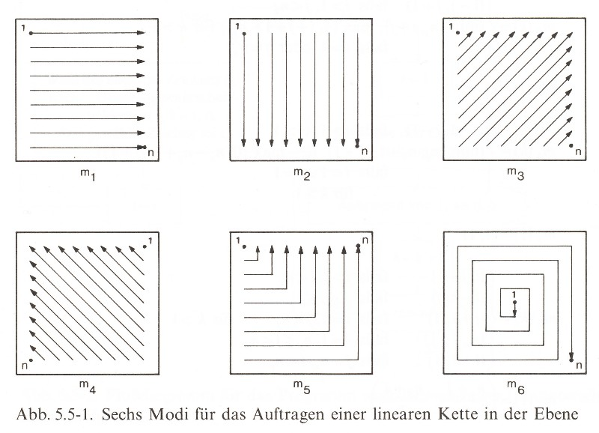
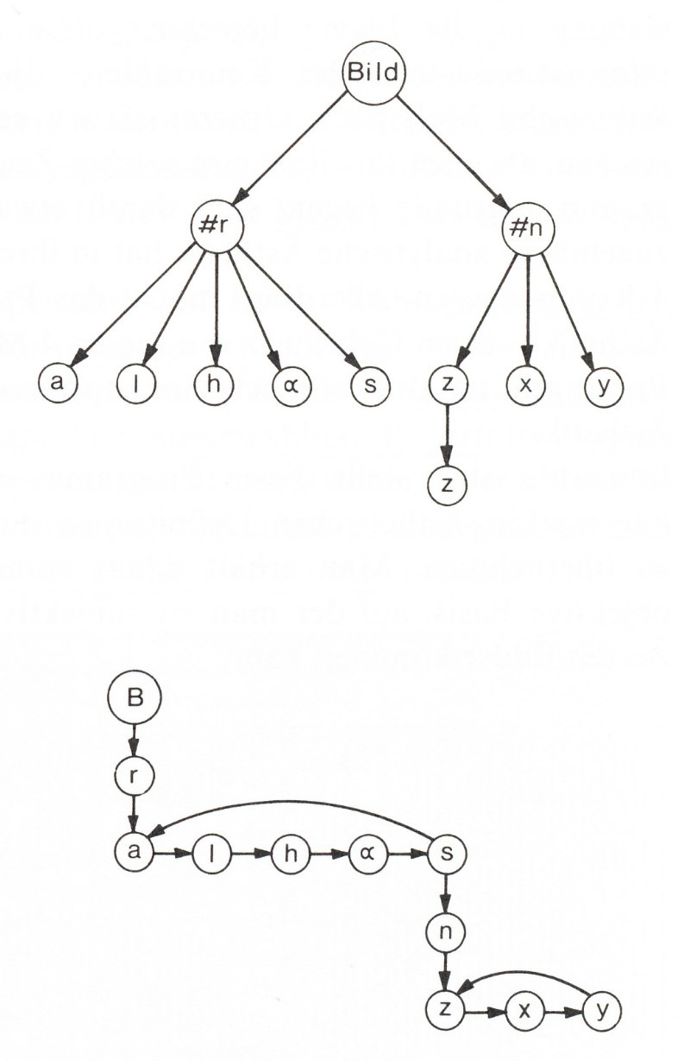
Frieder Nake: Walk-Through-Raster, 1966
Right, top: Walk-Through-Rasters, 1966, six modes (Nake: Ästhetik 1974, p.229, ill. 5.5-1).
Left: Walk-Through-Raster, series 2.1, four realisations, 1966, plotter drawings (Nake: Ästhetik 1974, p.236, ill. 5.5-5).
Right, bottom: Walk-Through-Raster, 1966, diagram of the tree structure (Nake: Ästhetik 1974, p.235, ill. 5.5-4).

Slide 12
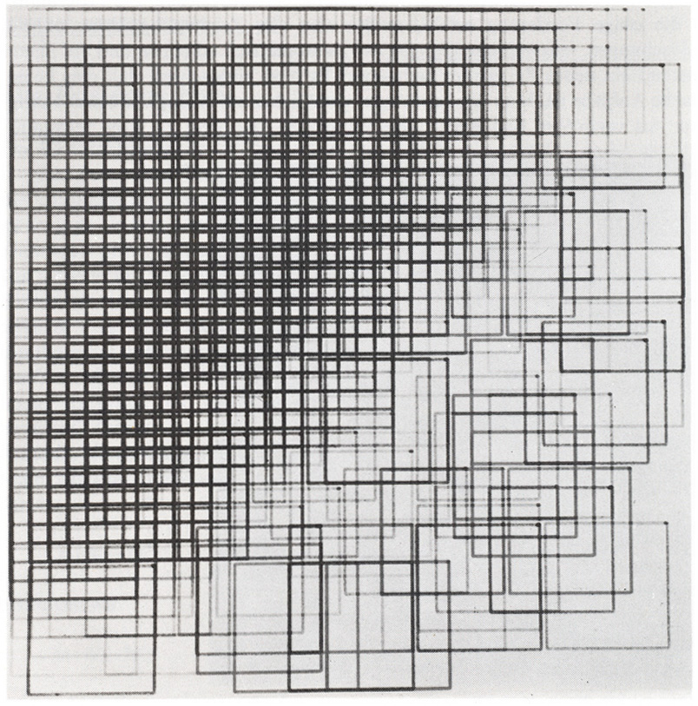
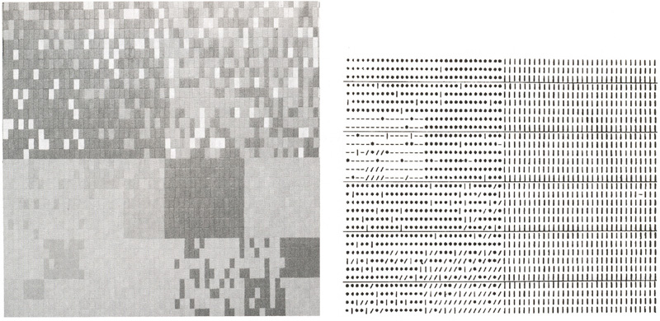
Frieder Nake: Computer Graphics
Walk-Through-Raster, series 7.1, 1966, plotter drawing in four colours (Nake: Ästhetik 1974, p.237, ill. 5.5-6).
Generative Aesthetics I, 1969. Left: Experiment 6.22, coloured leaflets on hardboard. Right: print of a result of the programmed computing process, Experiment 4.5a (Nake: Vergnügen 2004, unpaginated).

Slide 13
Literatur
Bibliography with informations about the abbreviations used in the captions:
Dreher, Thomas: History of Computer Art. Chap. Bibliography. In: URL: http://iasl.uni-muenchen.de/links/GCA-IXe.html
8

