Slide 1
History of Computer Art
URL: http://iasl.uni-muenchen.de/links/GCA_Indexe.html
Part IV: Video Tools
Seminar, 28nd April 2014/4th September 2015
Danube University Krems
Department for Arts and Image Science
MediaArtHistories: Masters of Art
Thomas Dreher
URL: http://dreher.netzliteratur.net

Slide 2
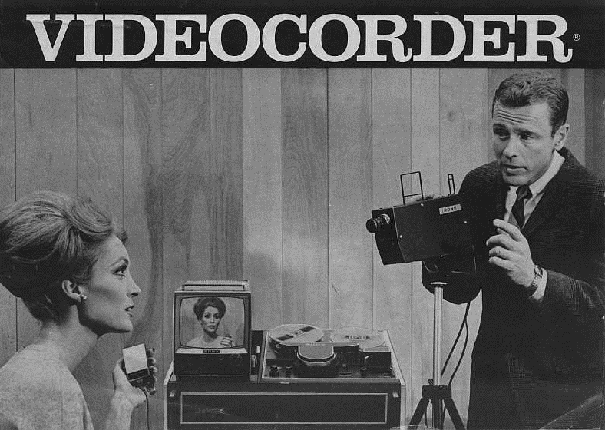
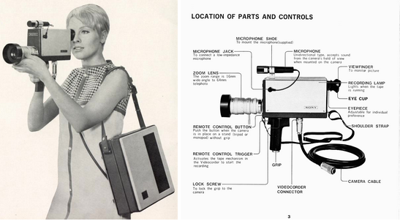
Early Video Systems
Left: Sony VCK 2000, since 1965. A woman with microphone and a man with the video camera mounted on a tripod. Behind it: Recorder with magnetic tape and monitor. Photo: Sony.
Image Source: http://www.smecc.org/sony_cv_series_video.htm
Middle: Sony Porta Pak CV 2400, since 1968. Left: Woman with video camera and portable video recorder. Right: Video camera. Photos: Sony.
Middle: Image source: URL: http://iasl.uni-muenchen.de/links/GCA-IV.1e.html
Image source: URL: http://www.smecc.org/video/wpe3C.gif

Slide 4
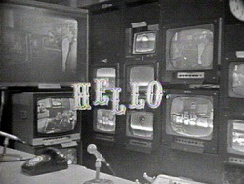
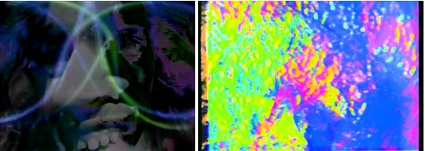
WGBH TV, Boston
Paik, Nam June.
Left: Electronic Opera #1, WGBH-TV, Boston, video, 1969.
Screenshot from URL: http://openvault.wgbh.org/catalog/ntw-mla000209-nam-june-paik-s-electronic-opera-1
Right: Video Commune – The Beatles from Beginning to End, WGBH-TV, Boston, video, 1970.
Screenshot from URL: http://www.medienkunstnetz.de/works/video-commune/
Kaprow, Allan: Hello, TV broadcast "The Medium is the Medium”, WGBH, Boston, video, 1969.
Image source: URL: http://www.eai.org/title.htm?id=14357
UR

Slide 5
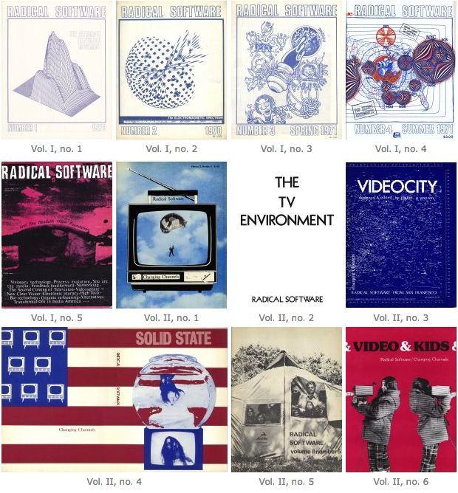
Radical Software, 1970-1974
UR
Covers of the Journal Radical Software, 1970-74. Image Source: URL: http://www.radicalsoftware.org/e/browse.html

Slide 6
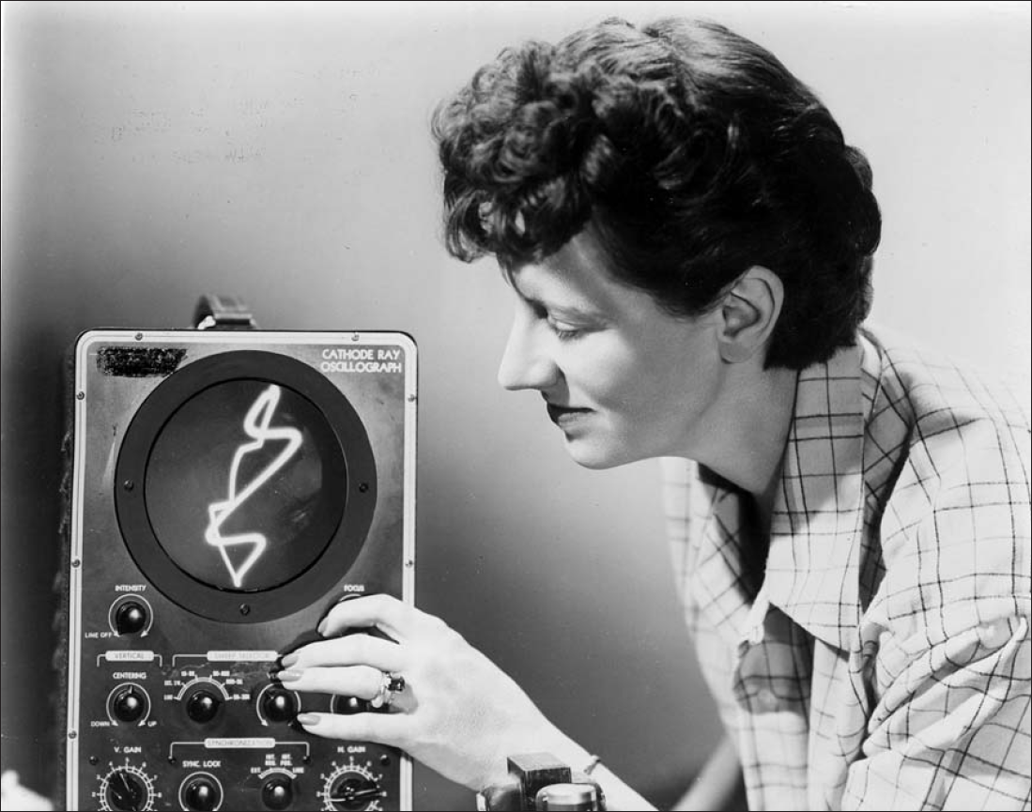
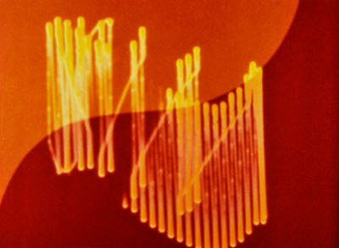
Oscillographs I
Bute, Mary Ellen:
Left: Bute at the fine-tuning of her oscillograph. Photo: Ted Nemeth, c. 1954. Courtesy Center for Visual Music (Zinman: Circuit 2012, p.140).
Right: Abstronic, film, 1952. Image Source: http://www.centerforvisualmusic.org/abstronic2%20em%20arts.jpg

Slide 7
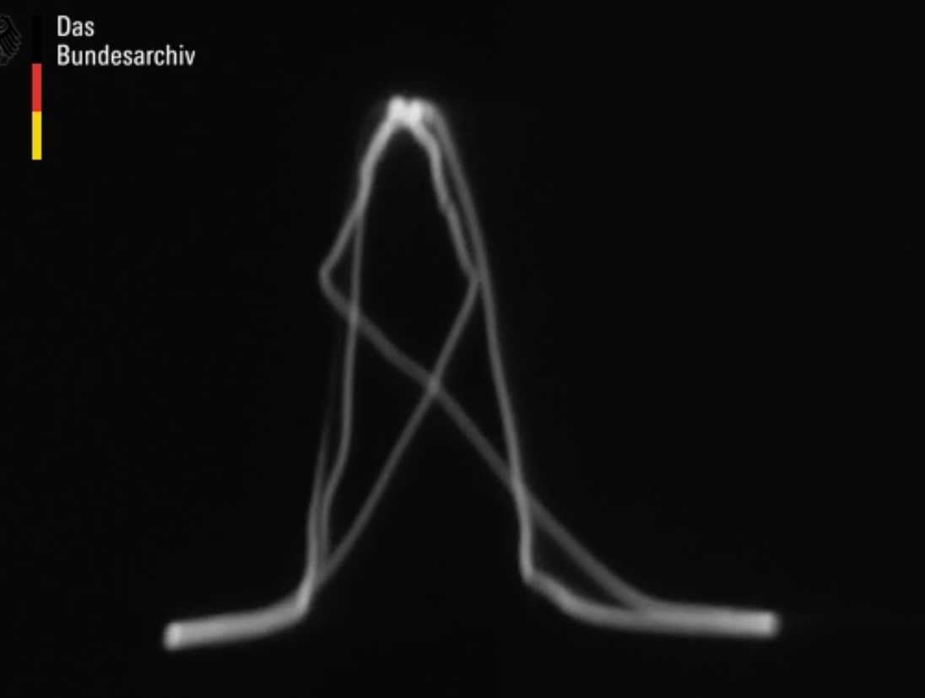
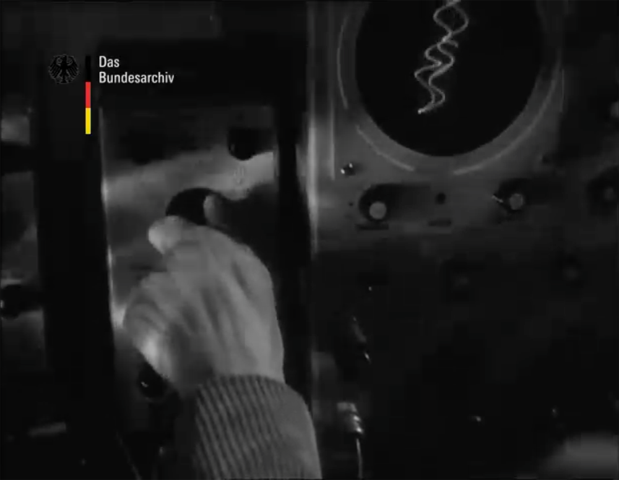
Oscillographs II
Franke, Herbert W.: UFA-Wochenschau 170/1959, film, 10/27/1959 (weekly show for cinemas). Cameraman: Vlasdeck. Left: screen of the oscillograph. Right: The units on the left of the oscillograph were used by Franke to readjust in real time the output, as it was produced by Franz Raimann´s analog calculation system..
Image Source: https://www.filmothek.bundesarchiv.de/video/584360

Slide 8
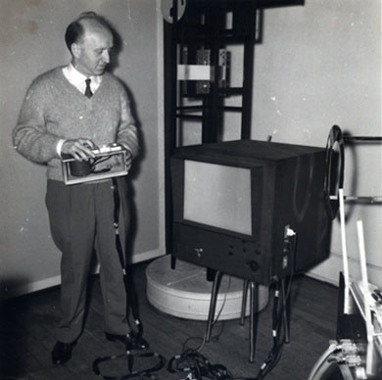
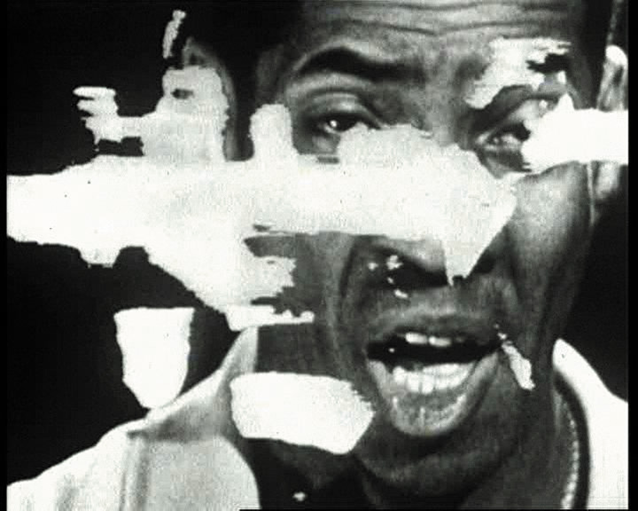
Luminoscope
Schoeffer, Nicolas:
Left: Luminoscope I, 1959. Image Source: https://s-media-cache-ak0.pinimg.com/originals/cd/ff/dd/cdffddc08e492b15d474a1d1fdbe8083.jpg
Rigth: Variations luminodynamiques, film, 1961. Documentation of the programme sent by the television channel ORTF, 25th October 1961. Still with the gospel singer Gordon Heath. Image Source: http://www.olats.org/schoffer/archives/Variations%20Luminodynamiques.html

Slide 9
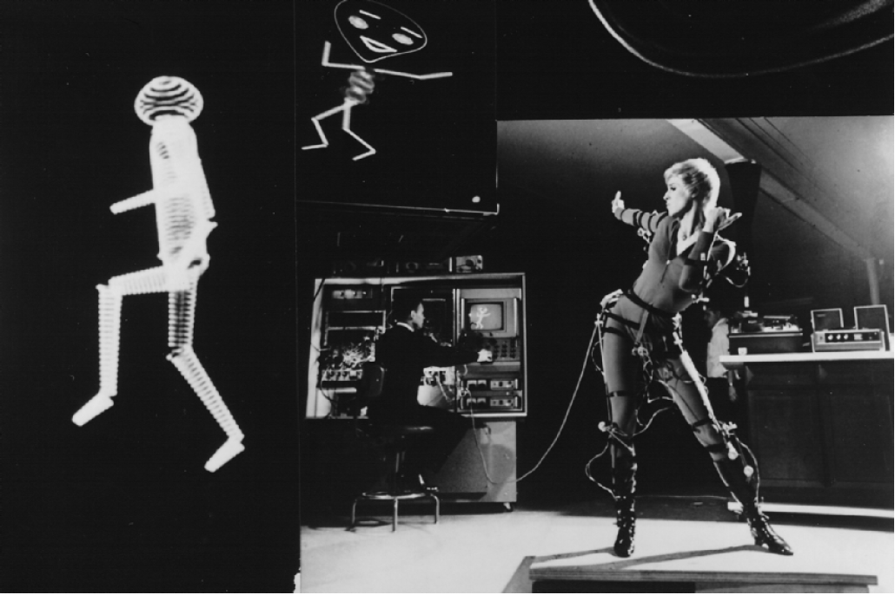
ANIMATE
Harrison III, Lee: ANIMAC, 1962. A dancer controls the line patterns of a figure by activating sensors mounted on her body. Denver 1962 (photomontage). Image Source: URL: http://www.vasulka.org/Kitchen/PDF_Eigenwelt/pdf/092-095.pdf

Slide 10
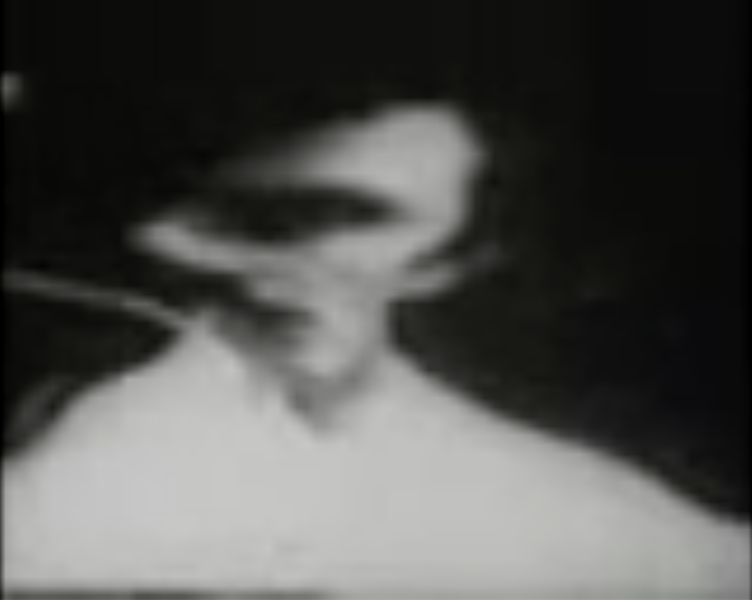
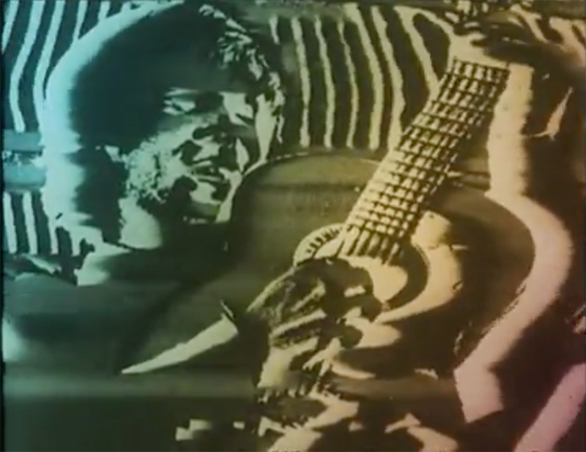
Ture Sjölander
Sjölander, Ture/Wikström, Bror/Modin, Bengt: Time, 1966. Film for Sveriges Radio (Stockholm). Image Source: http://www.centerforvisualmusic.org/abstronic2%20em%20arts.jpg
Sjölander, Ture/Weck, Lars: Monument, 1967. Film for Sveriges Radio, Stockholm, January 1968. Image Source: http://www.centerforvisualmusic.org/abstronic2%20em%20arts.jpg

Slide 11
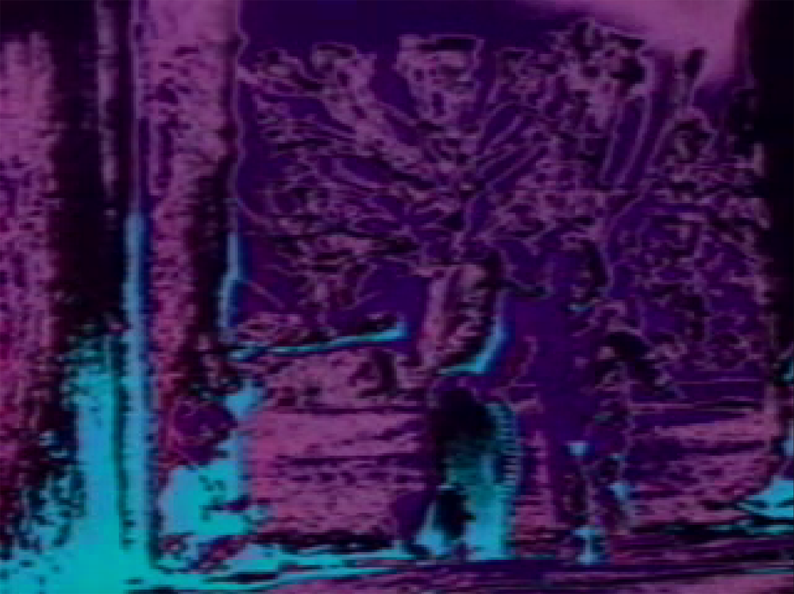
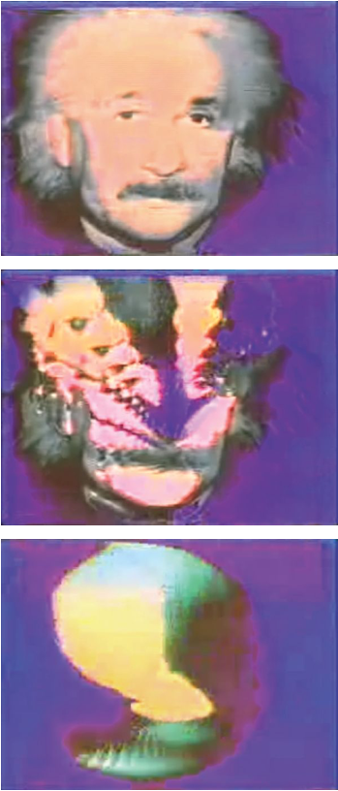
Truqueur Universel/Video Colour Synthesizer
Siegel. Eric: Einstine, video, 1969. (Kane: Algorithms 2014, p.73).
Cahen, Robert: L´invitation au voyage, video, 1973. Image Source: http://24-25.fr/work.php?work-id=gama:heure-exquise:main:Work:2169

Slide 12
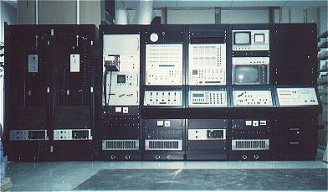
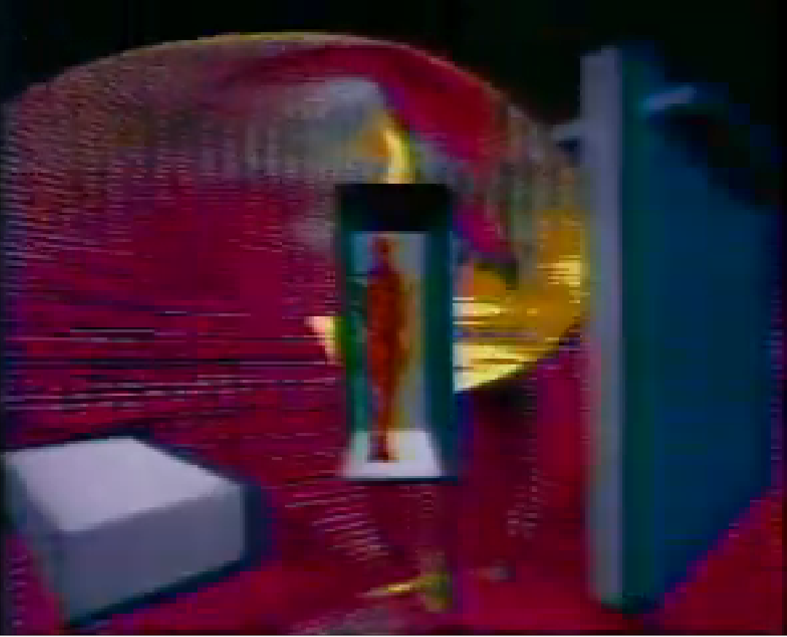
SCANIMATE
Harrison III, Lee: SCANIMATE, 1969. Brand new SCANIMATE at Dolphin Productions, New York City 1973. Image Source: URL: http://scanimate.zfx.com/photo1.html
Emshwiller, Ed: Scape-mates, video built with Scanimate in the TV Lab of the New York Station WNET/Thirteen, 1972.
Screenshot from: URL: https://www.youtube.com/watch?v=4PXs5szhnOw

Slide 13
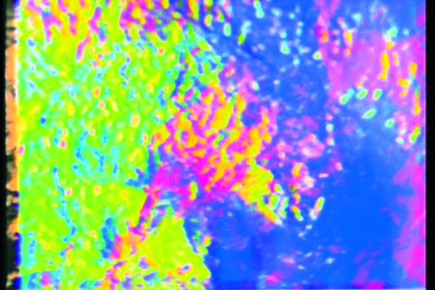
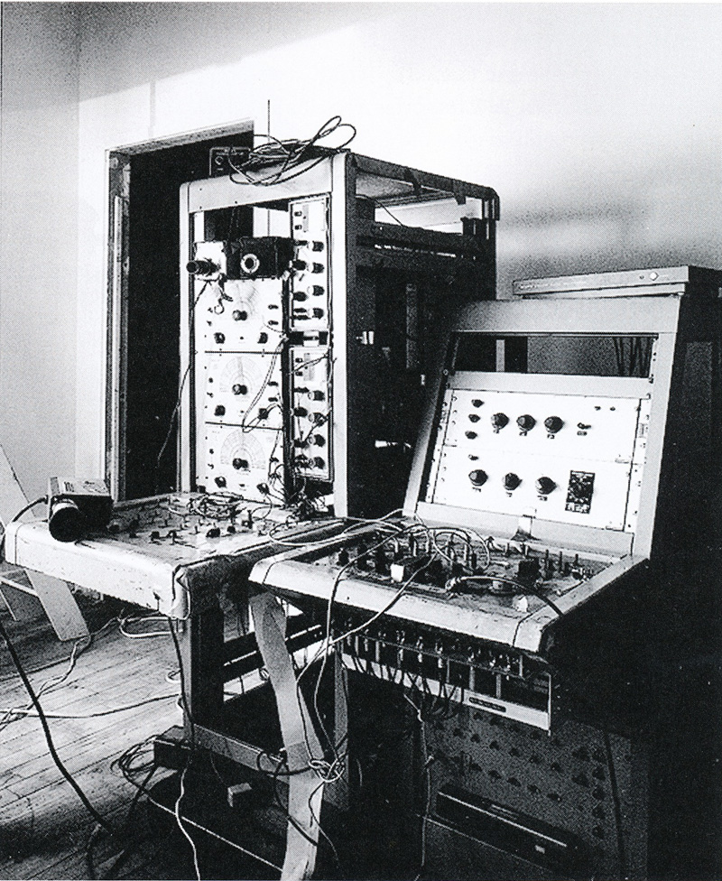
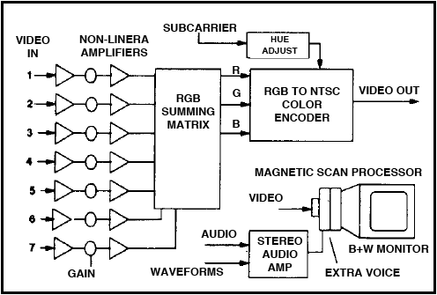
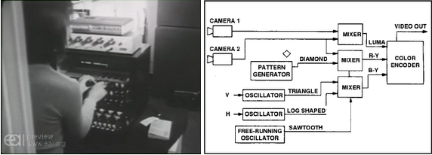
Video-Processors and Synthesizers, since 1970
Paik, Nam June: Video Commune – The Beatles from Beginning to End, WGBH-TV, Boston, Video, 1970. Screenshot from URL: http://www.medienkunstnetz.de/works/video-commune/
Abe, Shuya/Paik, Nam June: Paik/Abe Video Synthesizer. Left: model of 1972, WNET/Thirteen, New York (Courtesy Nam June Paik Studios, Inc. In: Joselit: Feedback 2007, p.47). Right: diagram of functions by Jeffrey Schier (Dunn/Vasulka/Weibel: Eigenwelt 1992, p.129).
Siegel, Eric: EVS Video Synthesizer, 1970. Left: Eric Siegel in the office of Electronic Arts Intermix, New York, ca. 1971. Screenshot from URL: http://www.eai.org/kinetic/ch2/siegel/filmvideo.html. Right: Function diagram by Jeffrey Schier (Dunn/Vasulka/Weibel: Eigenwelt 1992, p.121).
UR

Slide 14
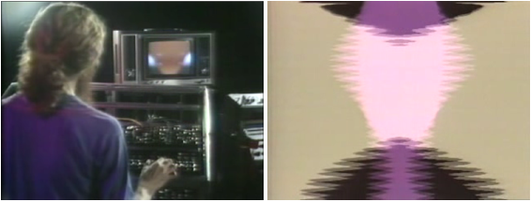
Stephen Beck: Direct Video Synthesizer, 1970
Beck, Stephen: Direct Video Synthesizer, 1970. Left: supervision. Right: diagram of functions by Jeffrey Schier. (Dunn/Vasulka/Weibel: Eigenwelt 1992, S.123s.)
Beck, Stephen/Jepson, Warner: Illuminated Music 2 & 3, video documentation by a programme of the PBS (Public Broadcasting Service), 1973. Left: Beck at his Direct Video Synthesizer. Right: Beck´s visualization of Jepson´s music. Screenshots from URL: http://www.ubu.com/film/beck_illuminated.html
UR

Slide 15
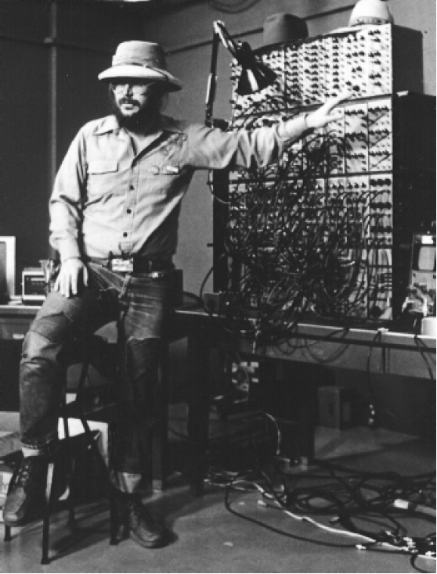
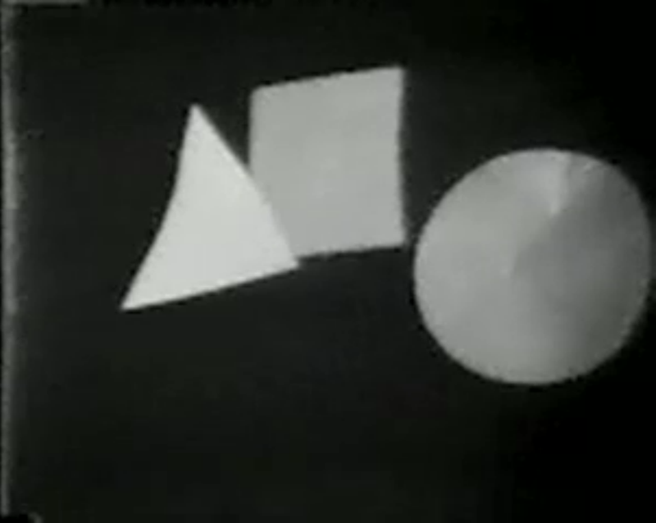
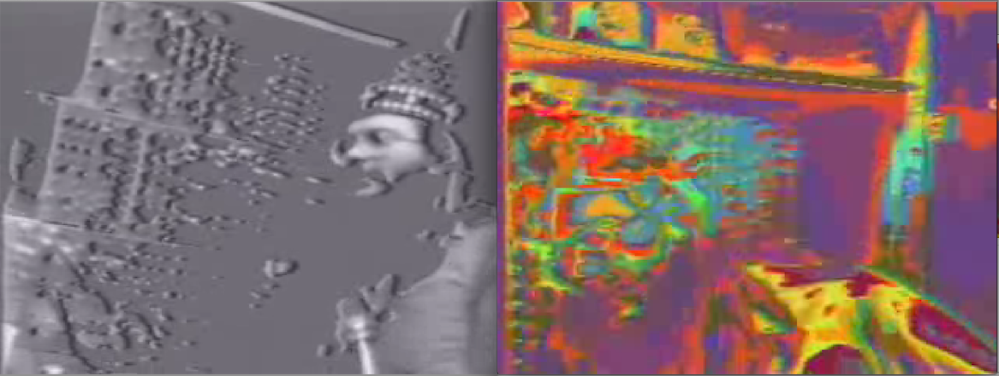
Dan Sandin: Analog Image Processor, 1971-73
Left: Dan Sandin with the Analog Image Processor, Chicago 1972 (Dunn/Vasulka/Weibel: Eigenwelt 1992, p.133).
Right: Triangle in Front of Square in Front of Circle in Front of Triangle, video, 1973. Screenshot from URL: http://www.vdb.org/titles/triangle-front-square-front-circle-front-triangle
Left, bottom: 5 Minute Romp Through the IP [Analog Image Processor], video, 1973.
Screenshots from URL: https://www.youtube.com/watch?v=8qh6jRzjmcY

Slide 16
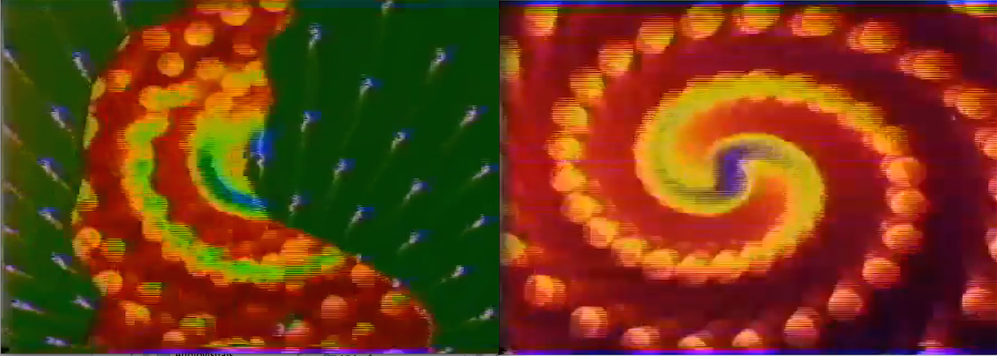
Ryral, 1976
DeFanti, Tom/Morton, Phil/Sandin, Dan/Snyders, Bob: Ryral, video of a live performance at the University of Illinois, Chicago 1976.
Screenshots from URL: https://www.youtube.com/watch?v=fnYwFstm4bk

Slide 17
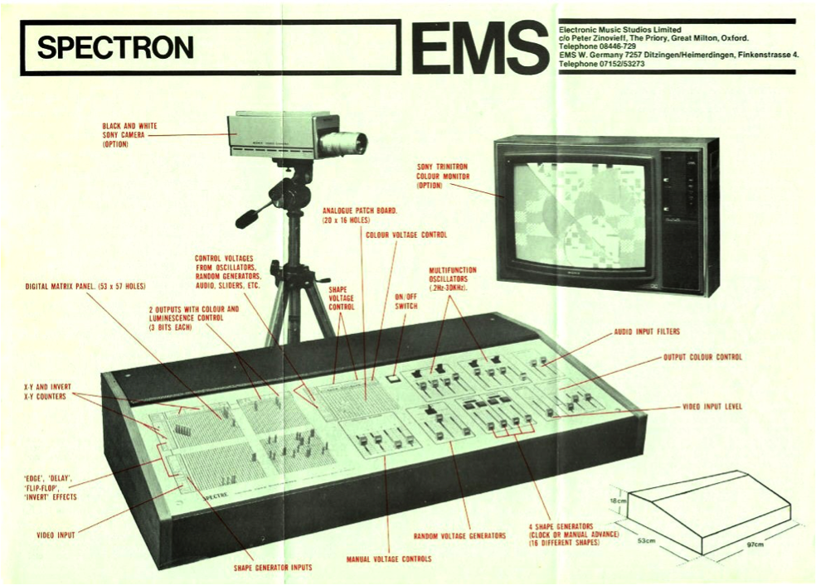
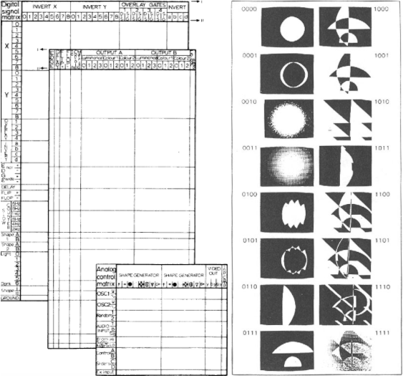
EMC Spectron I
Electronic Music Studios, Ltd (EMS): Spectron, 1974. Video synthesizer (Siedler: EMS undated, p.7).
Left: All parts.
Middle: Digital Signal Matrix and Analog Control Matrix (Monkhouse: Art 1974, p.26). Right: 16 basic forms (Siedler: Spectre undated). Image Source: http://www.centerforvisualmusic.org/abstronic2%20em%20arts.jpg

Slide 18
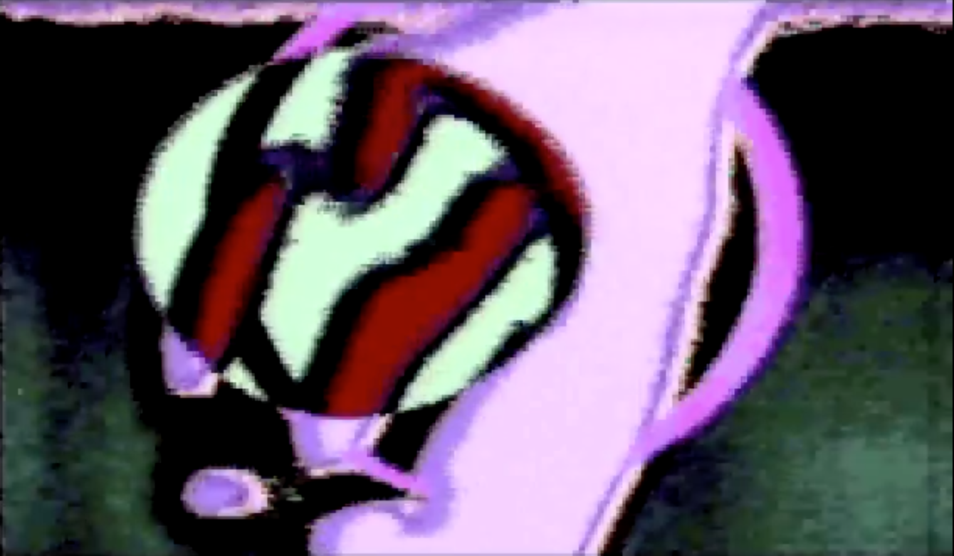
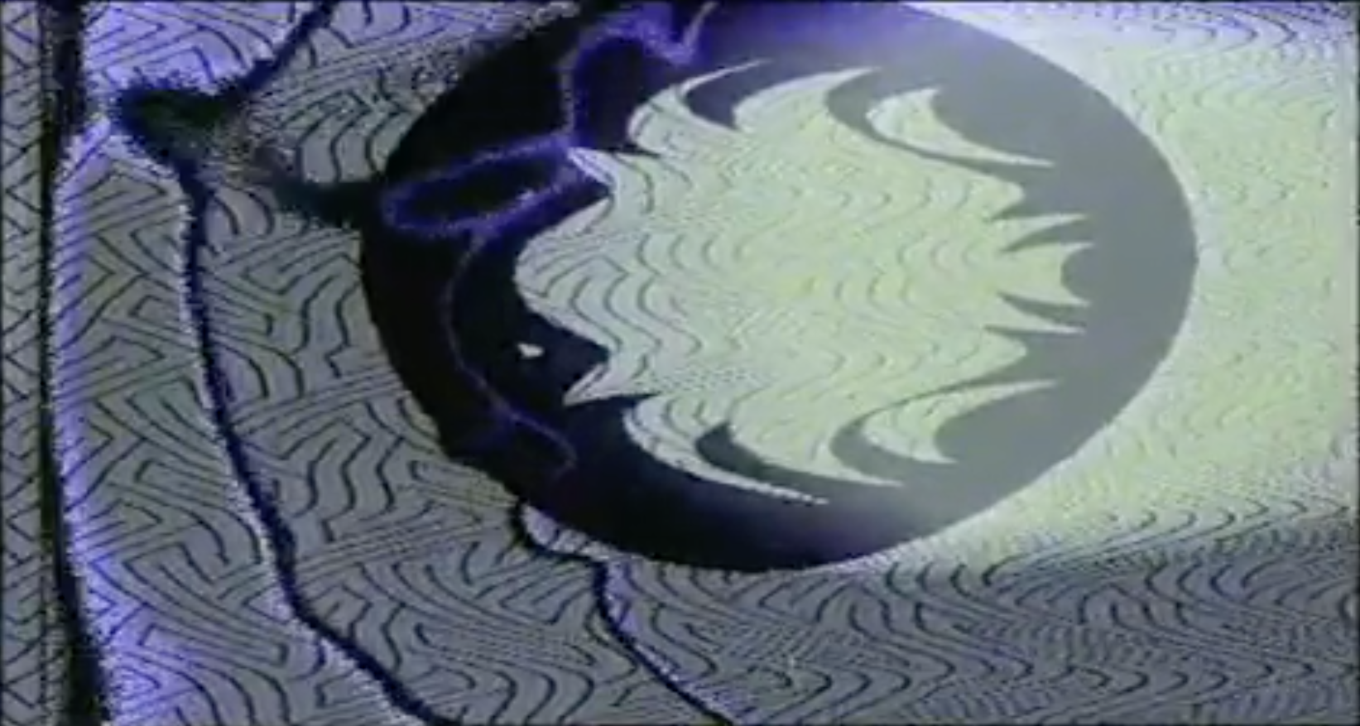
EMC Spectron II
Guyonnet, Jacques: Lucifer Photophore, video, 1975. Image Source: https://www.youtube.com/embed/T1cTqFGUf10
Calame, Geneviève/Guyonnet, Jacques: Labyrinthes fluides, video, 1976. Image Source: https://www.youtube.com/embed/TRgXqOhBQEU

Slide 19
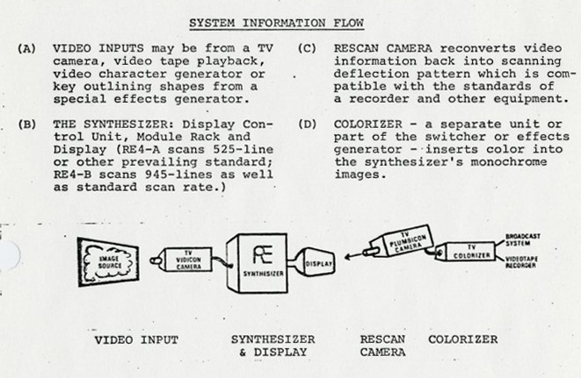
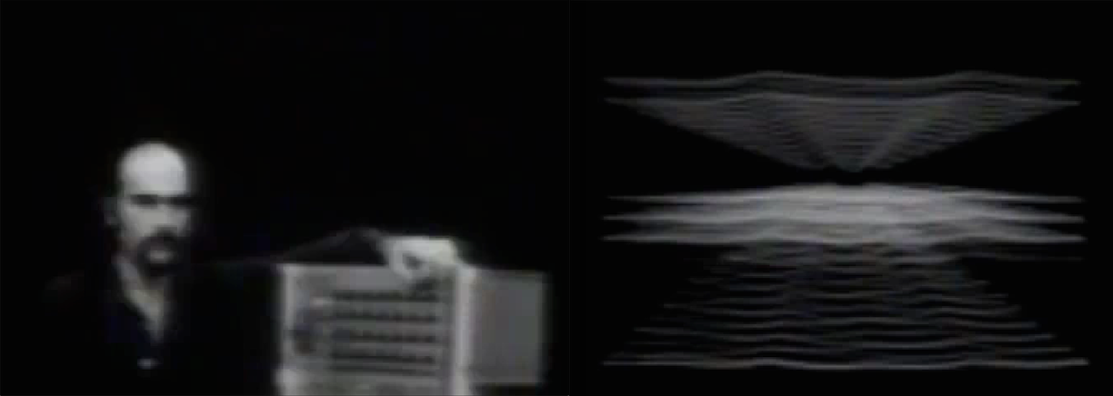
Bill Etra & Steve Rutt: The Rutt/Etra Scan Processor, 1973
Left, top: Rutt/Etra Model RE-4 Scan Processor.
Middle, top: function diagram by Jeffrey Schier.
(Dunn/Vasulka/Weibel: Eigenwelt 1992, p.137,139)
Right, top: User manual for the Rutt/Etra Scan Processor with "system information flow".
(Rutt/Etra: RE Video Synthesizer Systems Models RE 4A and RE 4B 1974, p.3).
Right, bottom: Rutt/Etra Scan Processor, 1973. Demo by Bill Etra, video. Screenshots from URL: https://www.youtube.com/watch?v=EZQiHuTbnes

Slide 20
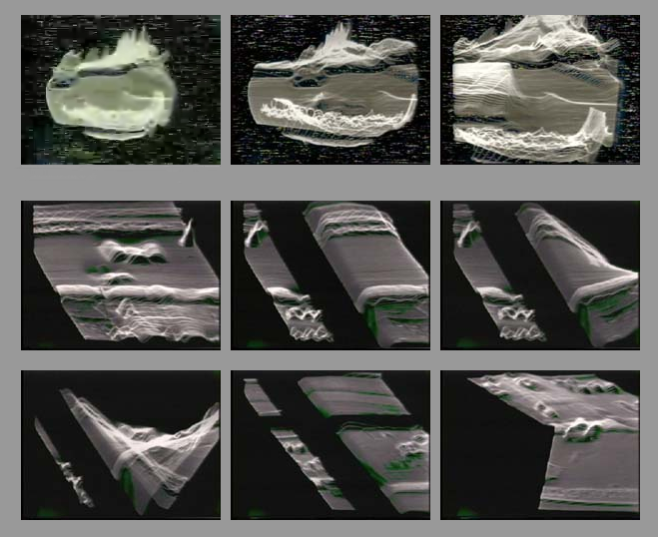
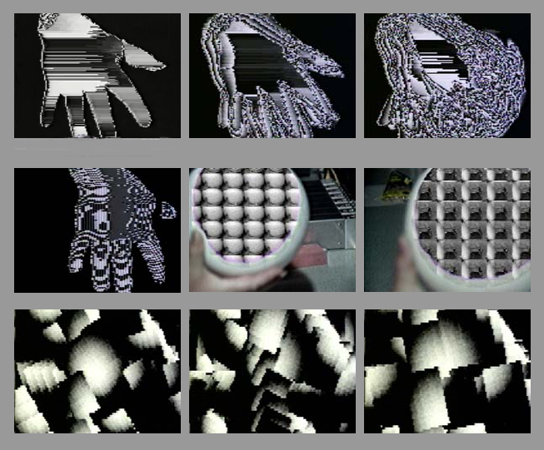
Woody Vasulka (I)
Left: C-Trend, video built with the Rutt/Etra Scan Processor, 1974.
Screenshot from URL: http://vasulka.org/Videomasters/pages_stills/index_19.html
Right: Artifacts, video built with the Digital Image Articulator, 1980.
Screenshot from URL: http://vasulka.org/Videomasters/pages_stills/index_14.html

Slide 21
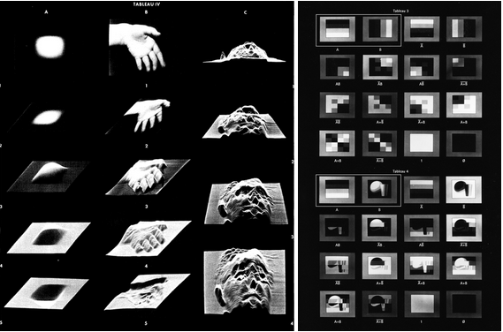
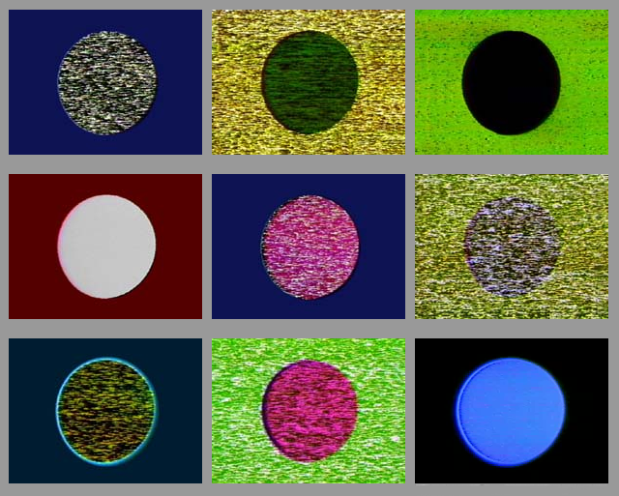
Woody Vasulka (II)
Noisefields, video realised with analog video tools, 1974.
Screenshot from URL: http://vasulka.org/Videomasters/pages_stills/index_42.html
Left: Didactic Video, Tableau IV, 1975 (Vasulka/Nygren: Video 1975, p.13), demonstration of the Rutt/Etra Scan Processor.
Middle: Syntax of Binary Images, Tableau 3 & 4, 1978 (Vasulka/Weibel: Buffalo 2008, p.423), demonstration of the relations between the discrete elements “A” and “B” in “The Arithmetic Logic Unit (ALU)”.

Slide 22
Literatur
Bibliography with informations about the abbreviations used in the captions:
Dreher, Thomas: History of Computer Art. Chap. Bibliography. In: URL: http://iasl.uni-muenchen.de/links/GCA-IXe.html
8

