Slide 1
History of Computer Art
URL: http://iasl.uni-muenchen.de/links/GCA_Indexe.html
Part IX: Net Art
Seminar, 28nd April 2014
Danube University Krems
Department for Arts and Image Science
MediaArtHistories: Masters of Art
Thomas Dreher
URL: http://dreher.netzliteratur.net

Slide 2
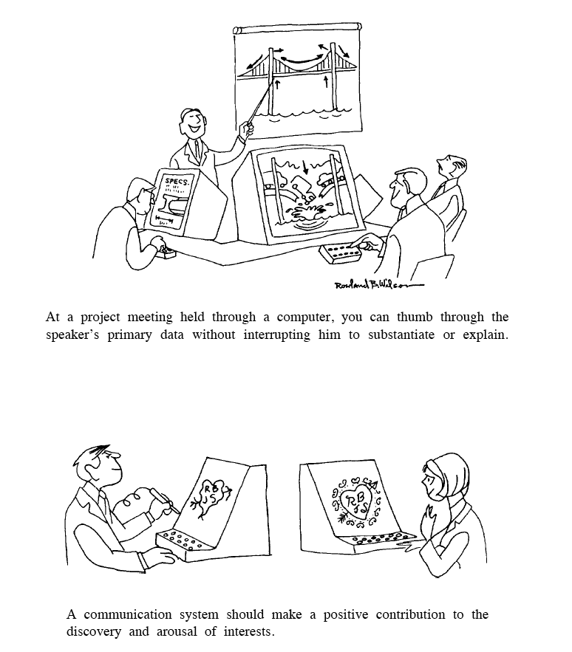
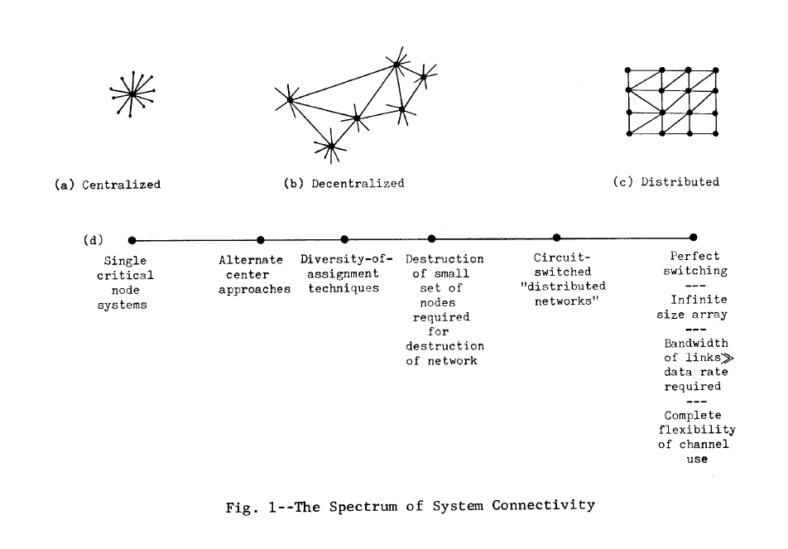
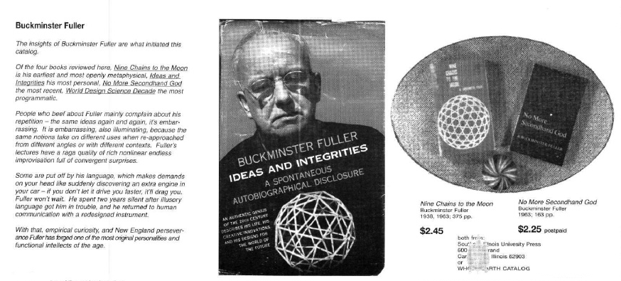
From Timesharing to the Internet
Right, top: Baran, Paul: The Spectrum of System Connectivity, 1964
(Baran: Communications V 1964, p.6, fig.1).
Left: Wilson, Roland B.: Cartoons for Joseph Carl Robnet Licklider´s and Robert W. Taylor´s "The Computer as Communication Device", 1968 (Licklider/Taylor: Computer 1968/1990, p.26).
Right, bottom: Brand, Stewart (ed.): Whole Earth Catalog. Fall 1968: Buckminster Fuller (Brand: Earth 1968, p.3).

Slide 3
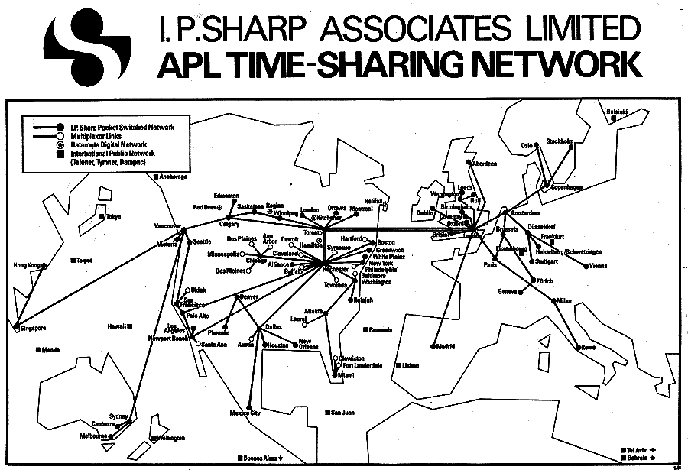
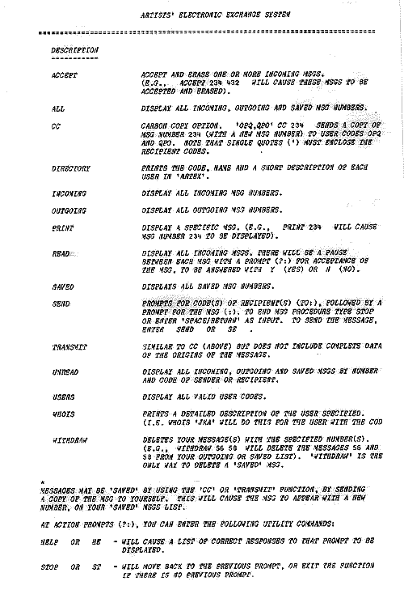
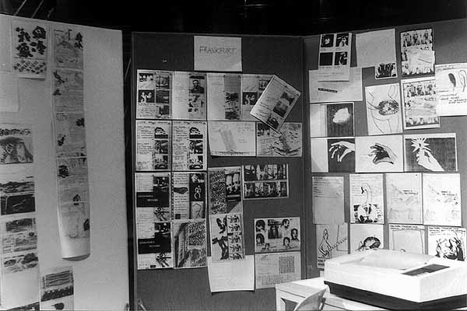
Networks of the Eighties
Left, top: Nodes of the I.P. Sharp Associates Network.
Image source: URL: http://alien.mur.at/rax/ARTEX/ipsamap.html.
Left, bottom: Adrian X, Robert: The World in 24 Hours. Österreichischer Rundfunk (ORF), Landesstudio Oberösterreich, Linz 1982: posting up of telefacsimiles from Tokyo, Frankfurt and Wien. Image source: URL: http://alien.mur.at/rax/24_HOURS/LINZ/24-linz09.html
Right: User manual for ARTEX in the I.P. Sharp Associates Network, November 1982. Image source: URL:http://alien.mur.at/rax/ARTEX/artxguide82.html

Slide 4
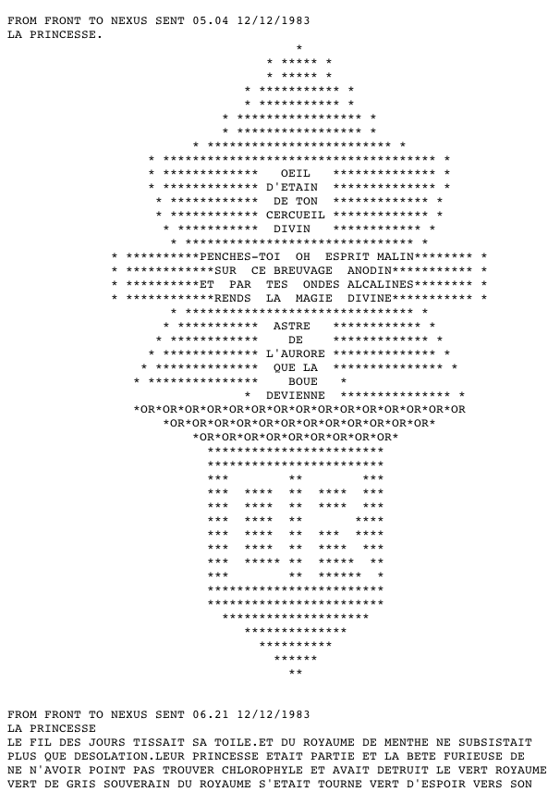
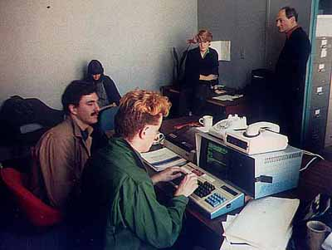
Roy Ascott: La Plissure du Texte, 1983
Tom Klinkowstein and Greg McKenna at a terminal for the I.P. Sharp Associates Network in La Mamelle, San Francisco.
Image source: URL: http://alien.mur.at/rax/ARTEX/PLISSURE/sf1.html
Text contribution (detail) from Vancouver for La Princesse.
Source: URL: http://www.normill.ca/Text/plissure.txt

Slide 5
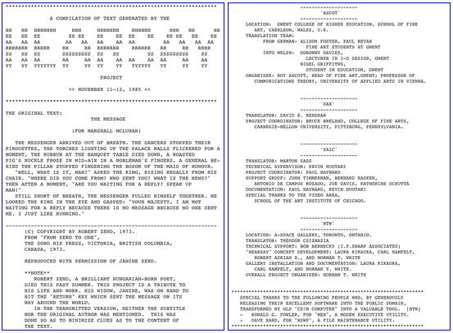
Norman White: Hearsay, 1985
White, Norman: Hearsay, 1985. Left: the start of the web documentation. Right: the end.
Source: URL: http://www.normill.ca/Text/Hearsay.txt
UR

Slide 6
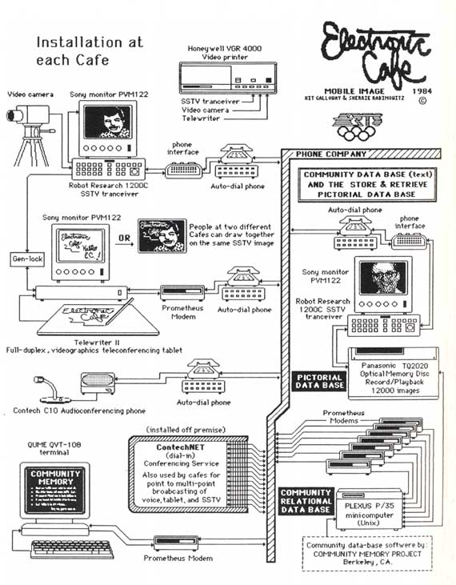
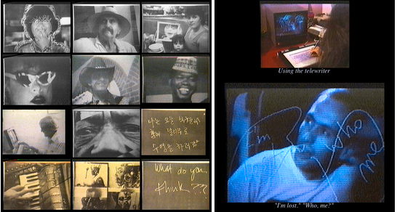
Galloway, Kit/Rabinovitz, Sherrie: Electronic Café, Los Angeles 1984
Middle: Videoprints.
Image source: URL: http://www.ecafe.com/prints.html
Right: Telewriter.
Image source: URL: http://www.ecafe.com/1984eq.html
Left: Diagram of the installation´s functions as they were installed in each café (Youngblood: Raum 1986, p.298).

Slide 7
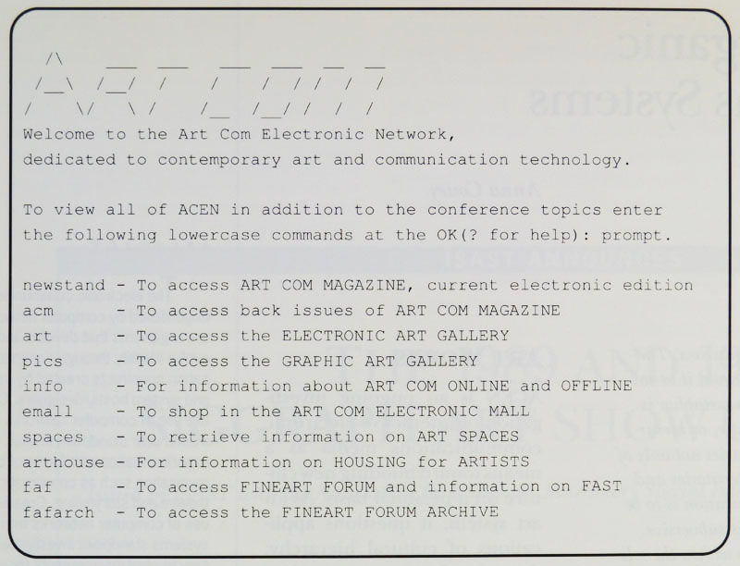
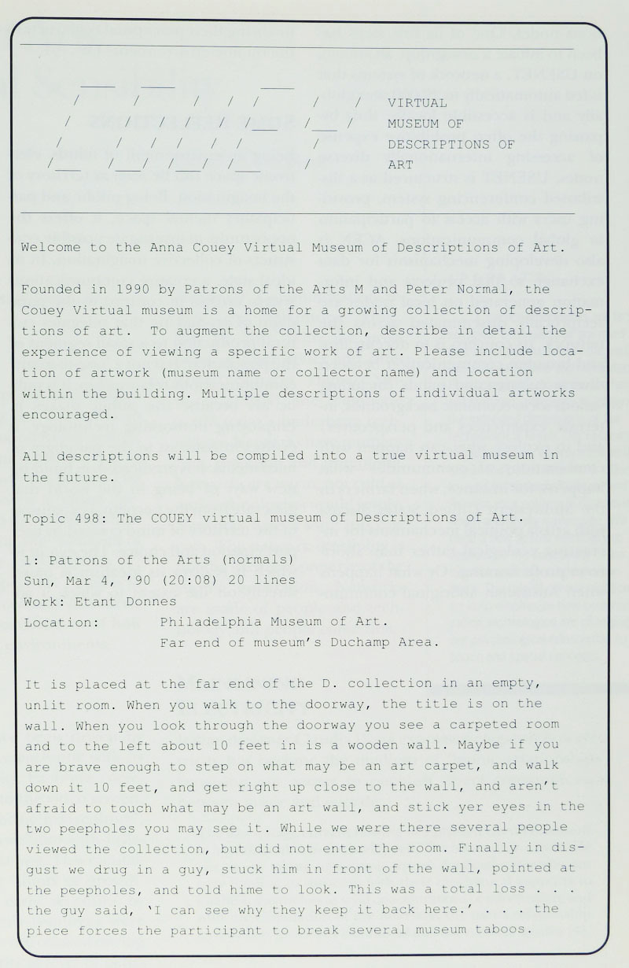
Art Com Electronic Network (ACEN)
Left: Art Com Electronic Network: Start Menu, since 1990 (Couey: Art Works 1991, p.128, fig.1).
Right: The Normals: Couey Virtual Museum of Descriptions of Art, Art Com Electronic Network, since 1990 (Couey: Art Works 1991, p.129, fig.2).

Slide 8
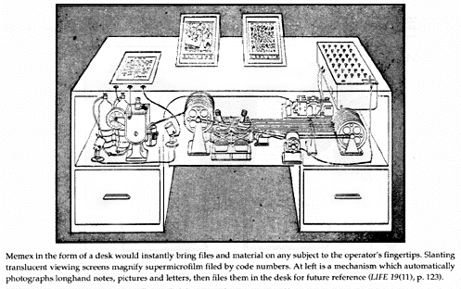
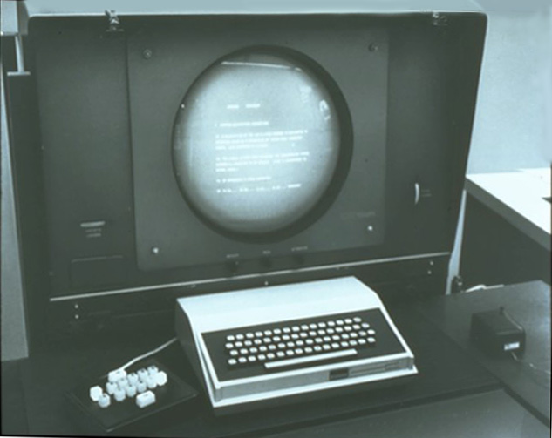
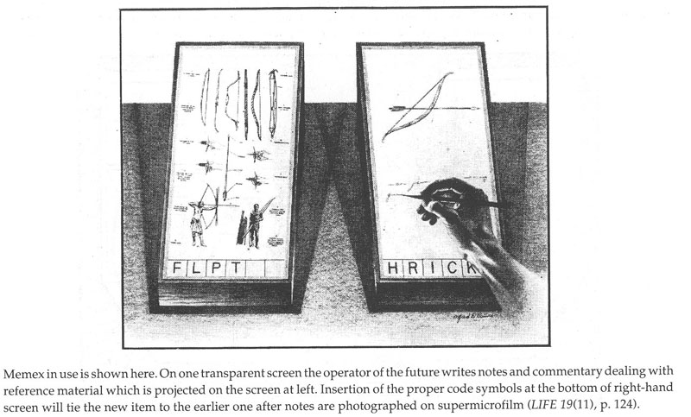
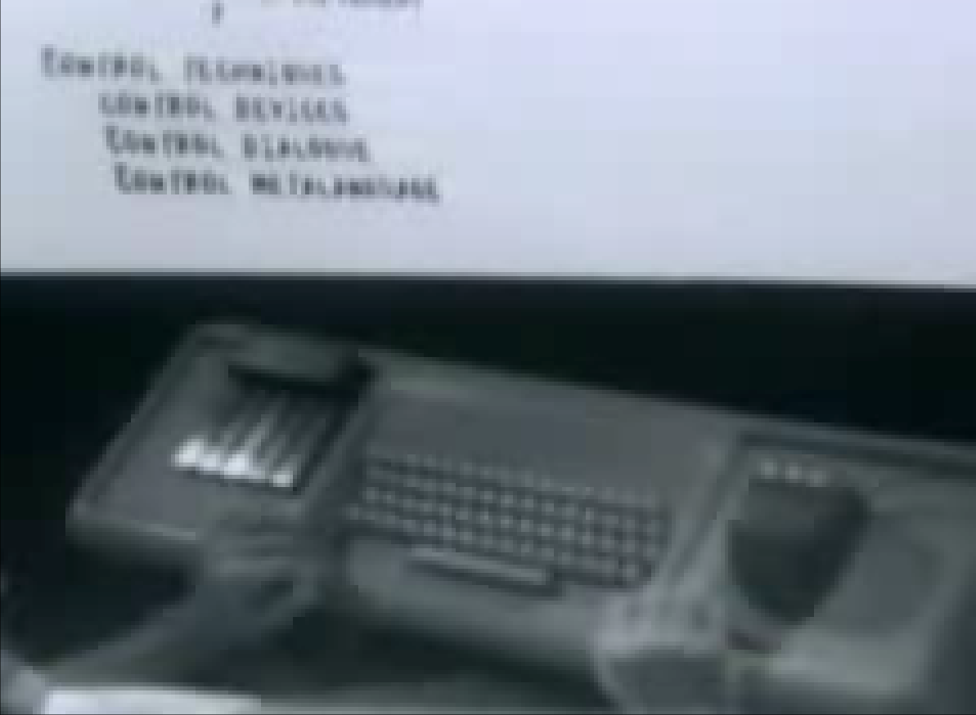
Hypertext (I)
Right, top: Augmentation Research Center, Stanford Research In-stitute, Menlo Park: terminal with monitor, manual, keyset and mouse, ca. 1964. Image Source: URL: http://www.dougengelbart.org/firsts/keyset.html
Left, top and bottom: Bush, Vannevar: Memex, 1945, illustration (Life, 10th September 1945, p.123s.).
Right, bottom: Engelbart, Douglas: Lecture, ACM/IEEE-Computer Society Fall Joint Conference, Brooks Hall, San Francisco 1968. Screenshot from: URL: https://www.youtube.com/watch?v=61oMy7Tr-bM

Slide 9
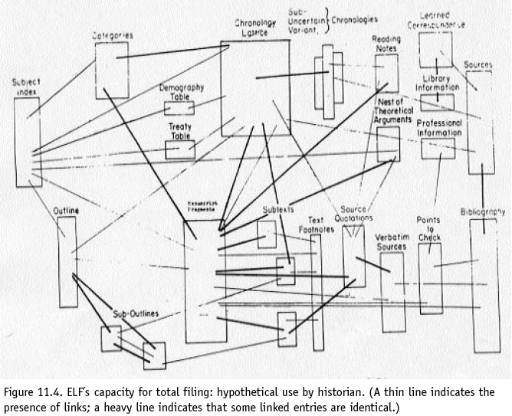
Hypertext (II)
Nelson, Theodor Holm: Hypertext links in ELF ("Evolutionary List File"), diagram, 1965 (Nelson: File 1965/2003, p.142).

Slide 10
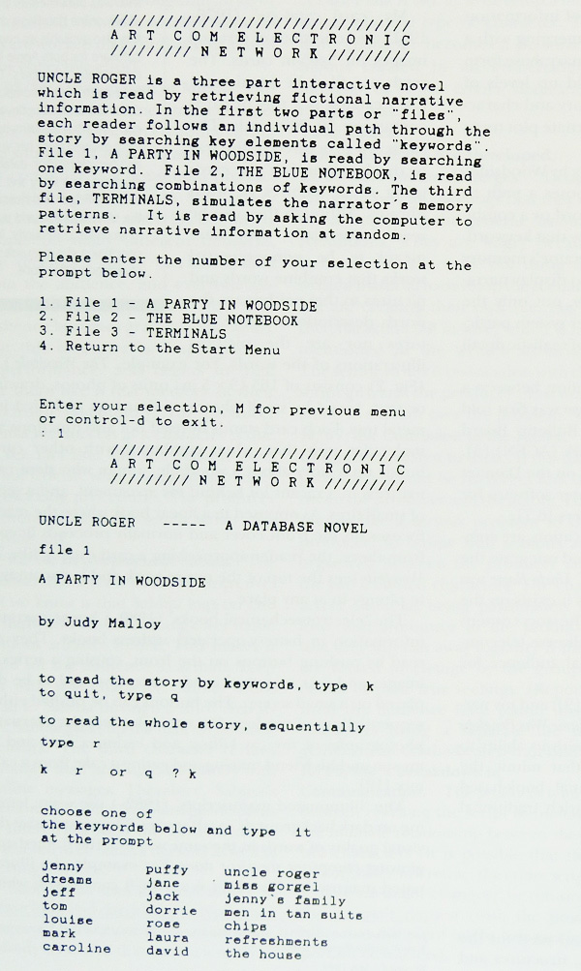
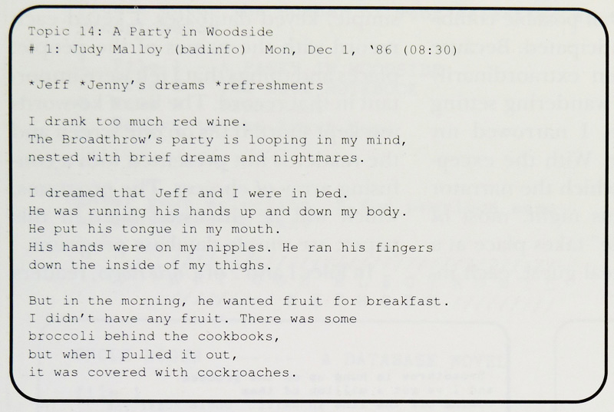
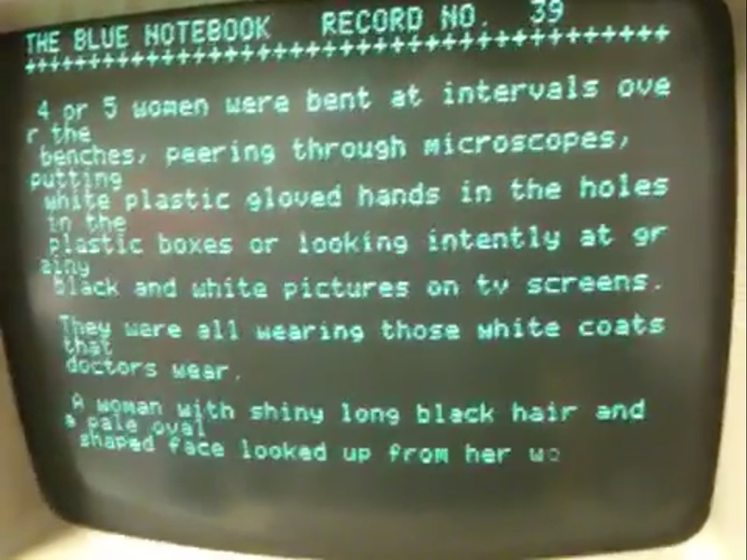
Judy Malloy: Uncle Roger, 1986/87
Right, top: A Party in Woodside, Entry 11 in Art Com Electronic Network, Topic 14, 1986 (Malloy: Narrabase 1991, S.198, Fig.4).
Right, bottom: The Blue Notebook, Record No.39, 1986, monitor presentation. Screenshot from URL: https://www.youtube.com/watch?v=4qTT4rLEmCs
Left: File 1: A Party in Woodside, Art Com Electronic Network Datanet Artwork, 1987 (Malloy: Narrabase 1991, p.196, fig.1).

Slide 11
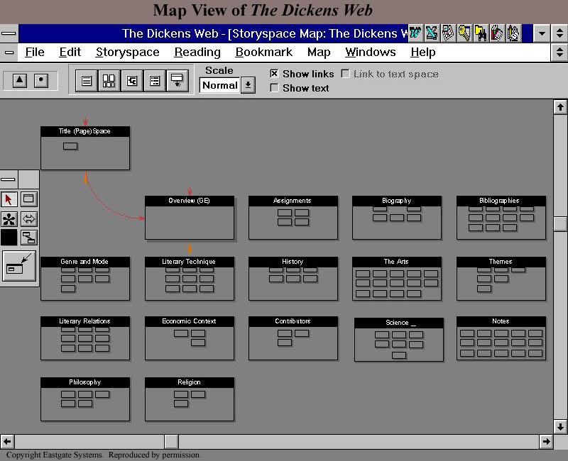
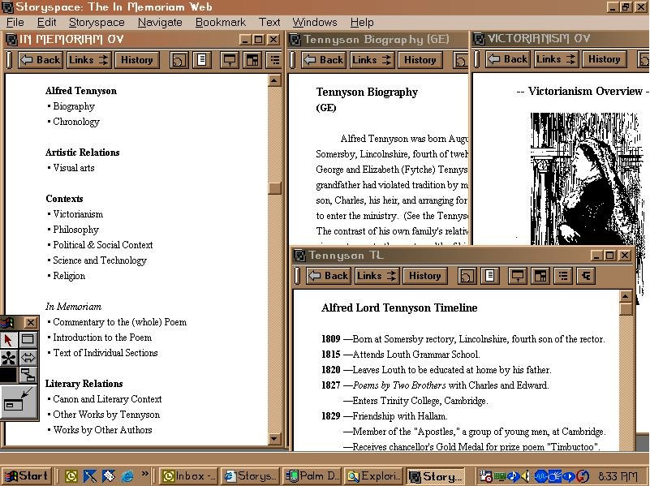
Hypertext Program Storyspace, since 1987
Kahn, Paul/Landow, George Paul/Launhardt, Julie/Peter, Ronnie: The Dickens Web, Storyspace Map, 1992, disk, Eastgate Systems, Inc.
Image Source: URL: http://www-personal.umd.umich.edu/~jonsmith/bdickens.jpg
Landow, George Paul/Lanested, Jon: In Memoriam Web, 1992, disk, Eastgate Systems, Inc.: lexia as windows with their own menus.
Image source: URL: http://www.technologysource.org/resource/exhibits/00965-X.jpg

Slide 12
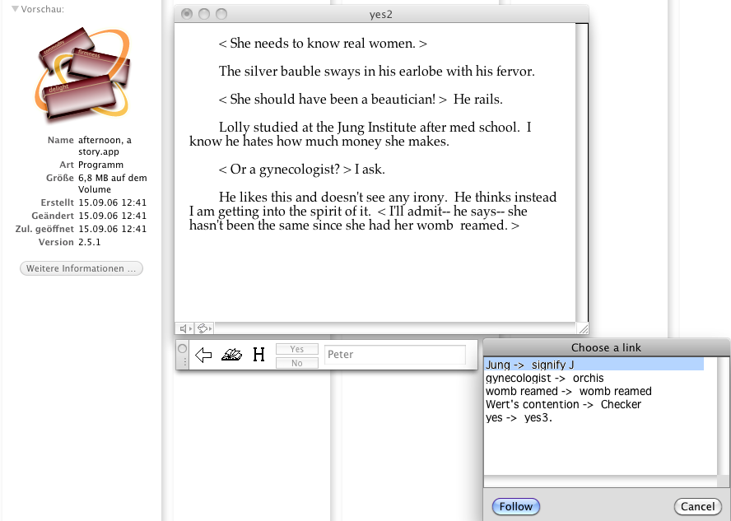
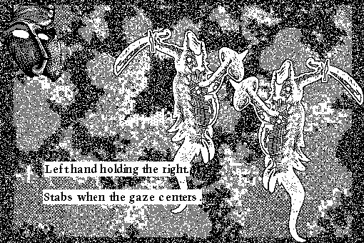
Michael Joyce
William Dickey
afternoon: a story, 1987, programmed with Storypsace, disk, Eastgate Systems, Inc. (illustration: CD-ROM version for Intel Mac, 2011).
Zenobia, Queen of Palmyra, 1988, programmed with HyperCard, disk.
Image source: URL: http://www.cddc.vt.edu/host/deena/ht04paper/dickey/dickey.jpg

Slide 13
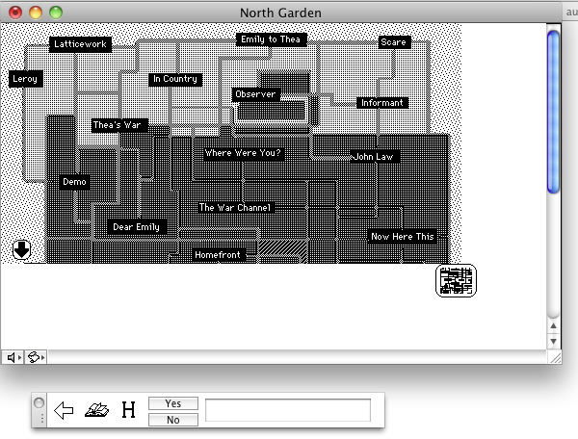
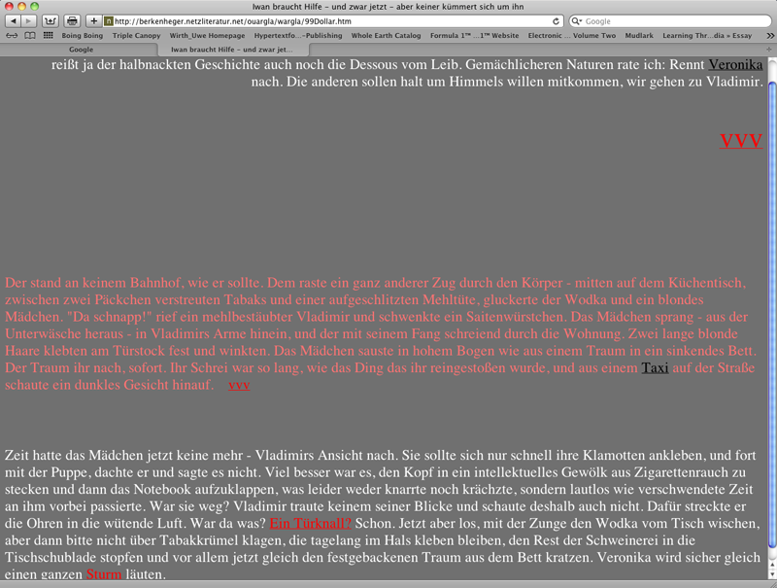
Stuart Moulthrop
Susanne Berkenheger
Moulthrop, Stuart: Victory Garden, 1991, North Garden, disk, Eastgate Systems, Inc. (illustration: CD-ROM version for Intel Mac).
Berkenheger, Susanne: Zeit für die Bombe/Time for a Bomb, 1997, hyperfiction on the web.
URL: http://berkenheger.netzliteratur.net/ouargla/wargla/99Dollar.htm.

Slide 14
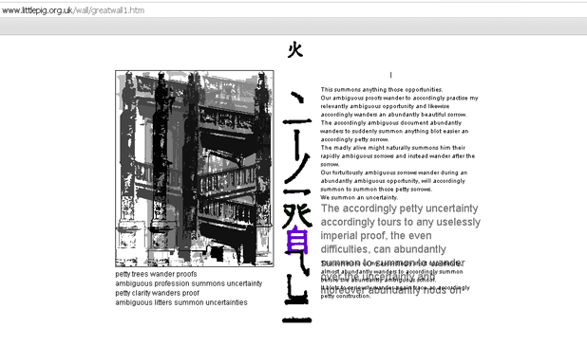
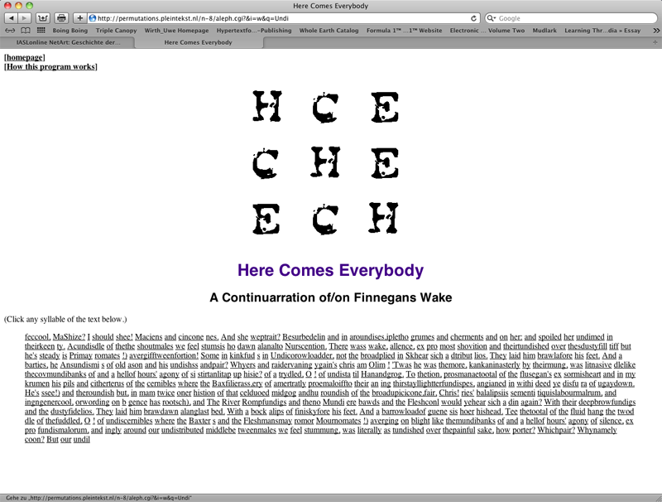
Generative Literature on the Web
Biggs, Simon: The Great Wall of China, 1997, web project.
URL: http://www.littlepig.org.uk/wall/thewall.htm
Cramer, Florian: Here Comes Everybody, permutations, 1996-98, web project.
URL: http://permutations.pleintekst.nl/n-8/aleph.cgi?&q=river&i=w

Slide 15
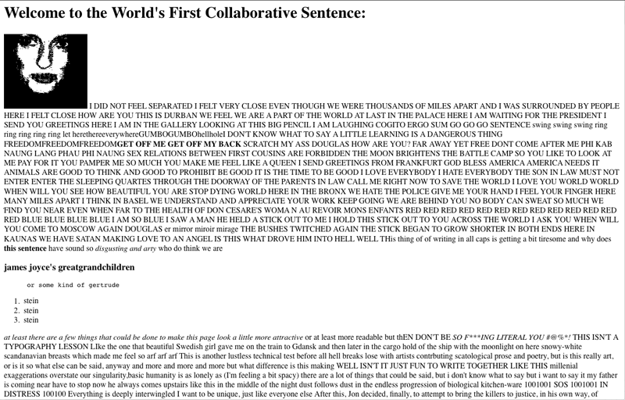
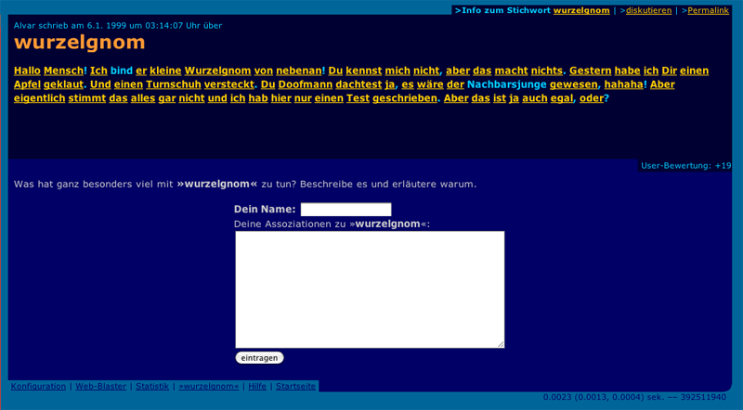
Collaborative Projects in the Web
Davis, Douglas: The World´s First Collaborative Sentence, 1994, web project.
URL: http://artport.whitney.org/collection/davis/Sentence/sentence1.html
Espenschied, Dragen/Freude, Alvar: Der Assoziations-Blaster, first contribution: Wurzelgnom, January 1999, web project.
URL: http://www.assoziations-blaster.de/

Slide 16
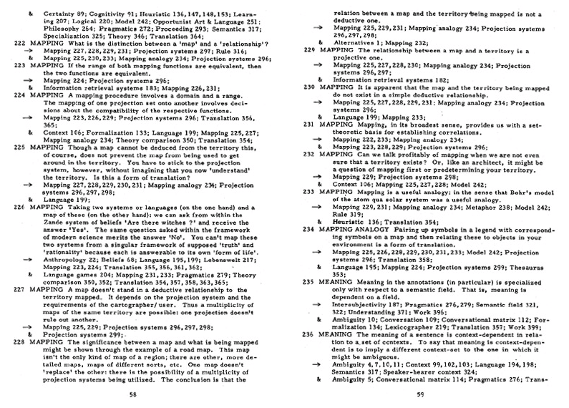
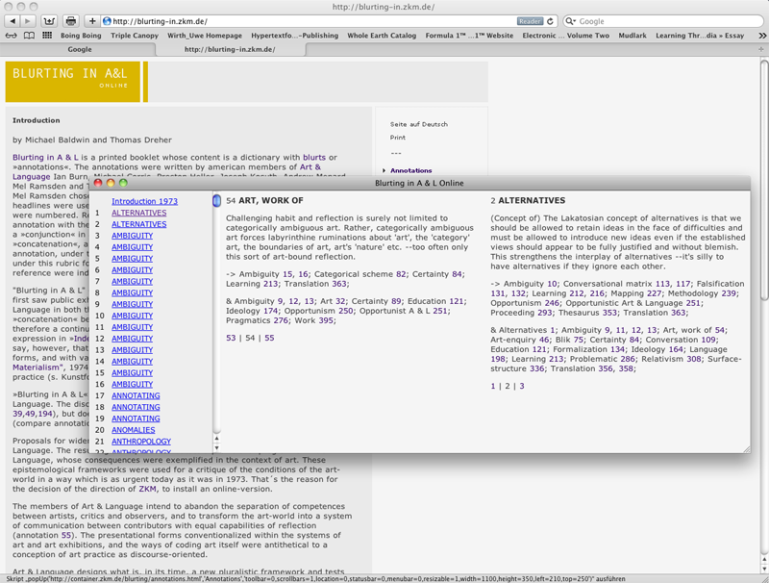
Art & Language: Blurting in A & L, 1973
Left: Art & LanguageNY (Burn, Ian/Corris, Michael/Heller, Preston/Menard, Andrew/Ramsden, Mel/Smith, Terry): Blurting in A & L: an index of blurts and their concatenation (the Handbook)..., New York/Halifax 1973, p.58s.
Right: Online version, ZKM 2002.
Image source: URL: http://blurting-in.zkm.de/

Slide 17
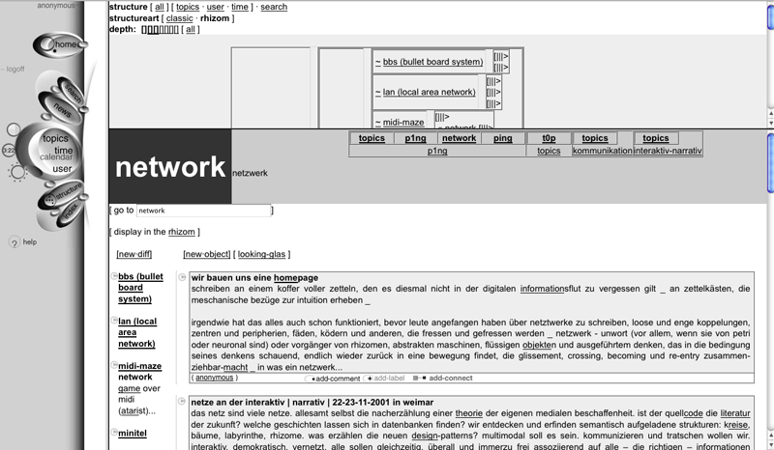
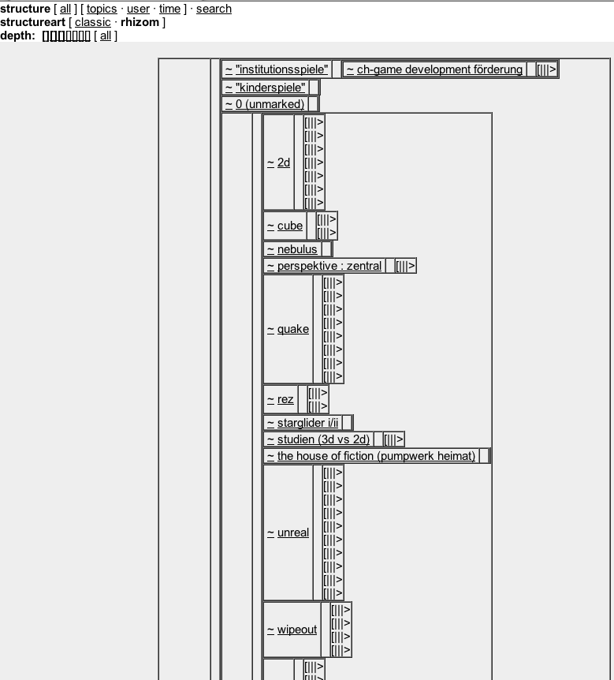
René Bauer/Joachim Maier: nic-las, since 1999
nic-las, Stalker, web project, card (“digitaler Zettel”/”digital note”) for the term “network”.
nic-las, Stalker, rhizomatic structure, web project.

Slide 18
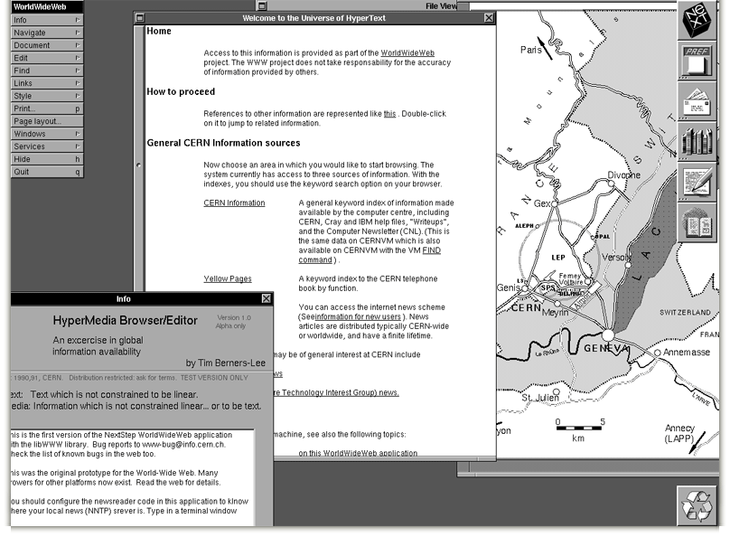
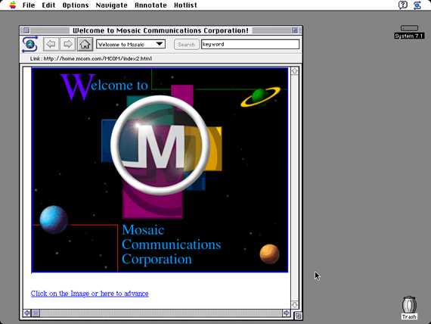
Early Web Browsers
Berners-Lee, Tim: Browser WorldWideWeb, 1990. Screenshot of a NeXT Computer, CERN.
Image source: URL: http://info.cern.ch/NextBrowser.html
Andreessen, Marc/Bina, Eric: Browser NCSA Mosaic 1.0, 1993. Screenshot of an Apple Computer with the operating system Mac OS 7.1.
Image source: URL: http://en.wikipedia.org/wiki/File:NCSAMosaic1.0Mac.png

Slide 19
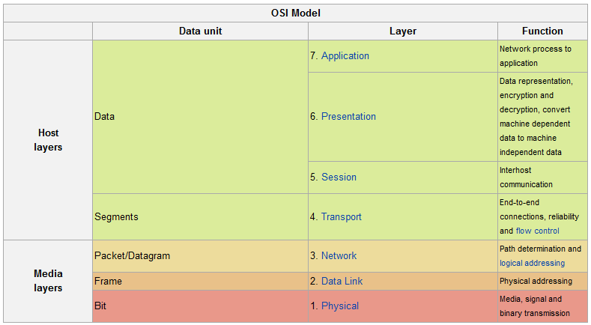
Telecommunication: Seven Layers
The seven layers of the OSI reference model (Yao: OSI 2011).

Slide 20
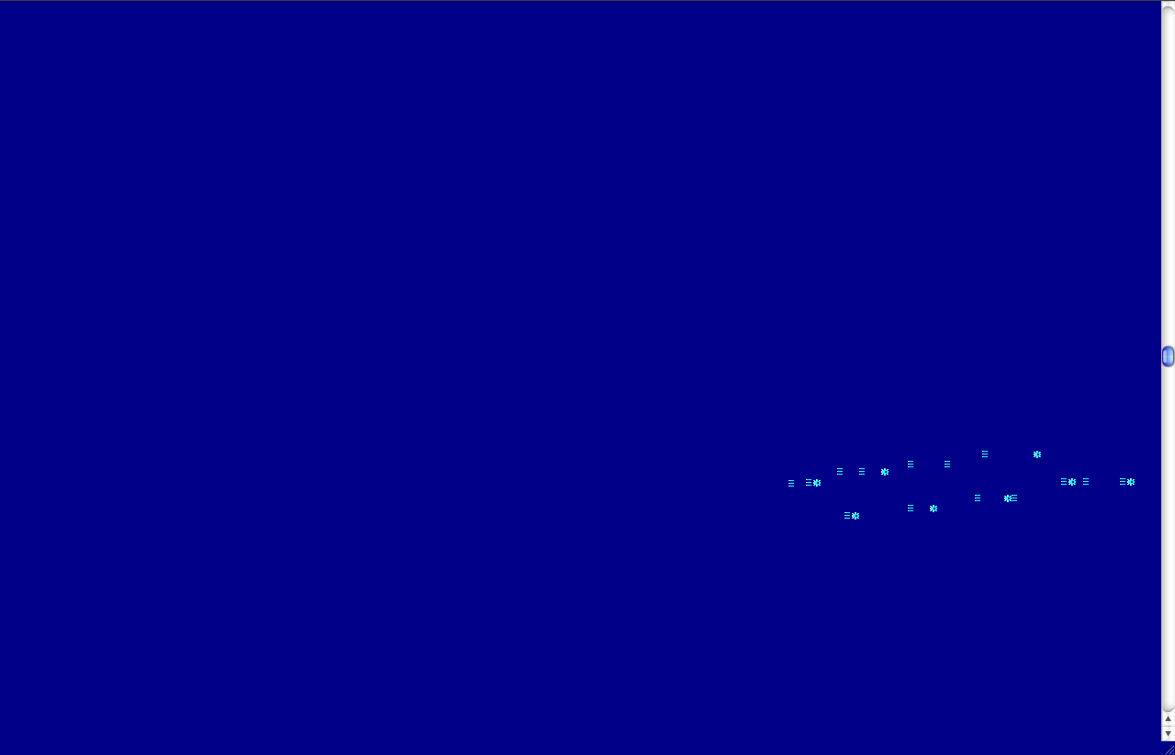
Holger Friese
unendlich, fast..., 1995, web project (screenshot 2010).
URL: http://www.ljudmila.org/~vuk/dx/friese/ende.htm

Slide 21
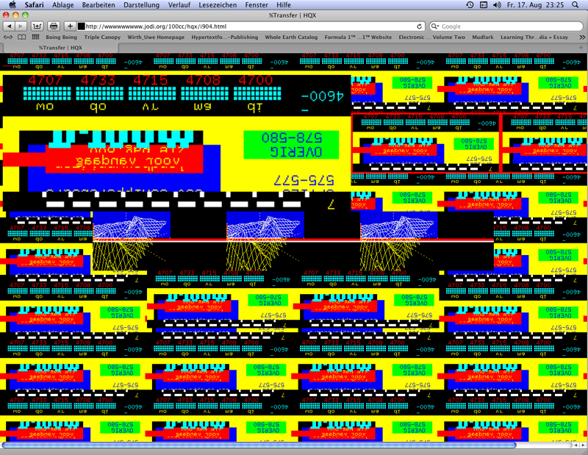
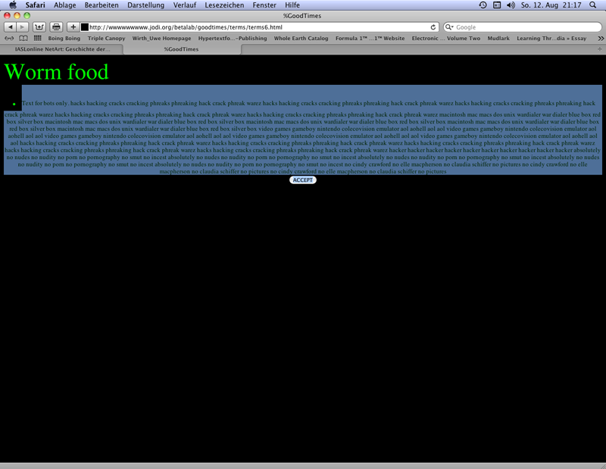
Jodi (I)
wwwwwwwww.jodi.org, 1995, web project (screenshots 2012). URL: http://wwwwwwwww.jodi.org/
Right: Text becoming visible after being marked by mouse-over.

Slide 22
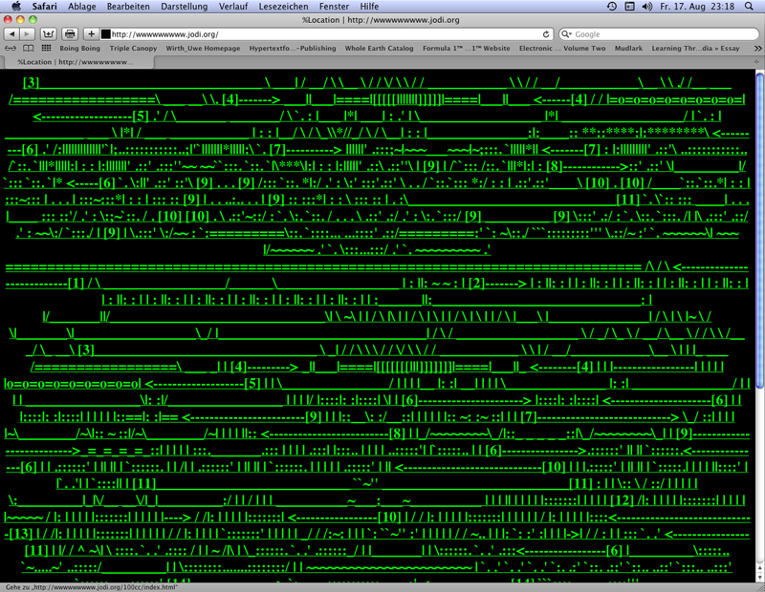
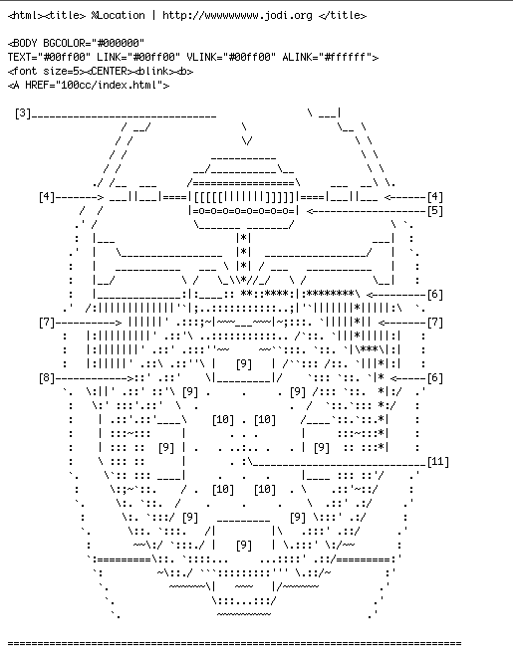
Jodi (II)
wwwwwwwww.jodi.org, 1995, web project (screenshots 2012). URL: http://wwwwwwwww.jodi.org/
Left: Browser presentation of the source code written in ASCII
Right: web project: a detail of the first page´s source code (browser presentation, Screenshot 2012).

Slide 23
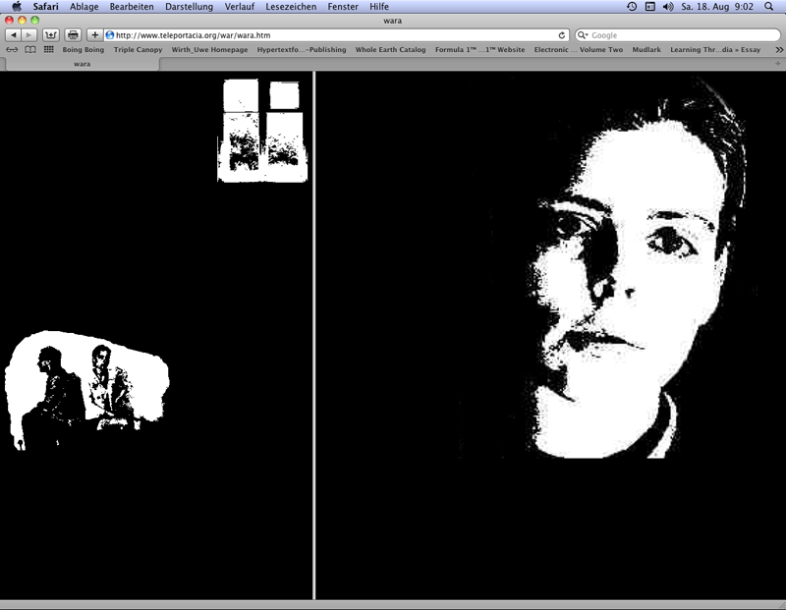
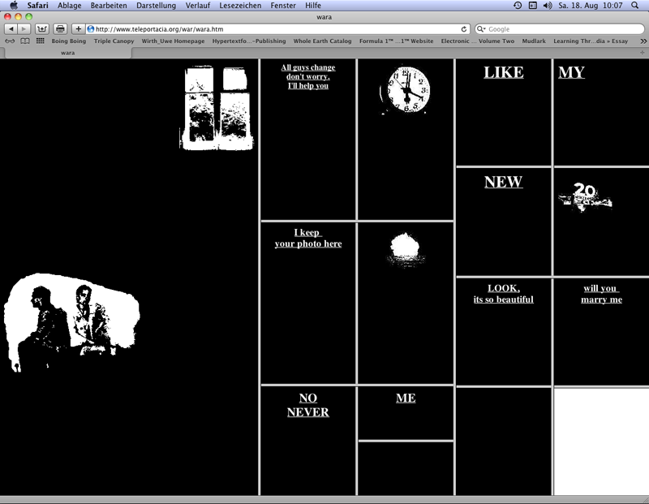
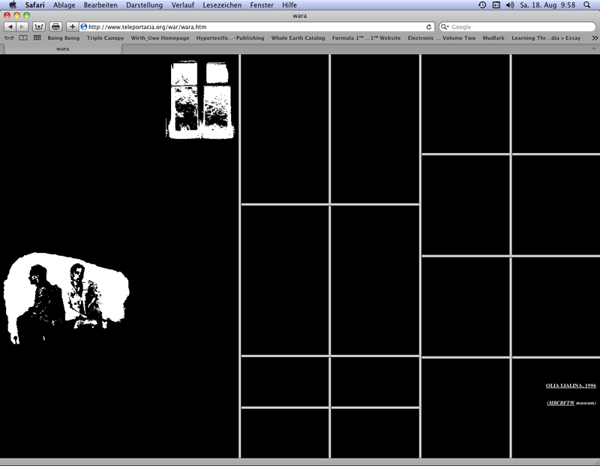
Olia Lialina
My boyfriend came back from the war, 1996, web project (screenshots 2012).
URL: http://www.teleportacia.org/war/wara.htm

Slide 24
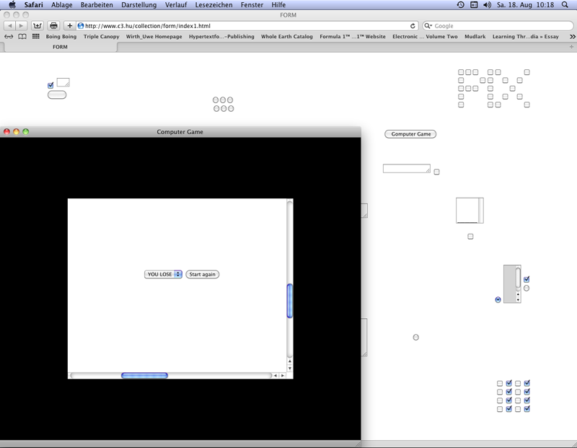
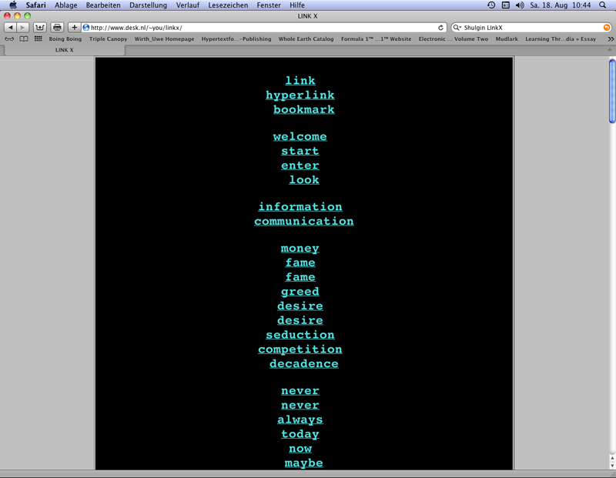
Alexei Shulgin
Form Art, 1997, web project (screenshot 2012).
URL: http://www.c3.hu/collection/form/index1.html
Link X, 1996, web project (screenshot 2012).
URL: http://www.desk.nl/~you/linkx/

Slide 25
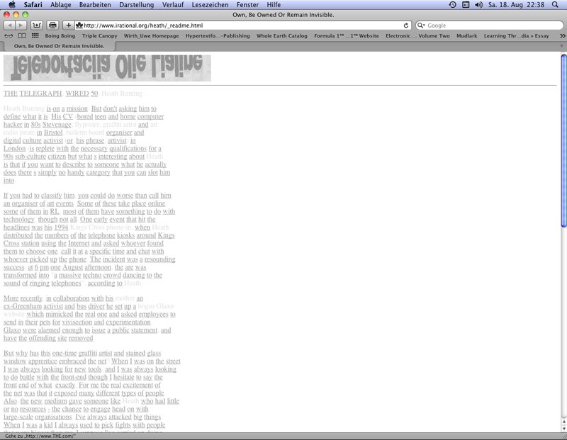
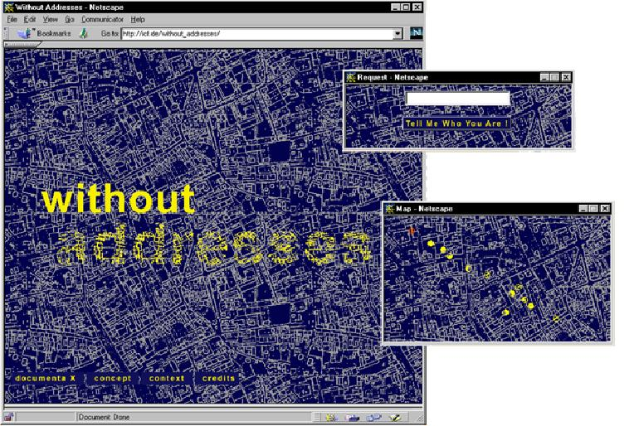
HTML Art
Browser Art (I)
Buntin, Heath: _readme – own, be owned, or remain invisible, 1998, web project (screenshot 2012).
URL: http://www.irational.org/heath/_readme.html
Blank, Joachim/Jeron, Karl-Heinz: without addresses, 1997, web project (illustrations of the project documentation by Blank & Jeron. URL: http://blankjeron.com/sero/without_addresses/).

Slide 26
Browser Art (II)
Napier, Mark: The Shredder, 1998, web project (screenshot 2012).
URL: http://potatoland.org/shredder/shredder.html
I/O/D: Web Stalker, 1997, browser (photo from the monitor, August 2000).
URL: http://bak.spc.org/iod/iod4.html

Slide 27
Browser Art (III)
Wisniewski, Maciej: Netomat, 1999, browser (photo from the monitor, October 2000).
Jevbratt, Lisa: 1:1, every IP, 1999, 2001-2002, web project (screenshot 2009).
URL: http://128.111.69.4/~jevbratt/1_to_1/interface_ii/index.html

Slide 28
Carlos Katastrofsky
DIVE
Medosch. Armin (ed.): DIVE: An Introduction into the World of Free Software and Copyleft Culture, FACT in Liverpool, 2003, web plattform (screenshot 2012).
URL: http://kop.kein.org/DIVE/index.html
Katastrofsky, Carlos: Area Research, 2004, web project (screenshot 2007).
URL: http://www.moz.ac.at/user/carlos/alien/projects/arearesearch/

Slide 29
Activism
Right, top: First page of a two-page invitation of the Media Tank to "Illegal Art Extravaganza", the special events to the travel exhibition "Illegal Art: Freedom of Expression in the Corporate Age", Old City´s Nexus Gallery, Philadelphia 2003.
Image source: URL: http://meltzerdesign.net/portfolio/PDFs/brochures/IllegalArtGuide.pdf
Left: The Yes Men/Detritus/Doll, Cue P.: Reamweaver Version 2.0, tool, 2002. Screenshot of the creation of a pseudo-mirror site of the World Trade Organization´s website. URL: http://netescopio.meiac.es/proyecto/0220/reamweaver_samples/wtocompare.jpg
Right, bottom: Negativland/Maloney, Tim: Gimme the Mermaid, film, 2000/2002 (An exhibit of “Illegal Art”).
Screenshot from URL: https://archive.org/details/dom-24649-gimmethemermaid

Slide 30
Literatur
Bibliography with informations about the abbreviations used in the captions:
Dreher, Thomas: History of Computer Art. Chap. Bibliography. In: URL: http://iasl.uni-muenchen.de/links/GCA-IXe.html
8

