Slide 1
History of Computer Art
URL: http://iasl.uni-muenchen.de/links/GCA_Indexe.html
Part VI: Music Video and Demoscene
Seminar, 28nd April 2014
Danube University Krems
Department for Arts and Image Science
MediaArtHistories: Masters of Art
Thomas Dreher
URL: http://dreher.netzliteratur.net

Slide 2
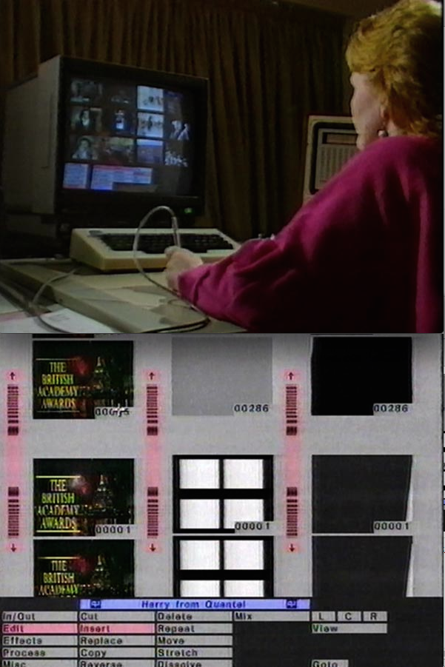
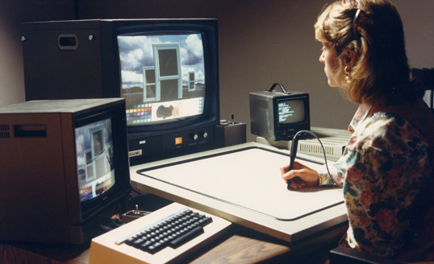
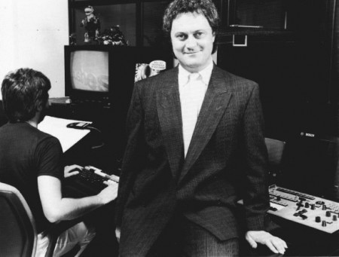
Technical Equipment for Music Clips
Technical Equipment used to create 3D Animations for Music Videos:
Left, top: Quantel Paintbox, 1981. Image source: URL: http://blog.quantel.eu/2011/03/the-quantel-paintbox-a-pioneering-computer-graphics-workstation/
Left, bottom: Chairman of Rushes, Godfrey Pye, stands in front of the company’s first Bosch FGS 4000 computer graphics system. Image source: URL: http://www.animatormag.com/archive/issue-18/issue-18-page-16/
Right: Quantel Harry, 1985-86.
Image source: URL: http://www2.tv-ark.org.uk/miscellaneous/other.html

Slide 3
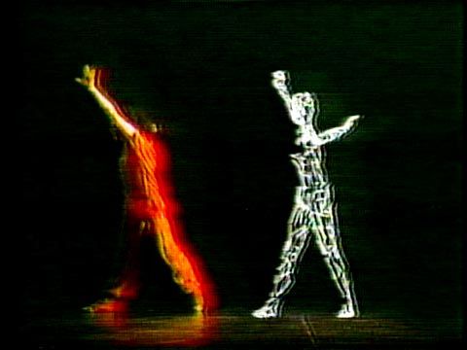
Music Clips (I)
Tharp, Twyla/Byrne, David: The Catherine Wheel, dance performance, 1981. Computer animation by Rebecca Allen for the film version, 1982. Image source: URL: http://rebeccaallen.com/v2/work/pop.img.php?ID=24&limit=14&nR=19
Costello, Elvis: Accidents Will Happen. Music video with animations of Annabel Jankel and Rocky Morton, 1978.
Screenshots from URL: http://www.dailymotion.com/video/x27zt1_elvis-costello-accidents-will-happe_music?start=1

Slide 4
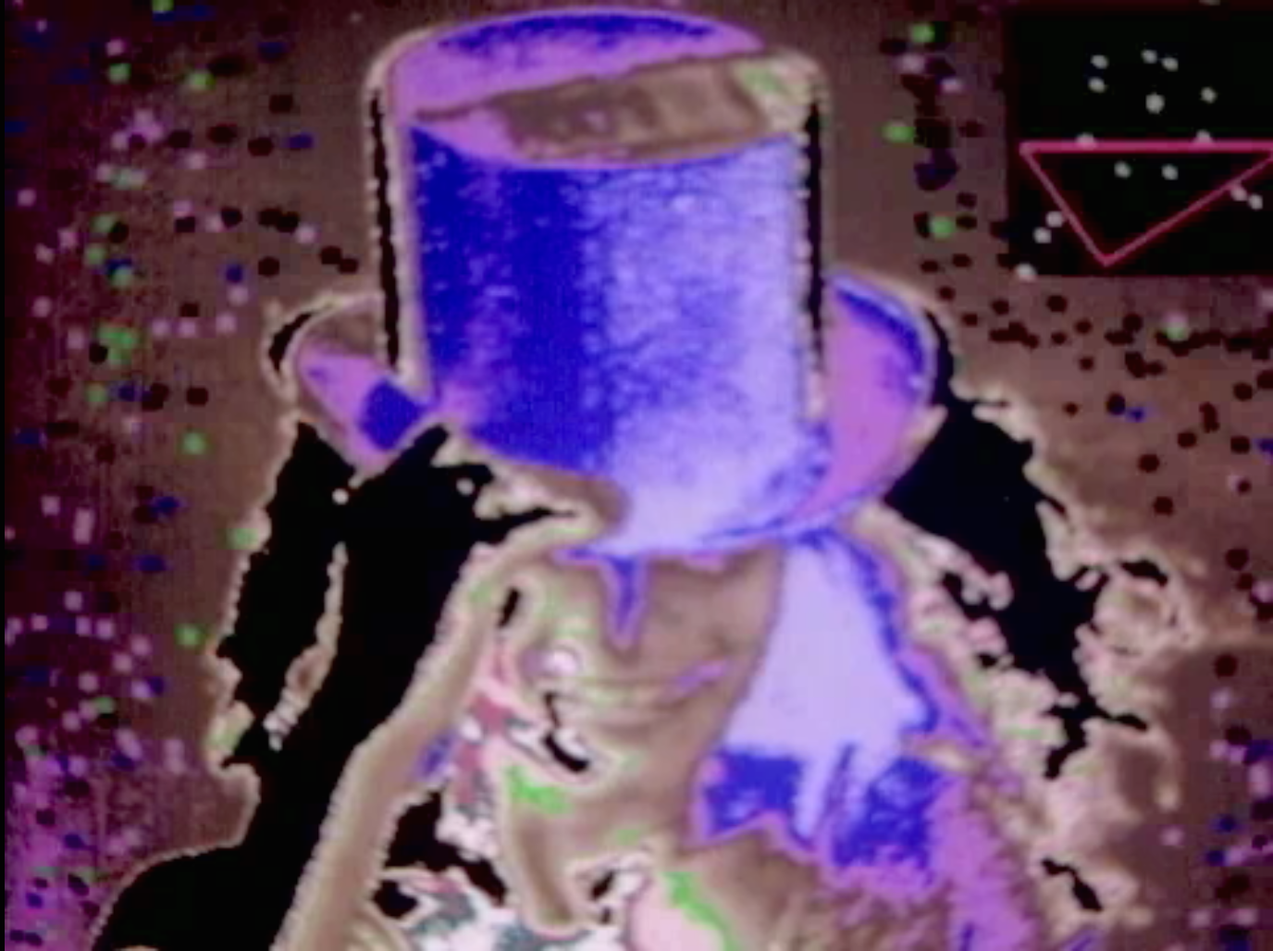
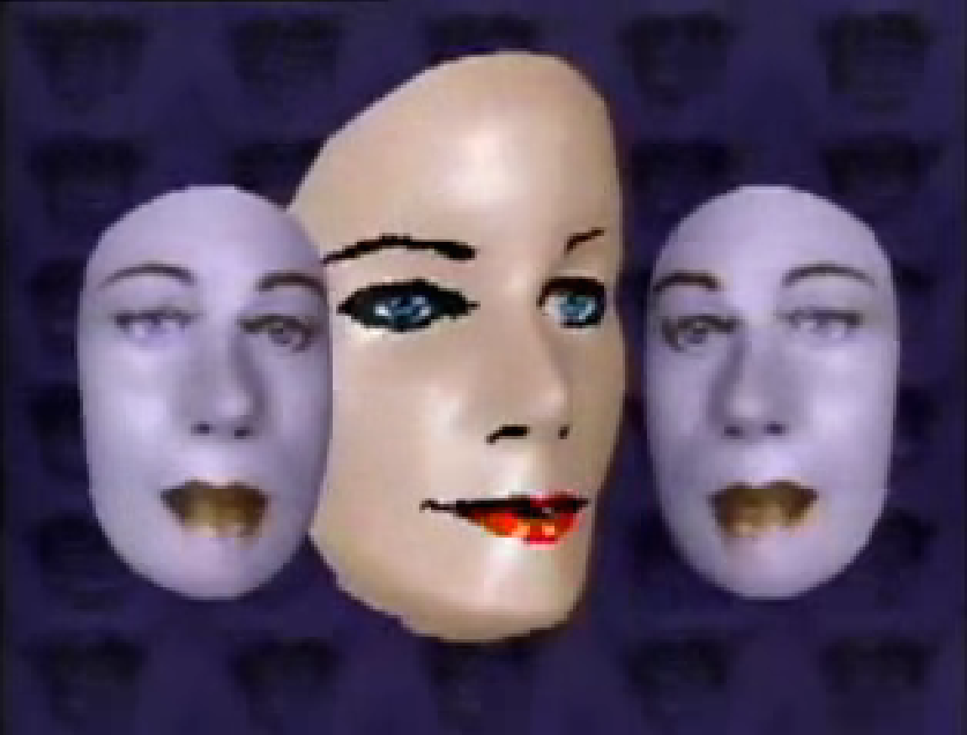
Music Clips (II)
Left: Steve Miller Band: Abracadabra, 1982. Music video by Peter Conn.
Screenshot from URL: http://milesconsulting.org/motionAbraHi.html
Right: Powers, Will (Goldsmith, Lynn): Adventures in Success, 1983. Music video by Rebecca Allen.
Screenshot from URL: https://www.youtube.com/watch?feature=player_embedded&v=JVLhZ2-pCRQ
UR

Slide 5
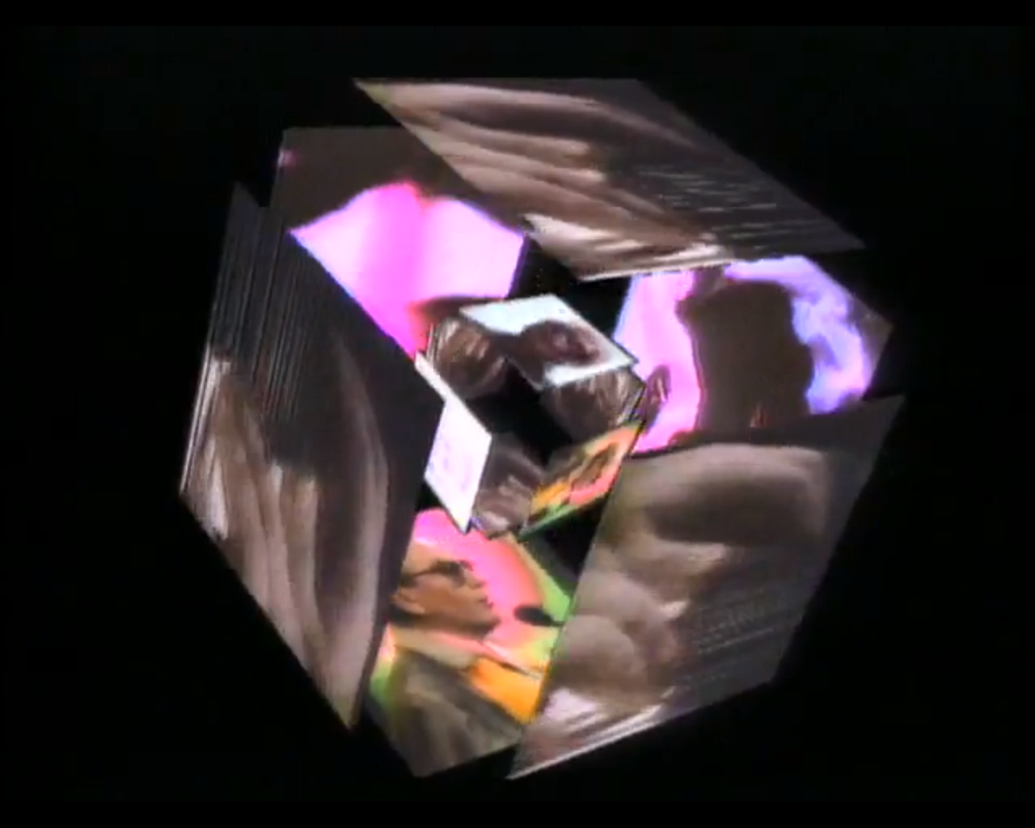
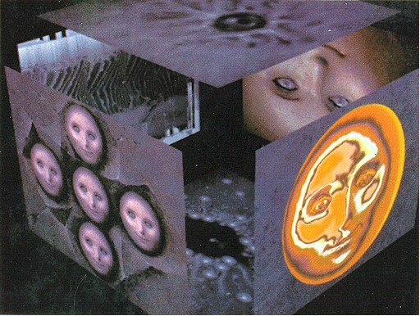
Robert Ashley: Perfect Lives, 1983
Left: Ashley, Robert: Perfect Lives, Part VII: The Backyard, 1983. Video opera, visualised by John Sanborn and Dean Winkler.
Image source: URL: https://www.youtube.com/watch?feature=player_embedded&v=-1LWC39Ehm4
Right: Emshwiller, Ed/Smith, Alvy Ray: Sunstone, video, 1979.
Image source: URL: http://www.alvyray.com/Art/Sunstone.htm
UR

Slide 6
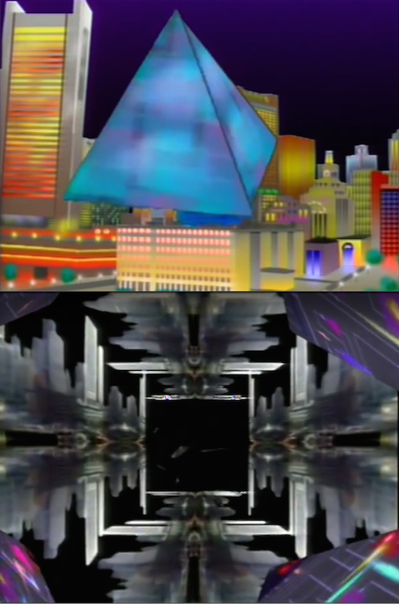
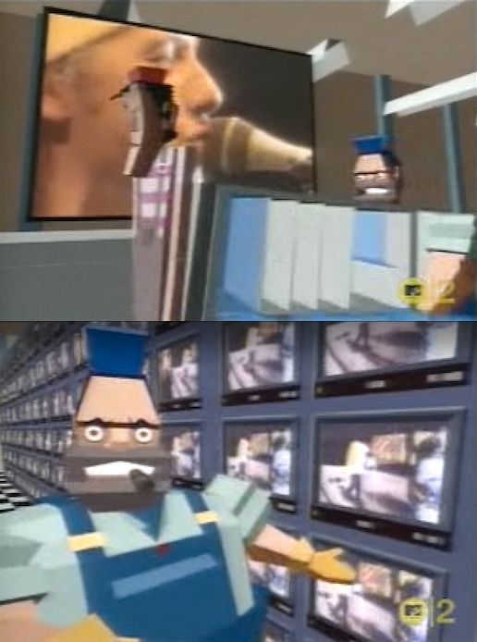
Music Clips (III)
Left: Tacuma, Jamaaladeen: Renaissance, 1984. Music video by John Sanborn and Dean Winkler.
Screenshots from URL: https://www.youtube.com/watch?v=5ur-WbHSBgs
Right: Dire Straits: Money for Nothing, 1985. Music video by Steve Barron.
Screenshots from URL: http://www.dailymotion.com/video/x2724a_25-dire-straits-money-for-nothing-1_music

Slide 7
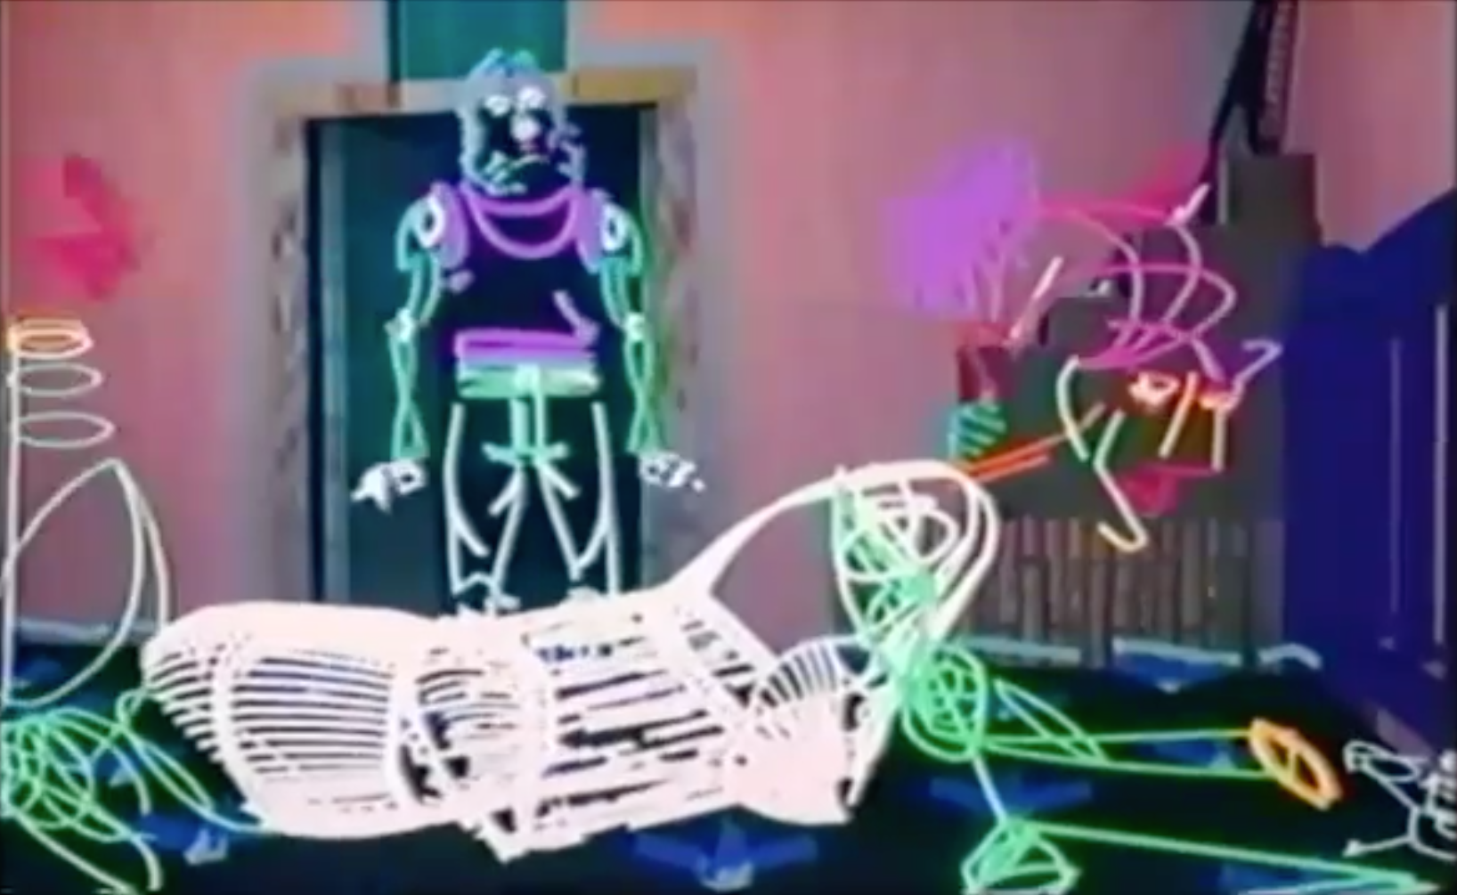
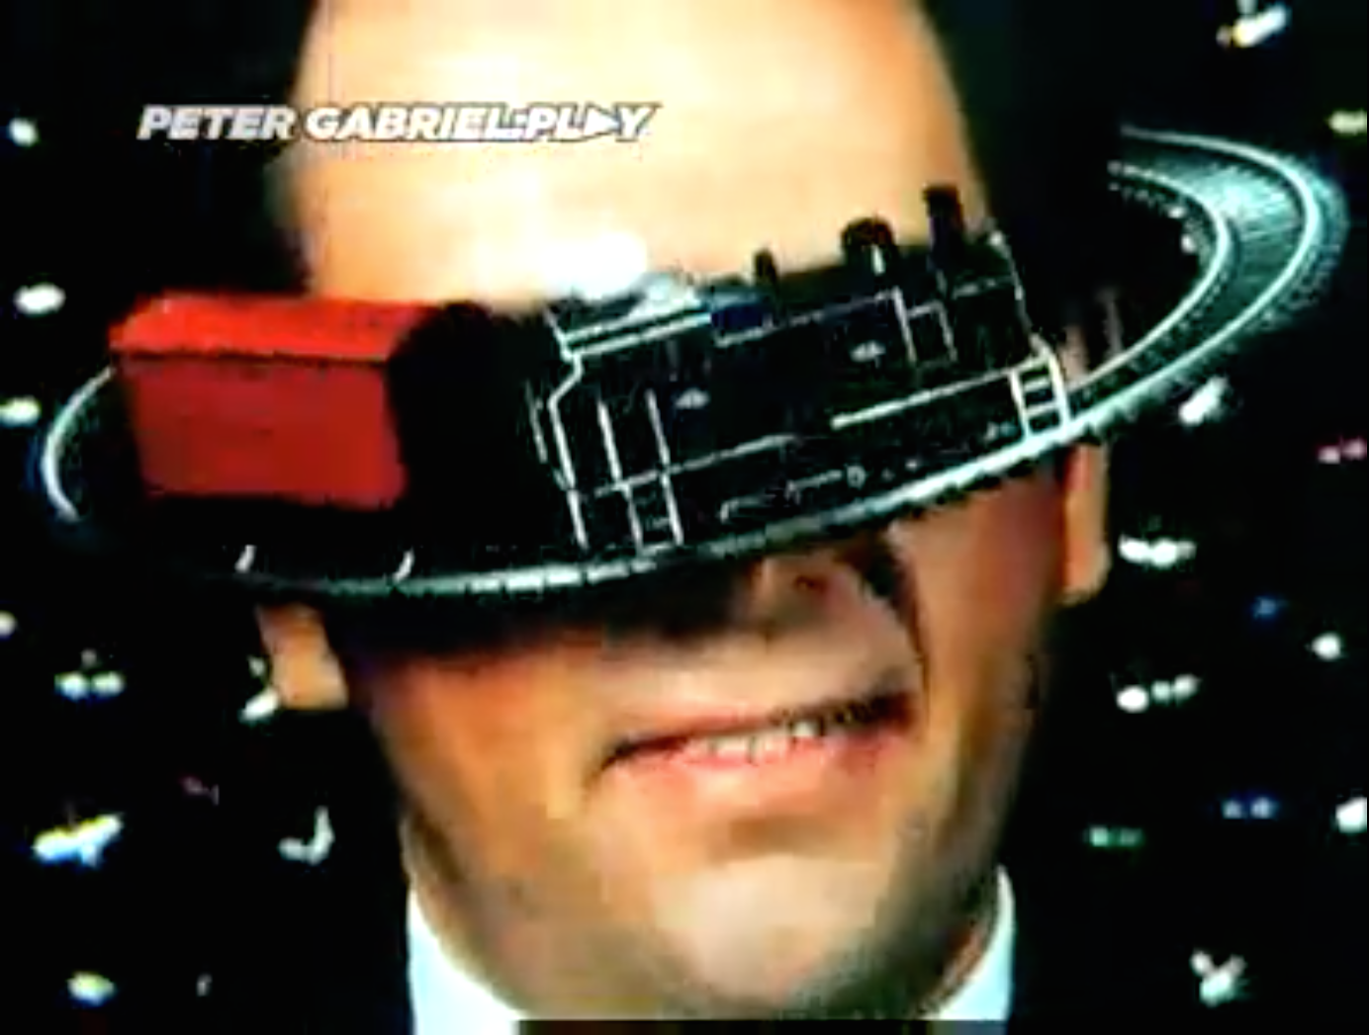
Music Clips (IV)
Jagger, Mick: Hard Woman, 1985. Music video by Digital Productions.
Screenshot from URL: https://www.youtube.com/watch?feature=player_embedded&v=rx8ONw76FPQ
Gabriel, Peter: Sledgehammer, 1986. Music video by Steven R. Johnson. The clip is realised without computerised image processing and takes up early animation methods with its fast cuts and fade-ins of `flying´ objects that move through the image space.
Screenshot from URL: http://www.dailymotion.com/video/x2302d_peter-gabriel-sledgehammer_music?start=3
UR

Slide 8
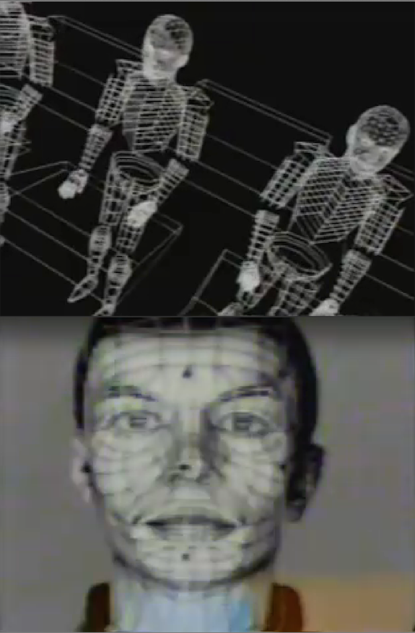
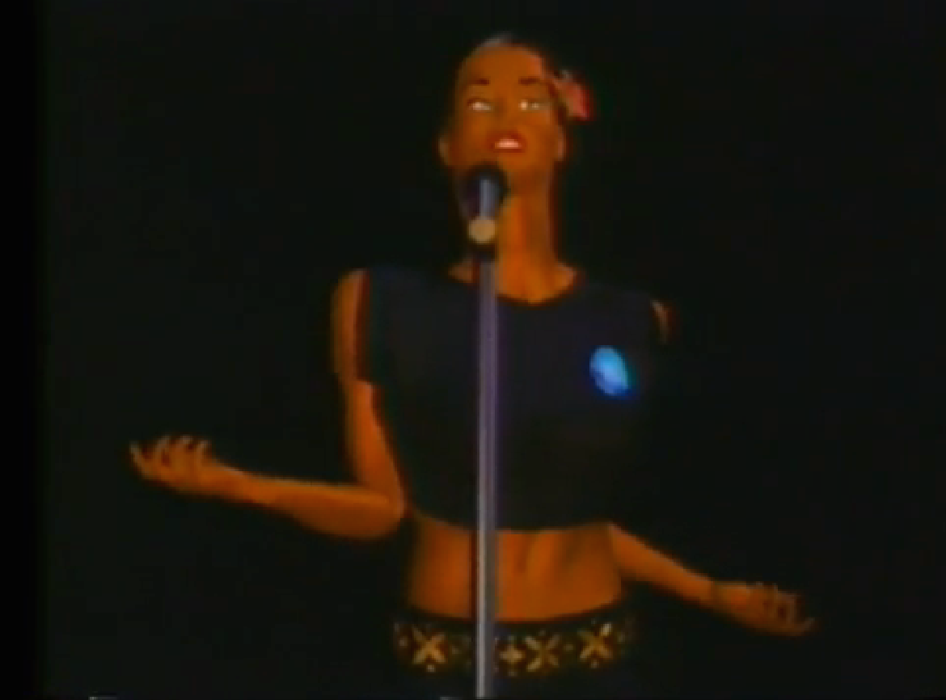
Music Clips (V)
Walczak, Diana/Kleiser, Jeff: Don´t Touch Me, video, 1989.
Screenshot from URL: https://www.youtube.com/watch?feature=player_embedded&v=8ovn8qRezPA
Kraftwerk: Musique non Stop, 1986. Music and video by Rebecca Allen.
Screenshots from URL: http://vimeo.com/28802324

Slide 9
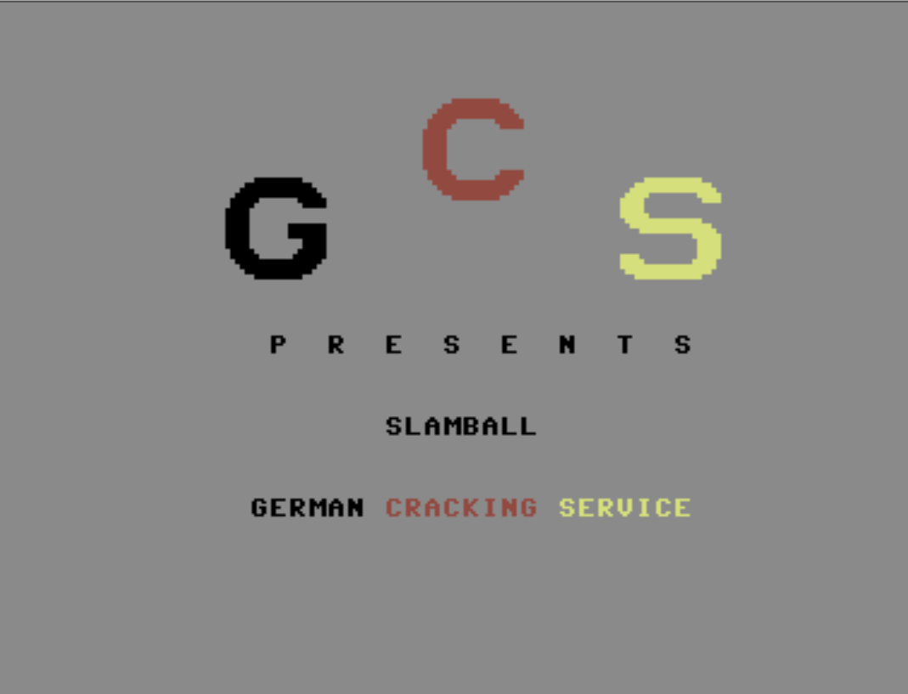
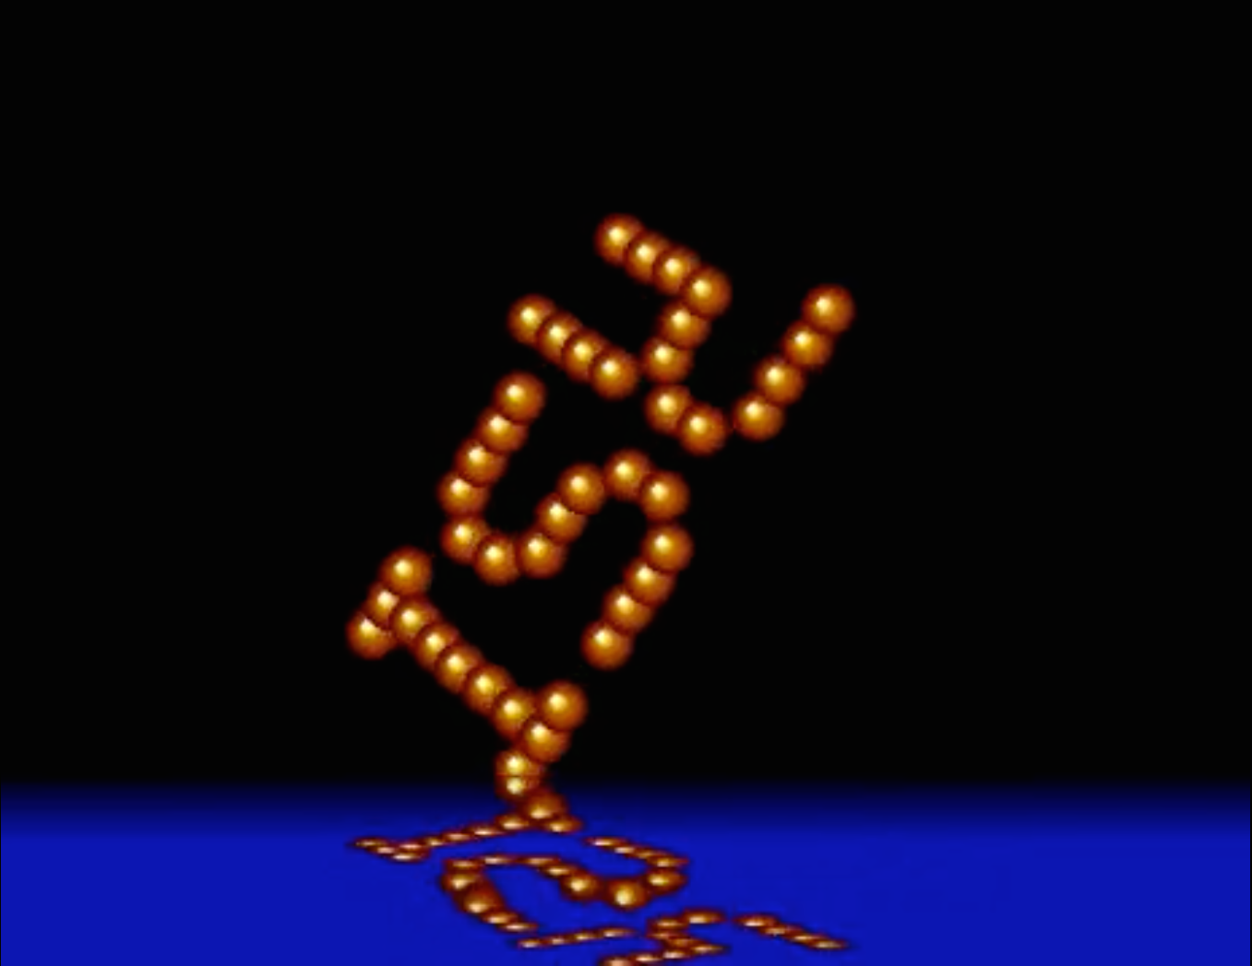
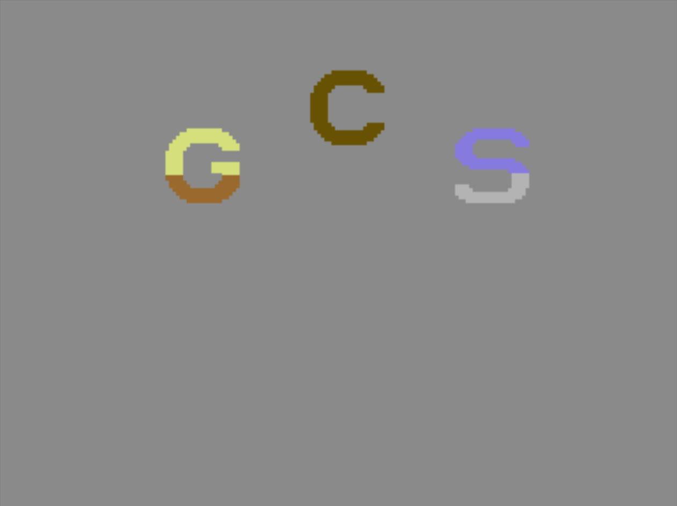
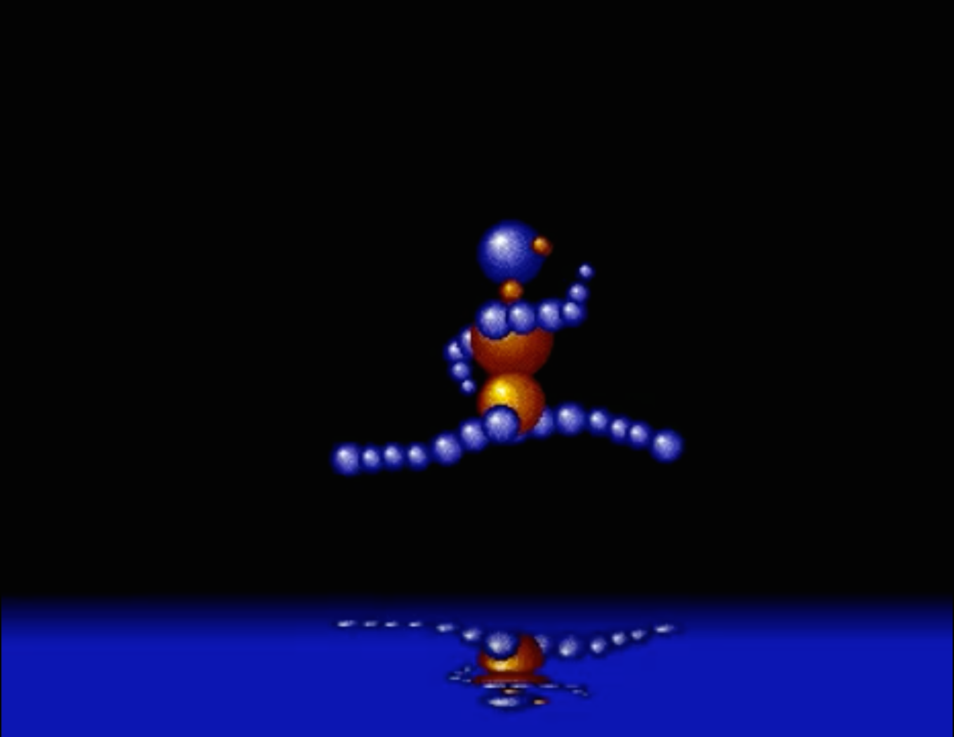
Demoscene
German Cracking Service: Slamball, cracktro for Commodore C64, 1984.
Screenshot from the demo file stored at URL: http://intros.c64.org/main.php?module=showintro&iid=523
RED SECTOR INC: Megademo, Commodore Amiga, 1989. Screenshots from URL: https://www.youtube.com/watch?feature=player_embedded&v=FrJPoICvmpI

Slide 10
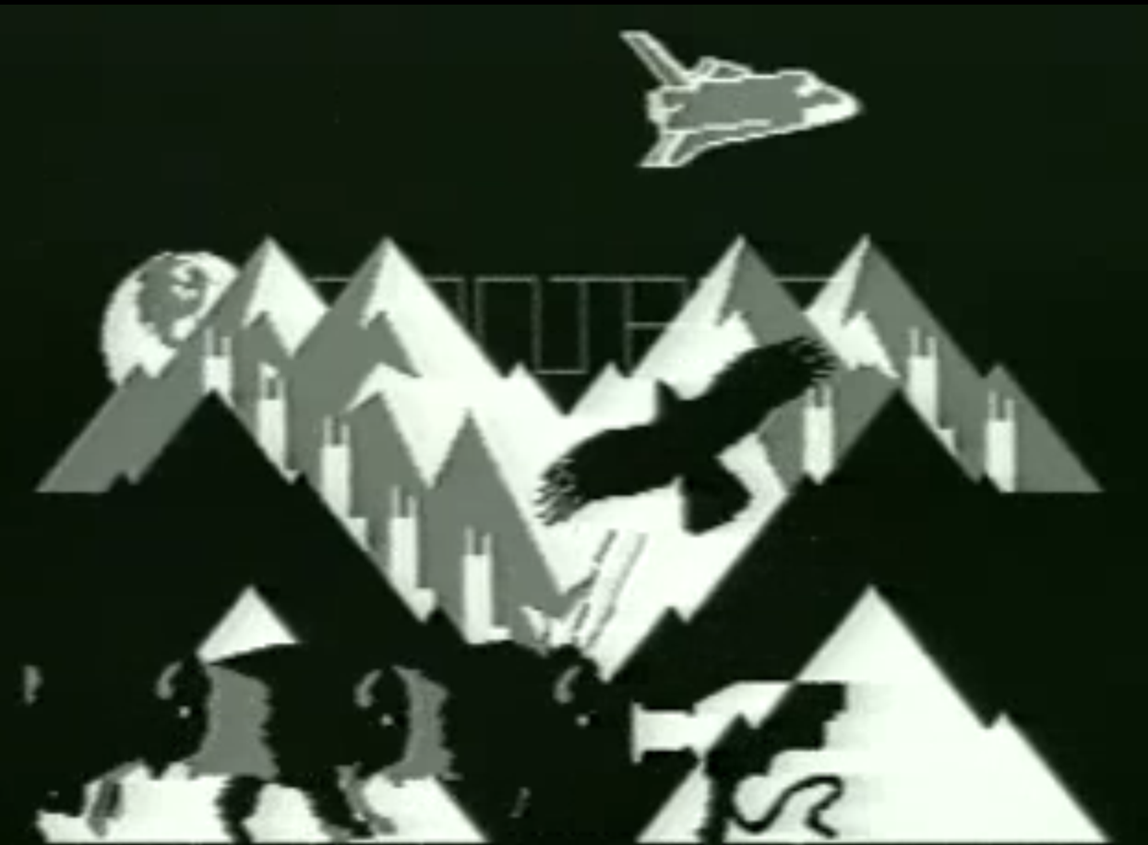
Mary Jane Veeder
The Techno-Imagery
Montana, video developed with ZGRASS (tool for Datamax UV-1), 1982.
Screenshot from URL: http://userwww.sfsu.edu/jkveeder/art/media/broadbnd/montana.htm
Export, Valie/Weibel, Peter: Voices from an Inner Space, intermedial performance, Brucknerhaus, Linz 9/17/1988.
Image source: URL: http://www.valieexport.at/en/werke/werke/?tx_ttnews[tt_news]=2125&tx_ttnews[backPid]=4&cHash=588c1671db

Slide 11
Literatur
Bibliography with informations about the abbreviations used in the captions:
Dreher, Thomas: History of Computer Art. Chap. Bibliography. In: URL: http://iasl.uni-muenchen.de/links/GCA-IXe.html
8

