Slide 1
History of Computer Art
URL: http://iasl.uni-muenchen.de/links/GCA_Indexe.html
Part VIII: Reactive Installations and Virtual Reality
Seminar, 28nd April 2014
Danube University Krems
Department for Arts and Image Science
MediaArtHistories: Masters of Art
Thomas Dreher
URL: http://dreher.netzliteratur.net

Slide 2
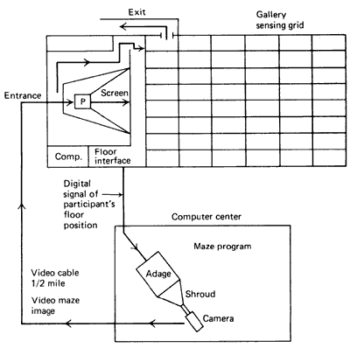
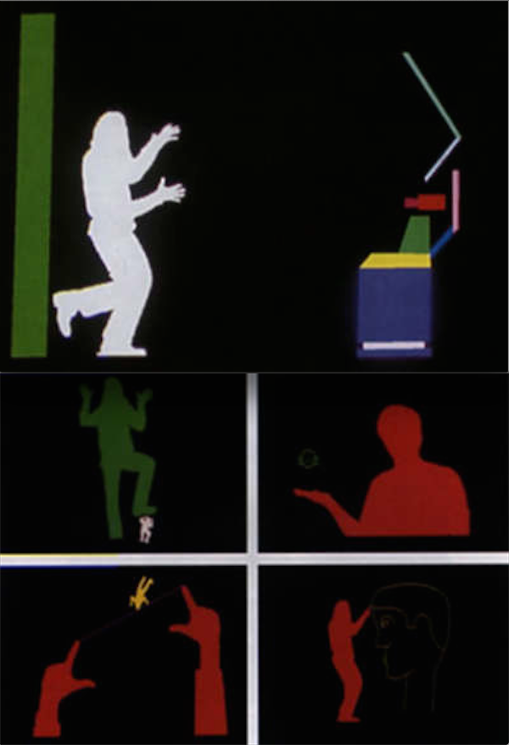
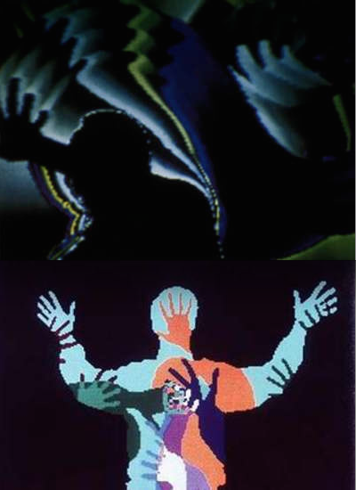
Myron Krueger
Left: Krueger: Myron: Psychic Space, 1971, ground plan (Krueger: Reality 1991, p.26, fig.2.9).
Right: Krueger, Myron: Videoplace, since 1974.
Image sources: URL: http://dada.compart-bremen.de/item/artwork/1346

Slide 3
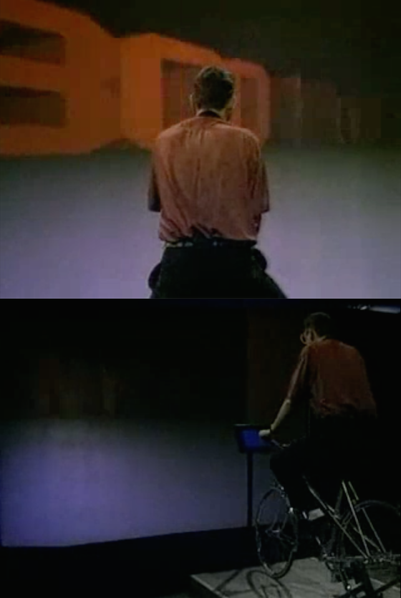
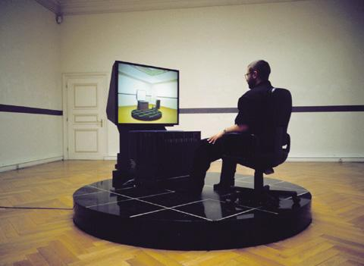
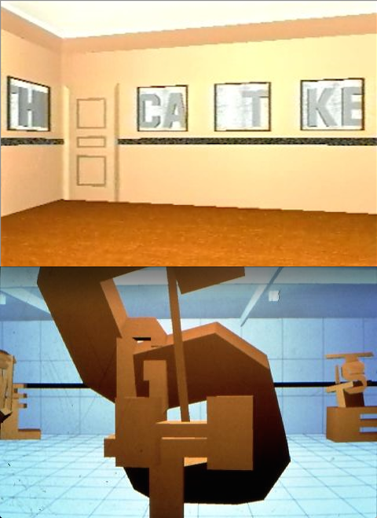
Jeffrey Shaw
Middle and Right: The Virtual Museum, reactive installation, 1991, exhibited at Francisco Carolinum, Linz 1992.
Image source: URL: http://www.medienkunstnetz.de/works/the-virtuel-museum/images/1/
Left: The Legible City, Man-hattan version, 1989.
Screenshots from URL: https://www.youtube.com/watch?v=61l7Y4MS4aU

Slide 4
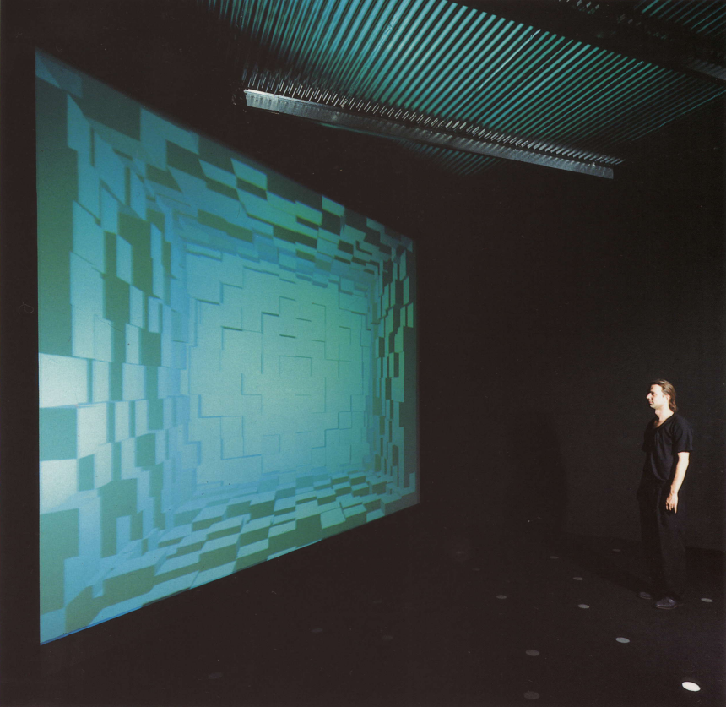
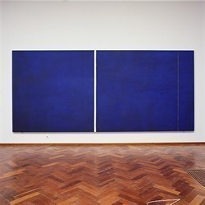
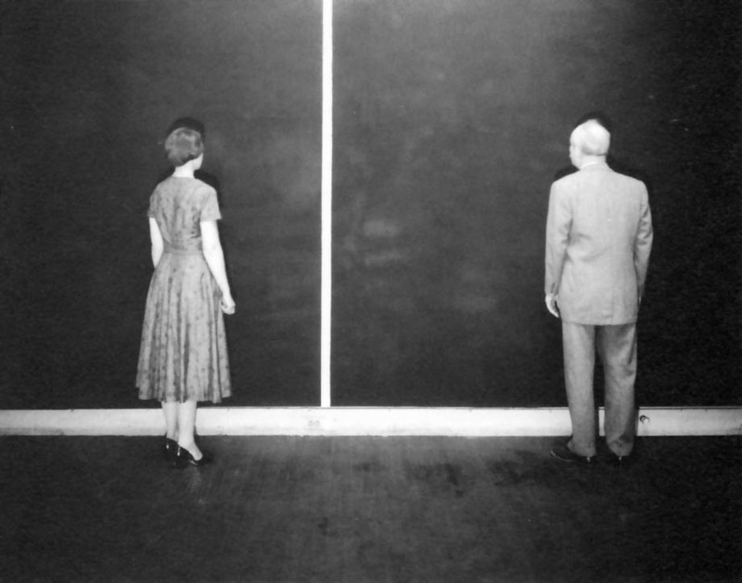
Peter Weibel (I)
Right, top: Newman, Barnett: Cathedra, 1951, oil and Magna on canvas, 96 x 204 inches, Stedelijk Museum Amsterdam. Image Source: URL: http://members.home.nl/kunstna1945/bijgevoegd%20foto%27s/Newman%20Cathedra%20SMA.jpg
Right, bottom: Barnett Newman and female observer in front of "Cathedra" in Newman´s Front Street Studio, New York. Photo: Peter A. Juley and Son. Smithsonian American Art Museum, Washington D.C. (Anfam: Abstract Expressionism 1990, p.147, fig.110).
Left: Weibel, Peter a.o.: On Justifying the Hypothetical Nature of Art and the Non-Identicality within the Object World, reactive installation, Gallery Tanja Grunert, Cologne 1992 (Schuler: Weibel 1997, p.246).

Slide 5
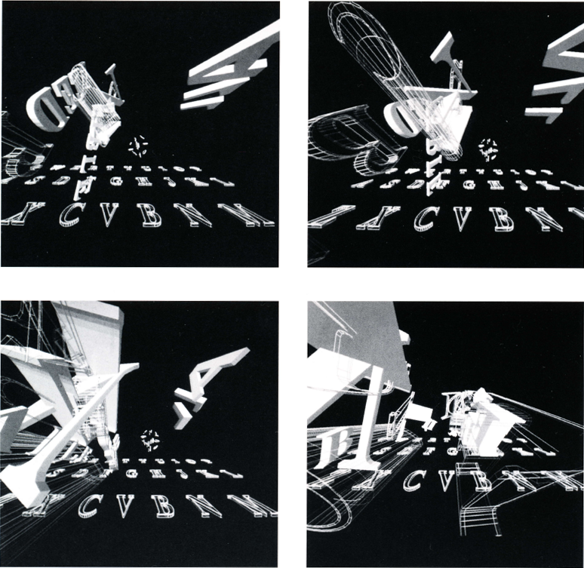
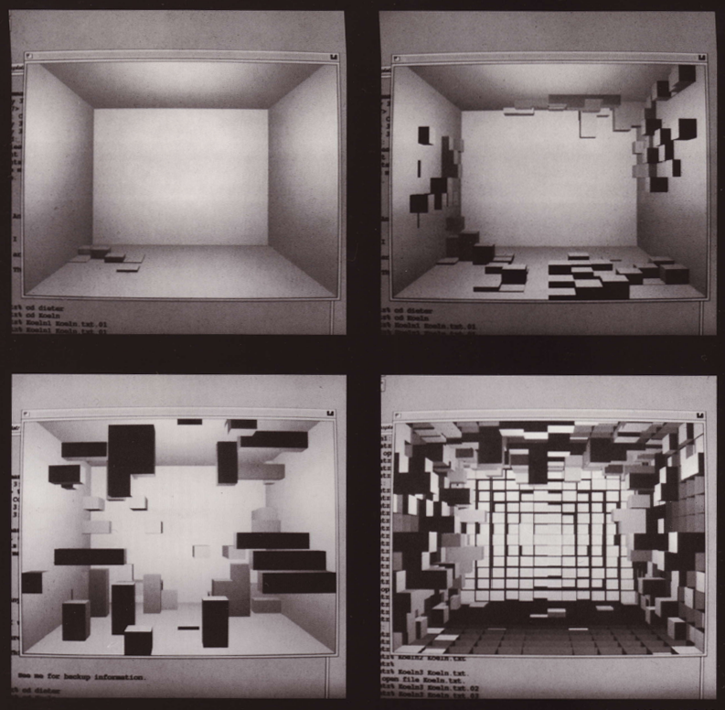
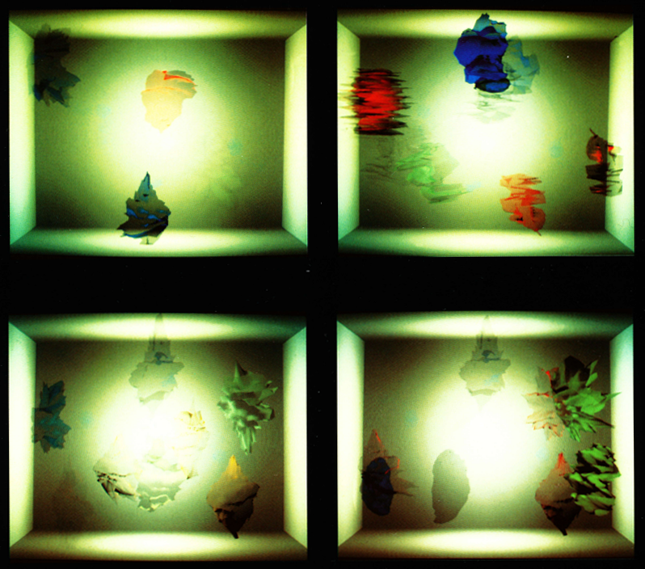
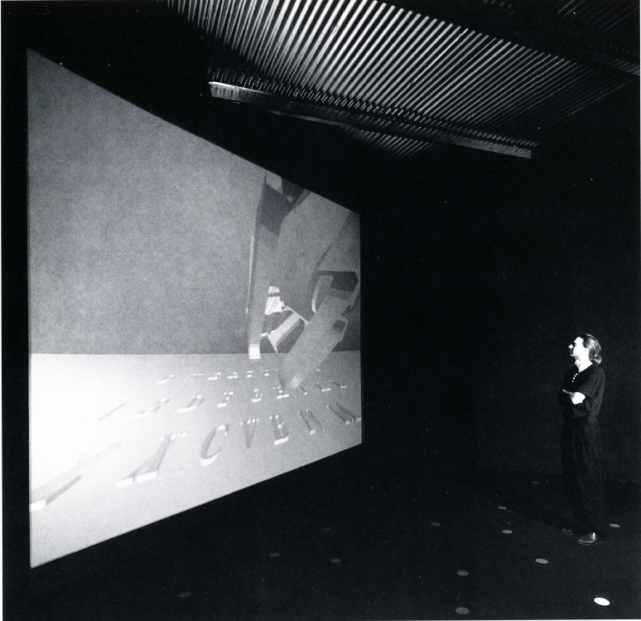
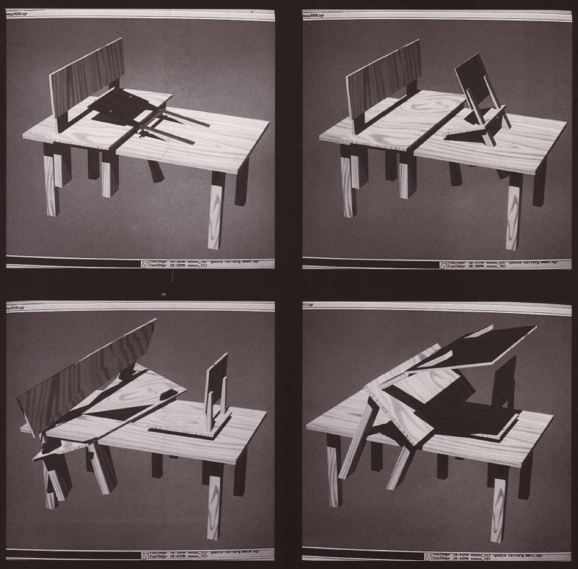
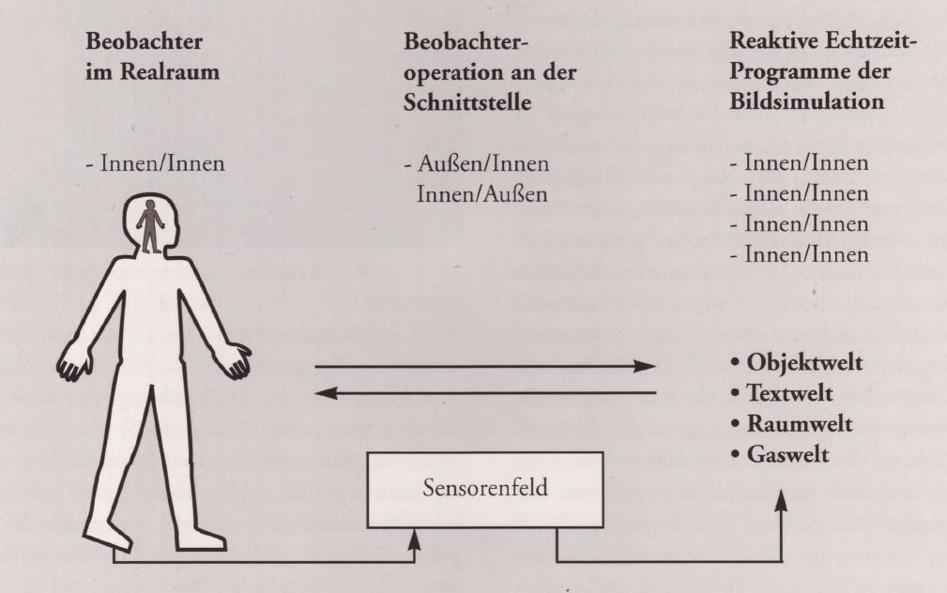
Peter Weibel (II)
Weibel, Peter/Institut für Neue Medien, Städelschule, Frankfurt: Zur Rechtfertigung der hypothetischen Natur und der Nicht-Identität in der Objektwelt/On Justifying the Hypo-thetical Nature of Art and the Non-Identicality within the Object World, 1992, installed at Gallery Tanja Grunert, Cologne 1992 (Schuler: Weibel 1997, p.45,244s.,247,249,251).
UR
Left above and bottom: Text World (Constanze Ruhm/Bob O´Kane), middle above: Architecture World (Dieter Beck), right above: Gas World (Gideon May/Laurent Mignonneau), middle bottom: Object World (Akke Wagenaar), right bottom: diagram of the interface to the virtual worlds.

Slide 6
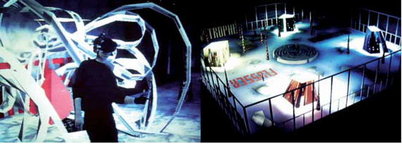
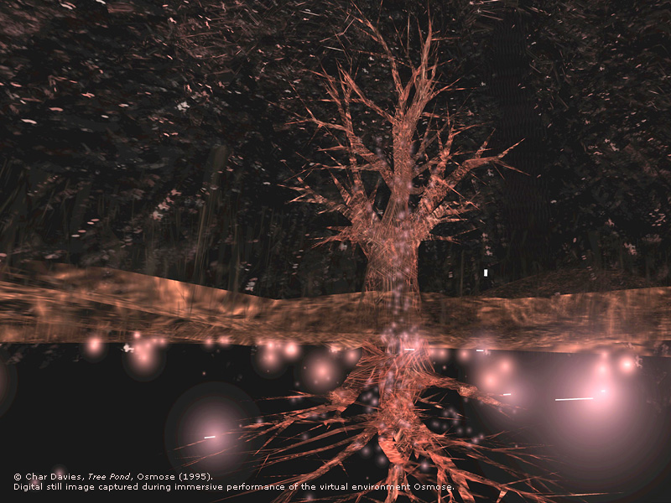
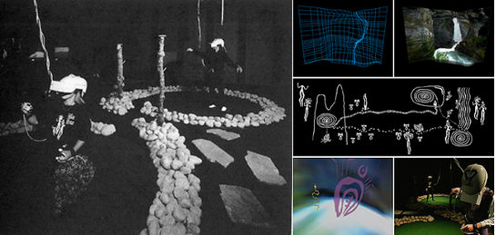
Virtual Reality
Left, top: Fleischmann, Monika/Strauss, Wolfgang: Home of the Brain, virtual reality installation, 1991/92 (Kluszczynski: Data 2011, p.70).
Right: Davies, Char: Osmose, virtual reality installation, 1995.
Image source: URL: http://www.immersence.com/osmose/os_treepond.html.
Left, bottom: Laurel, Brenda/Strickland, Rachel: Placeholder, virtual reality installation, 1993.
Image sources: URL: http://mindatplay.co.uk/placeholder.html, http://tauzero.com/Brenda_Laurel/Placeholder/Placeholder.html
UR

Slide 7
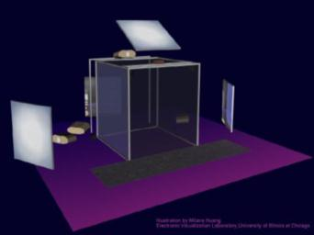
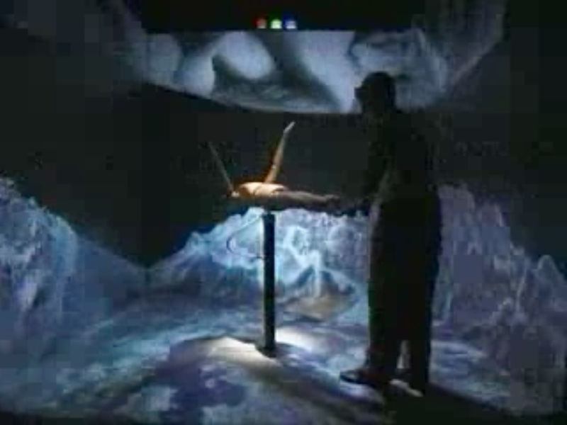
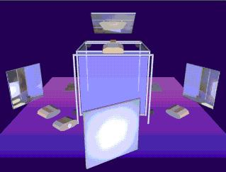
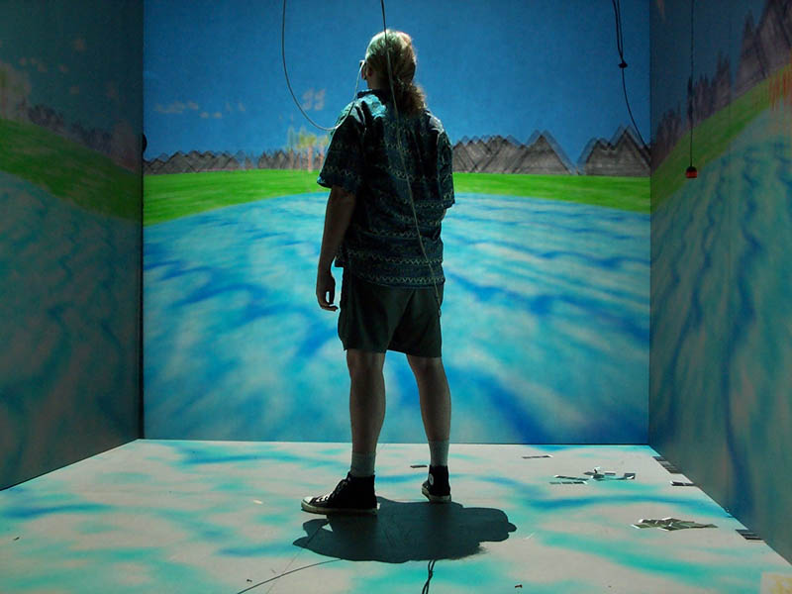
Cave, 1991-93
Right, top: Shaw, Jeffrey/Hegedüs, Agnes/Lintermann, John: Con FIGURING the CAVE, reactive installation in the CAVE, 1996.
Image source: URL: http://jeffrey-shaw.net/movies/097_001.mov.
Right, bottom: Pape, Dave: Crayoland, reaktive Installation im CAVE, 1995.
Image source: URL: http://upload.wikimedia.org/wikipedia/commons/6/6d/CAVE_Crayoland.jpg
Left: Sandin, Daniel J./DeFanti, Thomas A./Cruz-Neira, Carolina: CAVE, reactive installation, Electronic Visualization Laboratory (University of Illinois, Chicago), 1991-93. Image sources; URL: http://www.evl.uic.edu/pape/CAVE/oldCAVE/caveback_small.jpg, http://www.evl.uic.edu/pape/CAVE/images/cave.jpg

Slide 8
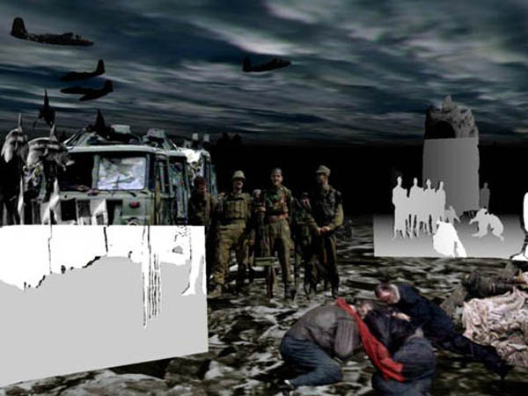
Maurice Benayoun
World Skin, reactive installation in the CAVE, 1997-2003. Image source: URL: http://webartacademy.com/wp-content/uploads/2010/08/web_art_academy_Benayoun_Virtual-Reality.jpg
UR

Slide 9
Literatur
Bibliography with informations about the abbreviations used in the captions:
Dreher, Thomas: History of Computer Art. Chap. Bibliography. In: URL: http://iasl.uni-muenchen.de/links/GCA-IXe.html
8

