Slide 1
History of Computer Art
URL: http://iasl.uni-muenchen.de/links/GCA_Indexe.html
Part X: Computer and Video Games
Seminar, 28nd April 2014
Danube University Krems
Department for Arts and Image Science
MediaArtHistories: Masters of Art
Thomas Dreher
URL: http://dreher.netzliteratur.net

Slide 2
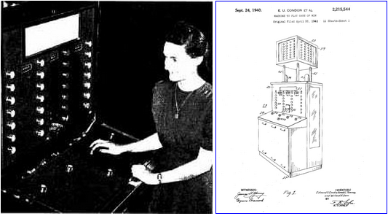
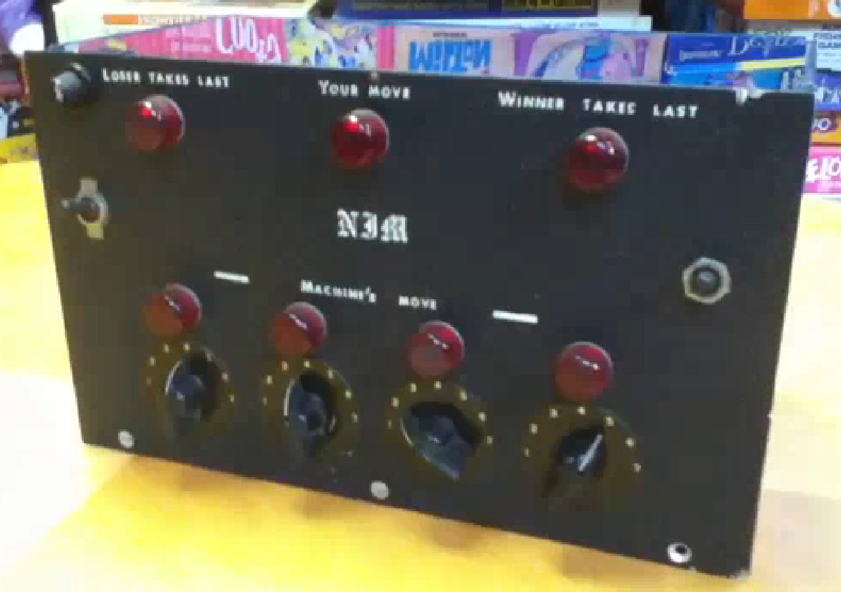
Early Computer Games (I)
Left and Middle: Condon, Edward U./Derr, Willard A./Gereld L. Tawney: Nimatron, 1940.
Left: Realisation by the Westinghouse Electric & Manufacturing Company, spring 1940, New York World´s Fair (source: The American Mathematical Monthly. Vol 49. January 1942, p.42ss.)
Image source: URL: http://www.goodeveca.net/nimrod/nimatron.html
Middle: Illustration of U.S. Patent 2,215,544.
Image source: URL: http://www.1939nyworldsfair.com/ftp/MACHINE_TO_PLAY_GAME_OF_NIM.pdf
Right: Redheffer, Raymond: Nim, box realised in using blue plexiglass, signed with "Raymond Redheffer MIT" (film by Mike Mozart, including some not quite correct informations according to the current level of knowledge).
Image source: URL: https://www.youtube.com/watch?v=2NWnmvMOqS0

Slide 3
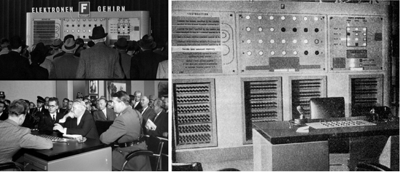
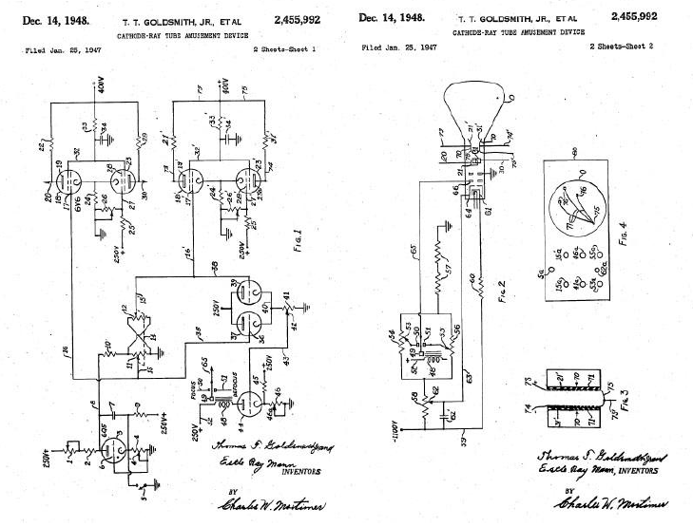
Early Computer Games (II)
Right, bottom: Goldsmith Jr., Thomas T./Grove,Cedar/Mann, Estle Ray: Cathode Ray Tube Amusement Device. U.S. Patent #2,455,992. 1948, Sheets 1 and 2, fig.1 - 4.
Image source: URL: http://www.pong-story.com/2455992.pdf
Left and Middle: Bennett, John/Stuart-Williams, Raymond: Ferranti Nimrod, 1951.
Left, top and bottom: Industrial Exhibition, fair grounds, Charlottenburg/Berlin, opening day 6th October 1951, Federal Minister of Economic Affairs Ludwig Erhard (left bottom, at the centre) plays against Nimrod and looses three times (Borchers: Jahre 2001. Source of the images: Heinz Nixdorf MuseumsForum, Paderborn. URL: http://www.heise.de/newsticker/meldung/Vor-50-Jahren-fing-alles-an-das-erste-Elektronenhirn-in-Deutschland-51722.html).
Middle: Exhibition of Science, Science Museum, South Kensington/London, Part of the Festival of Great Britain, London 1951. Image source: URL: http://goodeveca.net/nimrod/
UR

Slide 4
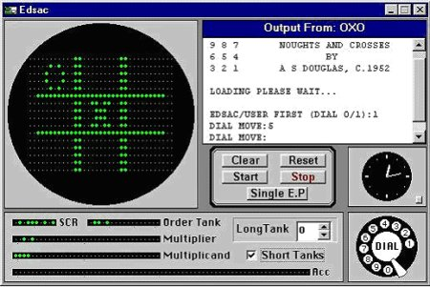
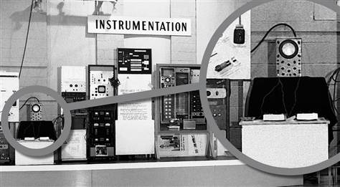
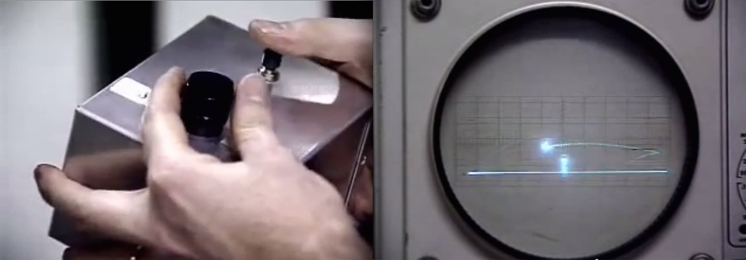
Early Computer Games (III)
Right, top and bottom: Higinbotham, William: Tennis for Two, 1958, Systron Donner Analog Computer, Germanium transistors, oscillograph (diameter: 5 inches), 2 boxes with turning knobs and press keys. Exhibited at the visitor´s day of the Instrumentation Division at the Brookhaven National Laboratory, U.S. Department of Energy, Upton/Long Island ("Tennis for Two" is presented enlarged in the wider circle. Image source: Brookhaven National Laboratory).
Left: Douglas, Alexander S.: Tic Tac Toe, 1949, game for the Mainframe Computer EDSAC (illustration: Tic Tac Toe in the EDSAC emulator). Image source: URL: http://img.index.hu/cikkepek/0506/tech//oxo.jpg
Image sources: Right, top: URL: http://www.msnbc.msn.com/id/27328345#.UHa_rY56STs
Right, bottom: URL: https://www.youtube.com/watch?v=s2E9iSQfGdg
UR

Slide 5
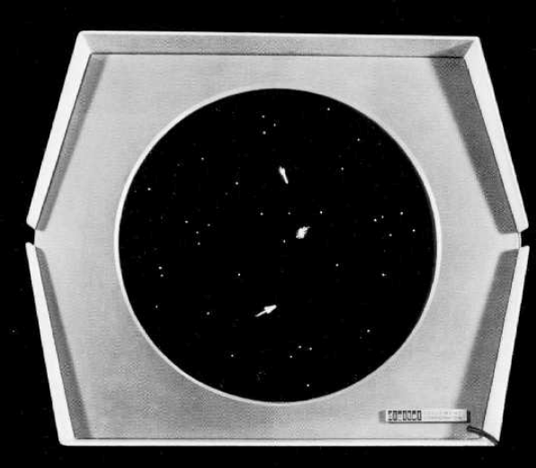
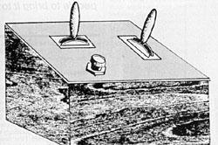
Early Computer Games (IV)
Left and right: Edwards, Dan/Graetz, Martin J./Kotok, Alan/Russell, Stephen R./Sampson, Peter/Wytanen, Wayne: Spacewar!, 1962, computer game for the minicomputer PDP-1, screen with two spaceships.
Left: Monitor.
Image source: URL: http://medienwissenschaft.uni-bayreuth.de/assets/Uploads/Koubek/forschung/KoubekSpielegeschichte.pdf
Right: console.
Image source: URL: http://spacewar.zorg.org/origins-of-spacewar.php

Slide 6
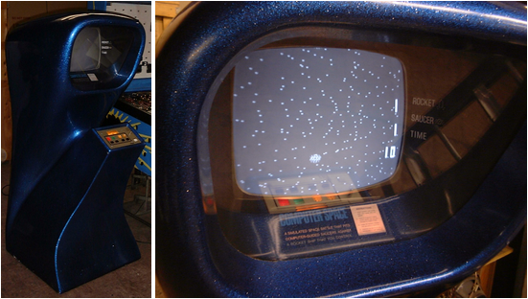
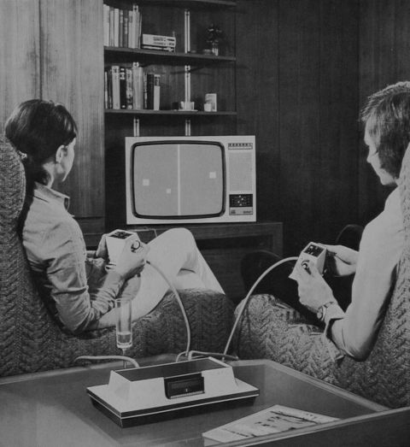
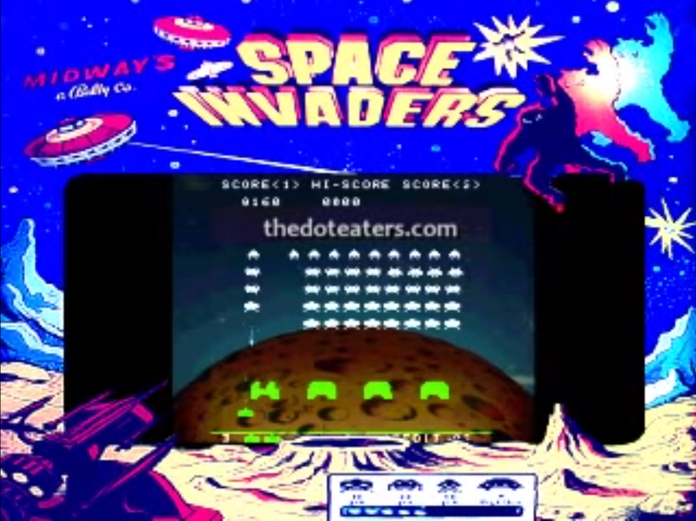
Arcade Games and Consoles (I)
Baer, Ralph: Tennis, one of the twelve games included in the Odyssey Home Entertainment System, Magnavox, 1972. Players with the console being connected to the TV. Image source: http://www.pong-mythos.net/index.php?lg=de&main=Odyssey-1972-&site=01:01:02
Bushnell, Nolan: Computer Space, Nutting Associates, 1971, arcade game.
Left: the case. Image source: URL: http://en.wikipedia.org/wiki/File:Nutting_ComputerSpace-Blue.JPG
Right: the screen. Image source: http://en.wikipedia.org/wiki/File:Nutting_ComputerSpace-Blue-Screen.JPG
Nishikado, Tomohiro: Space Invaders, Taito, 1979, arcade game. Image source: URL: https://www.youtube.com/watch?v=QObneYZIdKI
UR

Slide 7
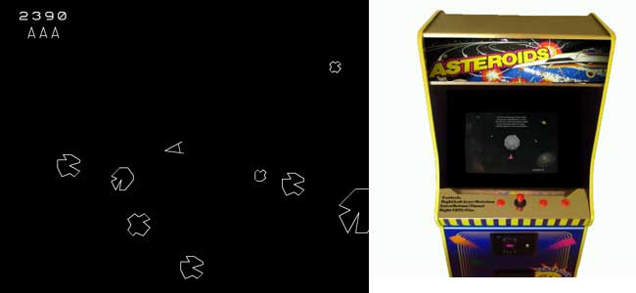
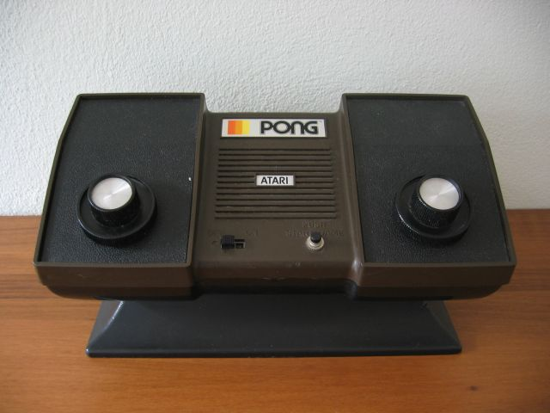
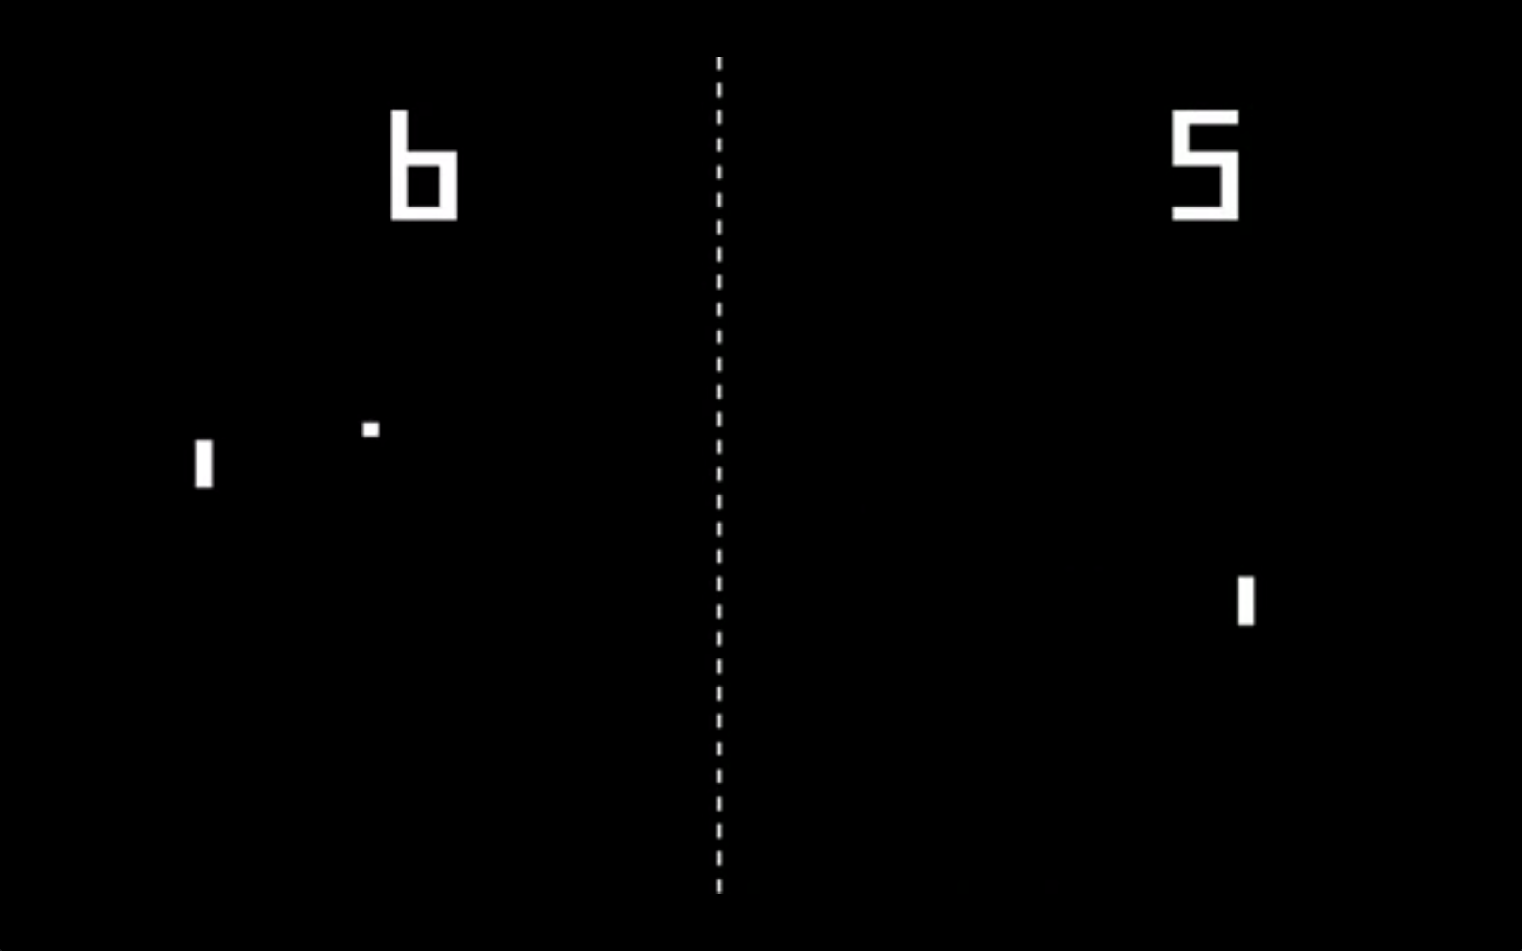
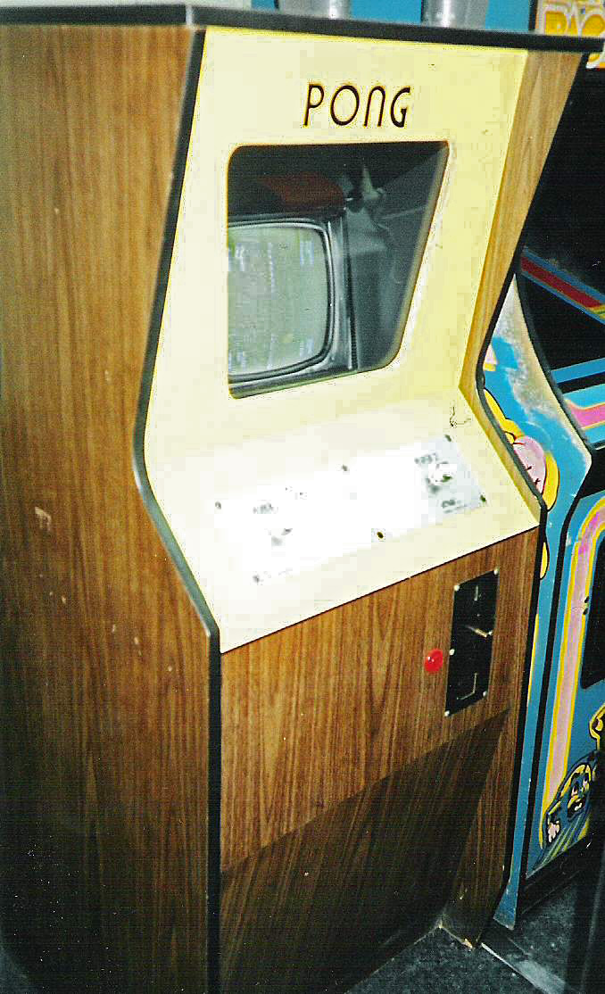
Arcade Games and Consoles (II)
Top, Left and middle: Rains, Lyle/Logg, Ed: Asteroids, Atari, 1979, arcade game. Image source: URL: http://www.retroland.com/asteroids/#.U2f0B2tsHc0
Top, right: Alcorn, Allan/Brown, Bob/Lee, Harold: Home Pong, Atari, 1975, game console. Image source: URL: http://www.pong-mythos.net/index.php?lg=de&main=Atari_Home_Pong&site=01:01:04
Alcorn, Allan: Pong, Atari. Bottom, left and middle: arcade game, 1972. Image sources: left: screenshot, URL: https://www.youtube.com/watch?v=3nu_L8uEzJw#t=221; middle: by ProhibitOnions, URL: http://de.wikipedia.org/w/index.php?title=Datei:PongVideoGameCabinet.jpg &filetimestamp=20120317213251

Slide 8
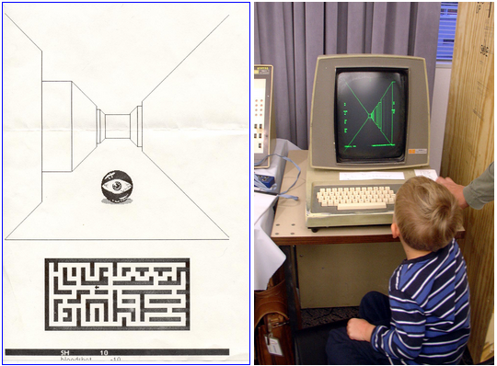
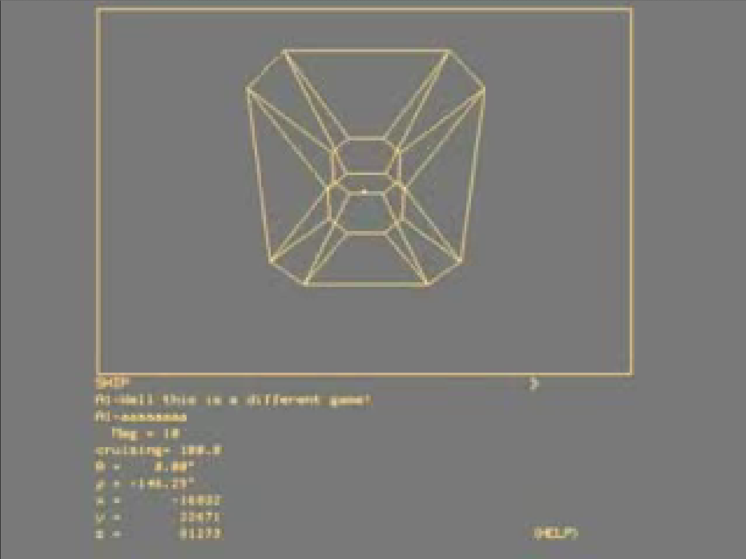
Ego Shooter (I)
Colley, Steve/Palmer, Howard/Thompson, Greg: Maze War, 1973-74, game for the minicomputer Imlac PDS-1.
Left: printout of a screenshot (from an implementation on the personal computer Xerox Star 8010), 1985-86.
Image source: URL: http://www.digibarn.com/collections/games/xerox-maze-war/maze-war.jpg
Right: child playing Maze War on an Imlac PDS-1, 30th Maze War Anniversary Event, DigiBarn Computer Museum, Mountain View/California 6th-7th November 2004.
Image source: URL:http://www.digibarn.com/history/04-VCF7-MazeWar/imlac-maze-kids/DSC00804.JPG
Bowery, James Allan: Spasim, 1973-74, multiplayer online game for the PLATO (Programmed Logic for Automated Teaching Operations) system.
Screenshot from: URL: https://www.youtube.com/watch?v=nMZv5Akcum8

Slide 9
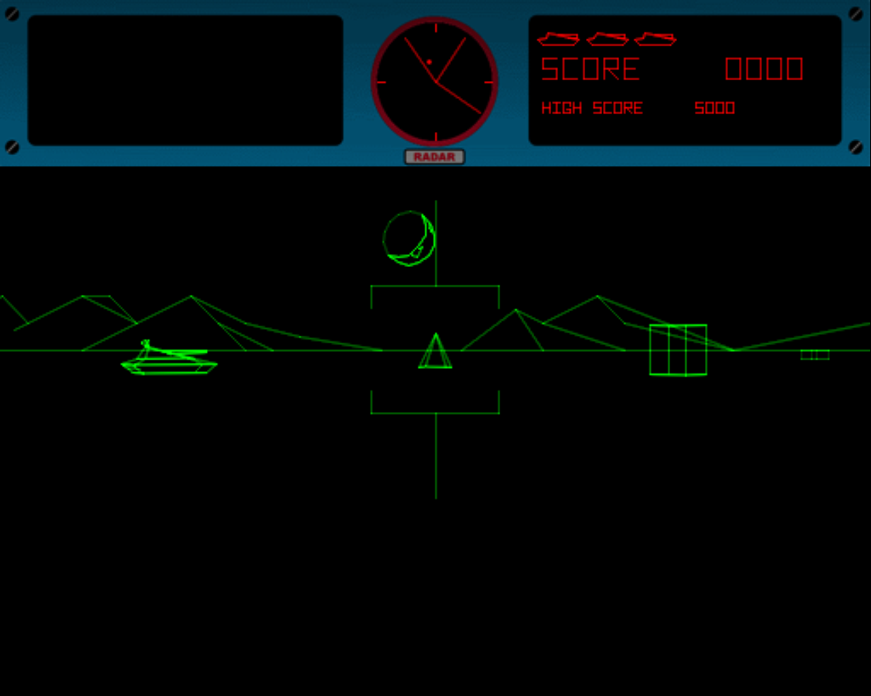
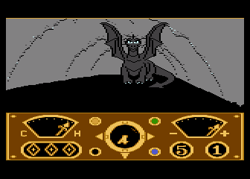
Ego Shooter (II)
Rotberg, Ed/Hoff, Morgan: Battlezone, Atari, 1980, arcade game. Screenshot from URL: http://www.atari.com/play/atari/battlezone
Kellner, Charlie/Seleme, Lance: The Eidolon, Lucasfilm Games/Epyx, 1985, computer game. Image source: URL: http://www.mobygames.com/game/atari-8-bit/eidolon/screenshots/gameShotId,150348/

Slide 10
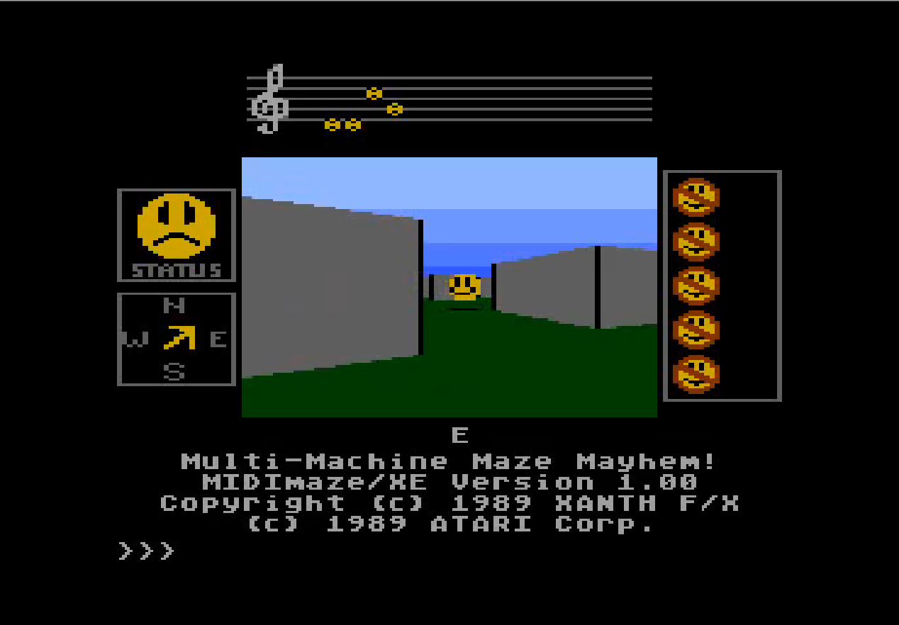
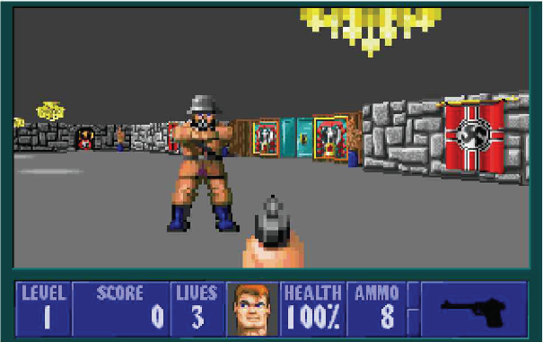
Ego Shooter (III)
Right: Xanth Software F/X: Midi Maze, Hybrid Arts, 1987, computer game.
Screenshot from URL: https://www.youtube.com/watch?v=29sTZedLcWk
Left: id Software (Romero, John/Carmack, John/Hall, Tom): Wolfenstein 3D, Apogee Games, 1992, computer game.
Image source: URL: http://books.google.co.uk/books?id=SYEzMIBe57kC&pg=PT74&dq=IE+2009+Proceedings+Australasian+Conference+Interactive+Entertainment&hl=de&sa=X&ei=oKJoU5_WLYmgyQPaqoGQDg&ved=0CC0Q6AEwAA#v=onepage&q=IE%202009%20Proceedings%20Australasian%20Conference%20Interactive%20Entertainment&f=false

Slide 11
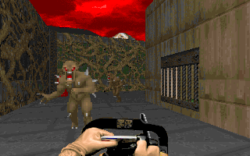
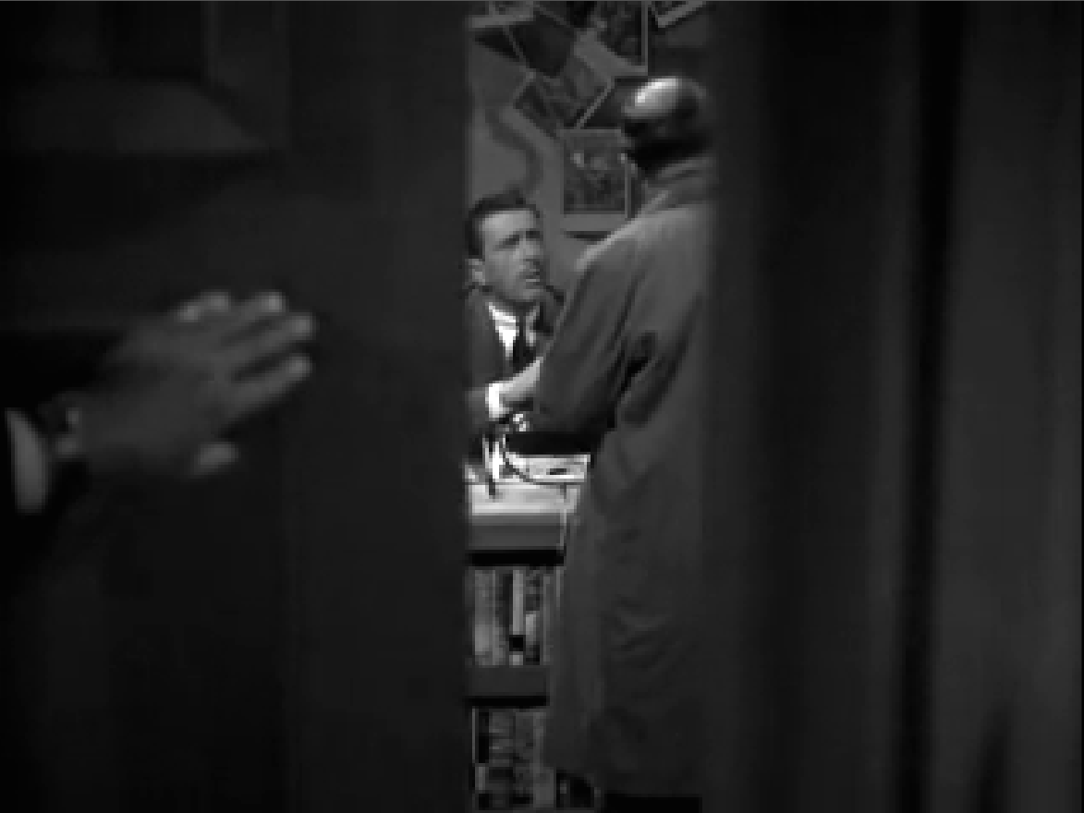
Ego Shooter (IV)
id Software (Romero, John/Carmack, John/Hall, Tom): Doom, Cdv Software Entertainment, Pearl Agency, 1993, computer game. Image source: URL: http://www.mobygames.com/game/dos/doom/screenshots/gameShotId,369142/
Montgomery, Robert: Lady in the Lake, 1947, movie. Screenshot from URL: http://www.youtube.com/watch?v04AKDw2wi5l

Slide 12
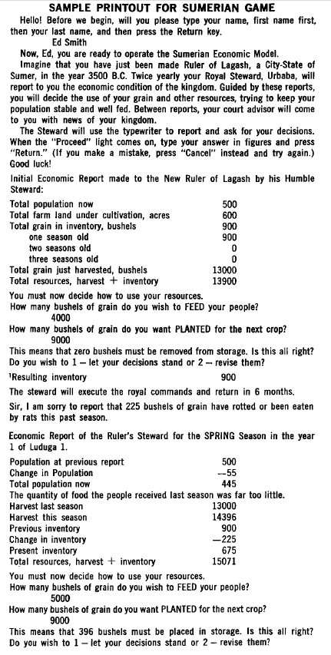
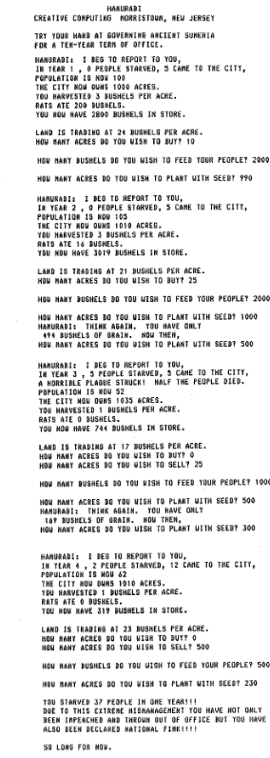
Strategy Games/God Games (I)
Left: Center for Educational Services and Research of the Board of Educational Services (BOCES)/William McKay (IBM): The Sumerian Game 1962-64, computer game for a timesharing system (Wing: Economics 1966, p.33).
Right: Ahl, David H.: Hammurabi (Ahl: BASIC 1978, p.78).

Slide 13
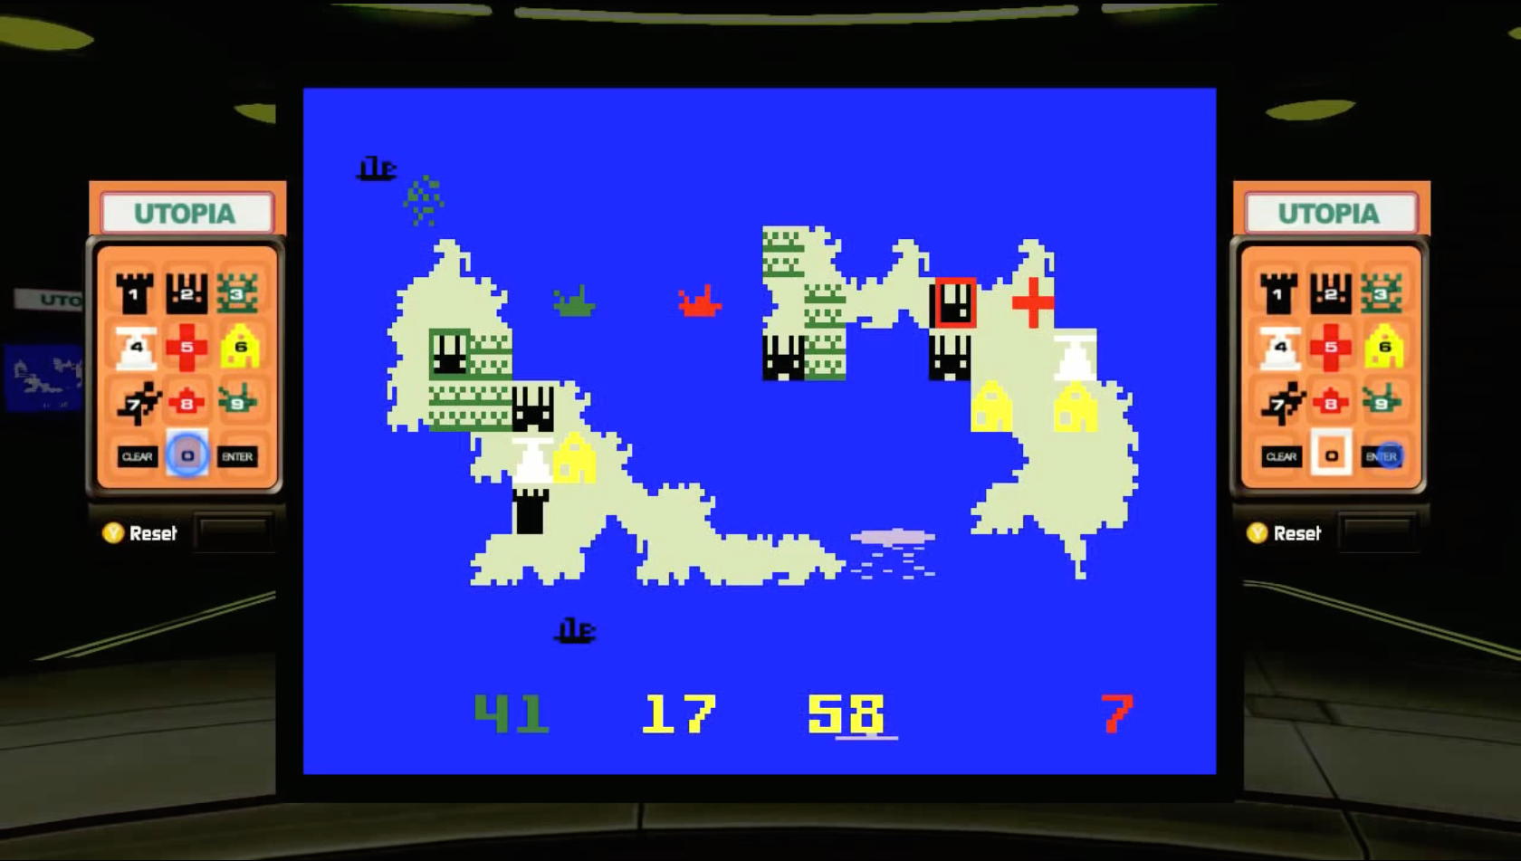
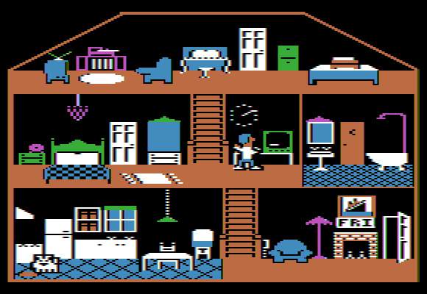
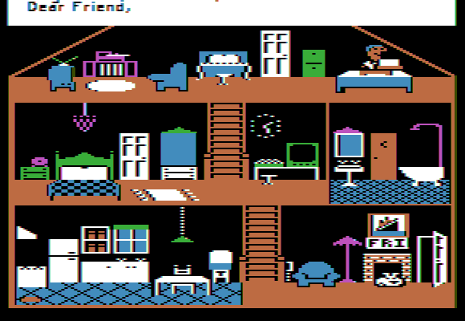
Strategy Games/God Games (II)
Daglow, Don: Utopia, Mattel Electronics, 1981, game for the console Mattel Intellivision (since 1980).
Screenshot from URL: https://www.youtube.com/watch?v=DS6fMMDAplk
Right, top and bottom: Crane, David/Gold, Rich: Little Computer People, Activision, 1985, computer game. Images from Apple II version, top: URL: http://www.mobygames.com/game/apple2/little-computer-people/screenshots/gameShotId,191391/; bottom: http://www.mobygames.com/game/apple2/little-computer-people/screenshots/gameShotId,191390/

Slide 14
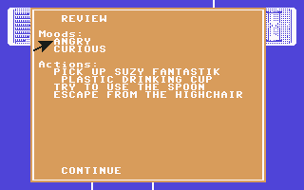
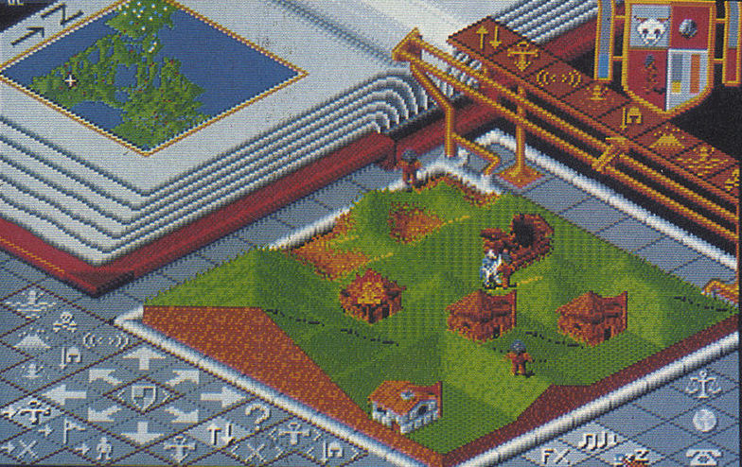
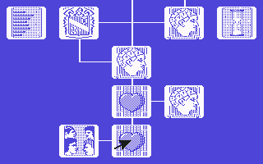
Strategy Games /God Games (III)
Right: Bullfrog Productions: Populous, Electronic Arts. 1989, computer game.
Image source: URL: http://www.kultpower.de/archiv/heft_powerplay_1989-beste-spiele_seite76
Left: Favaro, Peter J.: Alter Ego, Activision, 1986, computer game.
Images of the Commodore 64 version, above: URL: http://www.mobygames.com/game/c64/alter-ego/screenshots/gameShotId,240198/; bottom: URL: http://www.mobygames.com/game/c64/alter-ego/screenshots/gameShotId,240199/

Slide 15
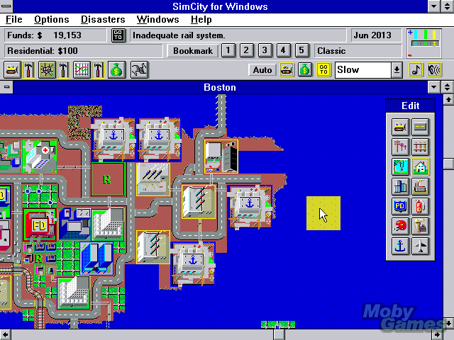
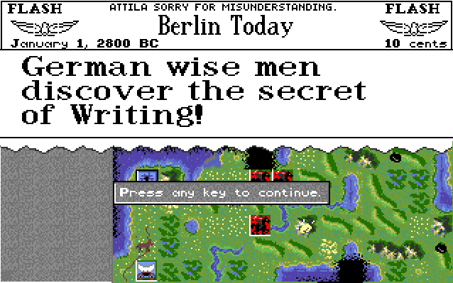
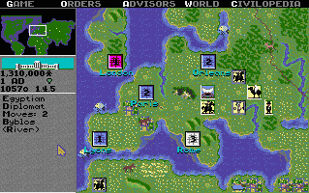
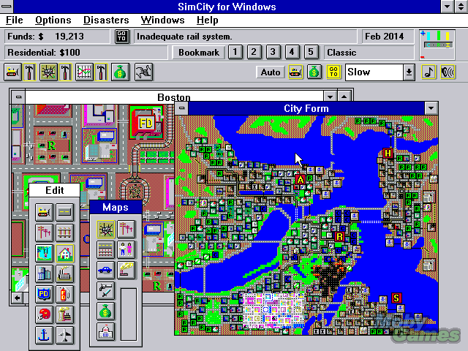
Strategy Games/God Games (IV)
Left, top and bottom: Wright, Will/Maxis: Sim City, Electronic Arts, 1989, computer game. Images of the Windows version, URL: http://www.mobygames.com/game/win3x/simcity/screenshots
Right, top and bottom: Meier, Sid/Shelley, Bruce: Civilization, Micro Prose, 1991, computer game. Images of Amiga version, URL: http://www.mobygames.com/game/amiga/sid-meiers-civilization/screenshots

Slide 16
Literatur
Bibliography with informations about the abbreviations used in the captions:
Dreher, Thomas: History of Computer Art. Chap. Bibliography. In: URL: http://iasl.uni-muenchen.de/links/GCA-IXe.html
8

