Slide 1
History of Computer Art
URL: http://iasl.uni-muenchen.de/links/GCA_Indexe.html
  Part XI: Pervasive Games
  Seminar, 28nd April 2014
  Danube University Krems
  Department for Arts and Image Science
  MediaArtHistories: Masters of Art
Thomas Dreher
URL: http://dreher.netzliteratur.net

Slide 2
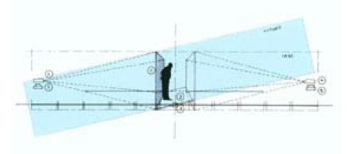
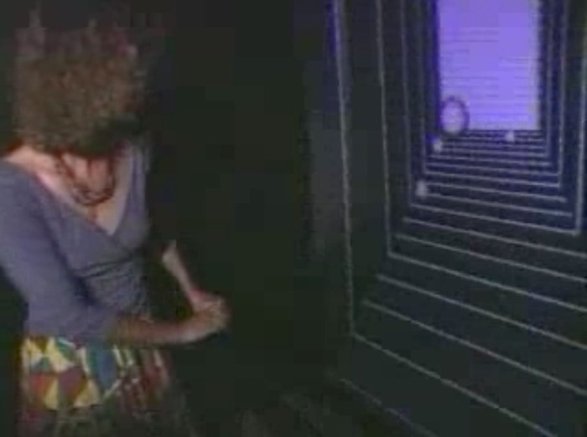
Spatialization (I)
Möller, Christian: Space (im)Balance, 1992, pavilion with reactive installation in the interior space, Donaulände, Linz.
Top: vertical plan (Möller: Space 1992, p.158).
Image source: URL: http://90.146.8.18/de/archiv_files/19921/1992_155.pdf
Bottom: The pavilion´s interior with one of the two projections and an observer standing on the platform with a modifiable gradient.
Image source: URL: http://www.christian-moeller.com/display.php?project_id=18&play=true

Slide 3
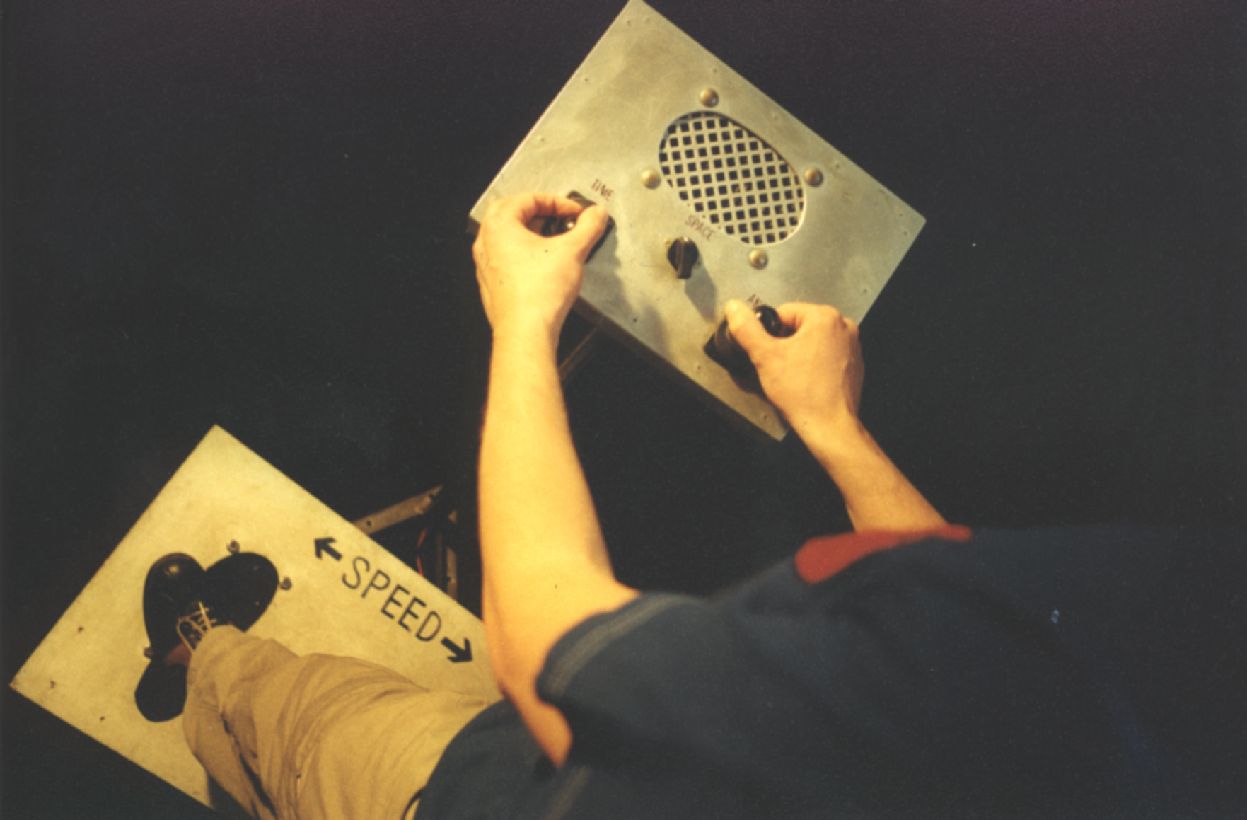
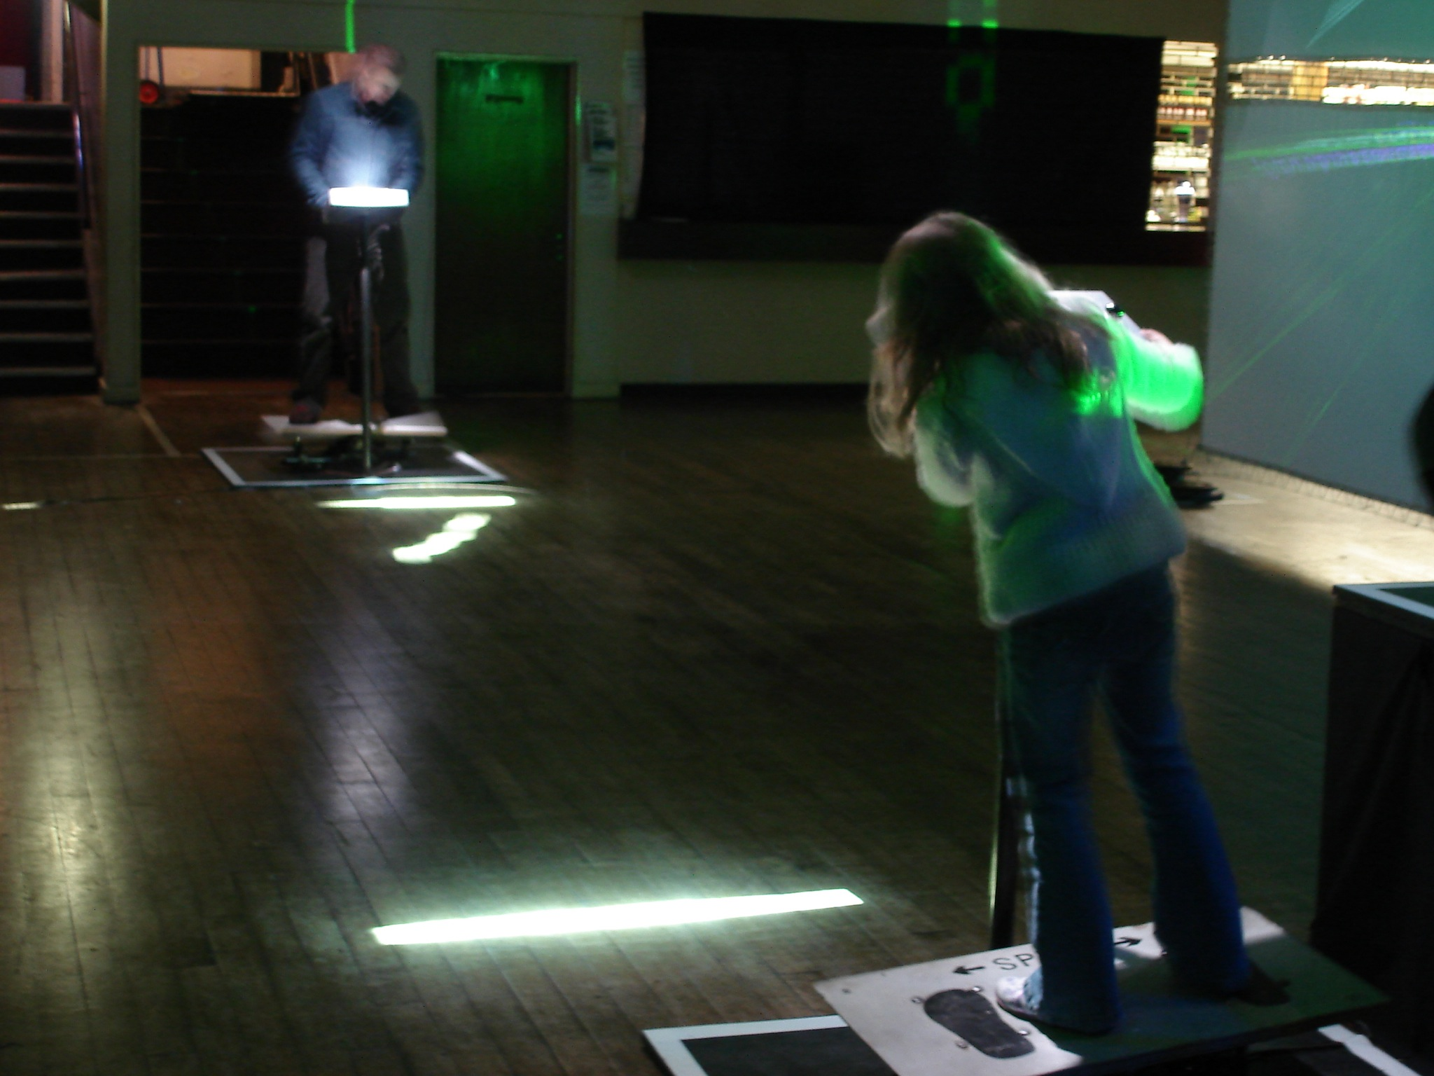
Spatialization (II)
Time´s Up: Sonic Pong, 1999, reactive installation.
Image source: URL: https://www.flickr.com/photos/10464117@N05/sets/72157624549801710
UR

Slide 4
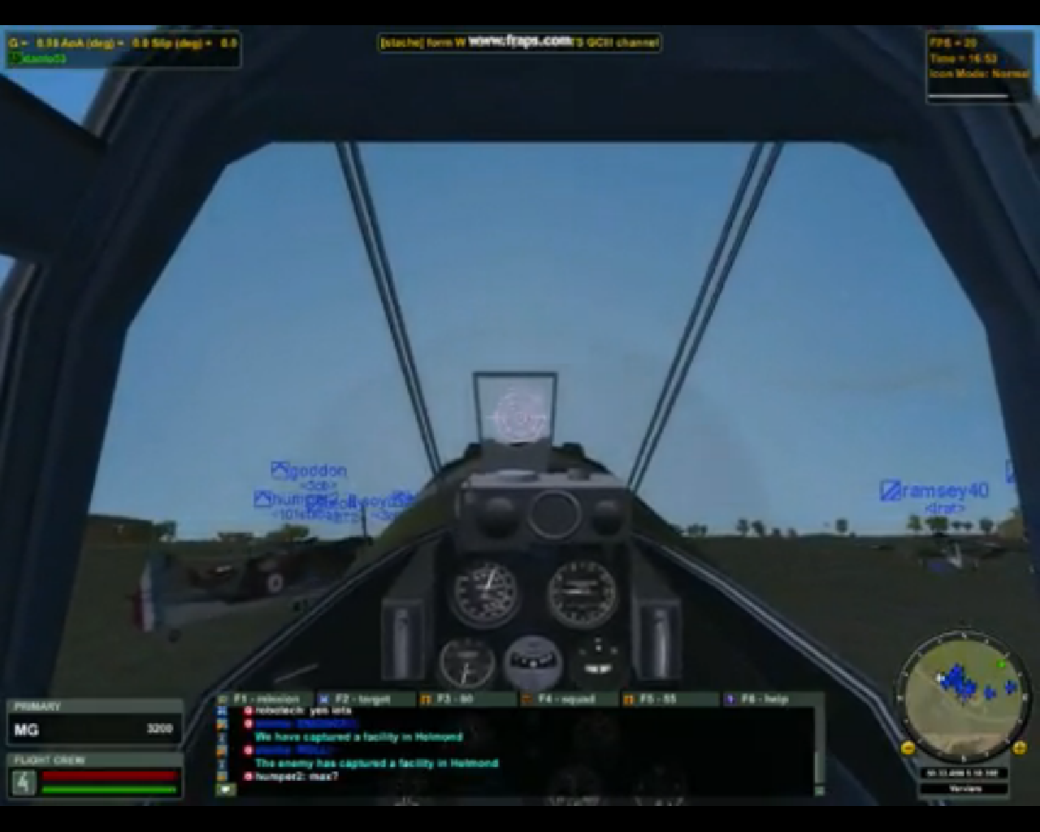
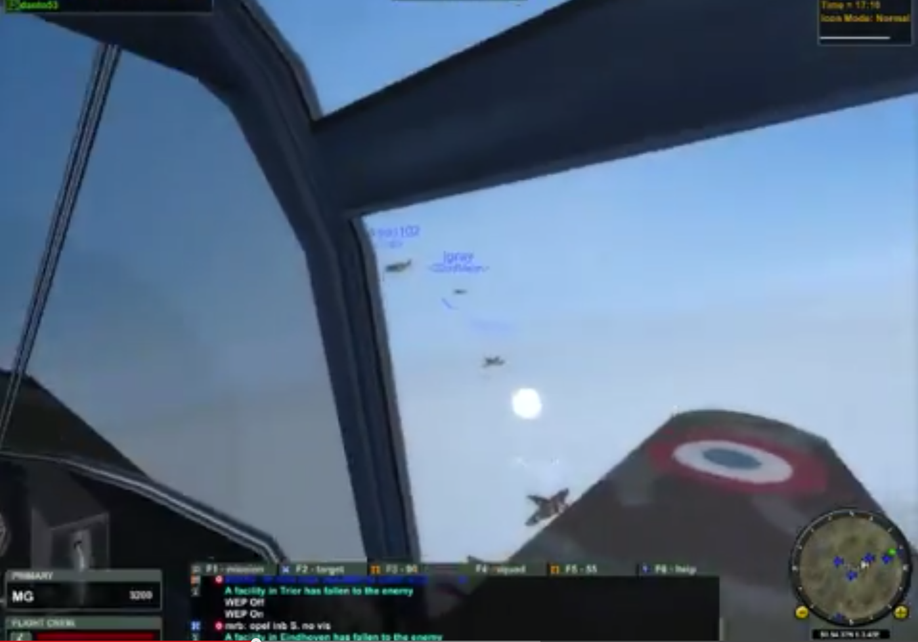
Massively Multiplayer Online Games (MMOG)
Battleground Europe: World War II online, 2001, MMOG. Screenshot from: URL: https://www.youtube.com/watch?v=RBMdJce91FA
UR

Slide 5
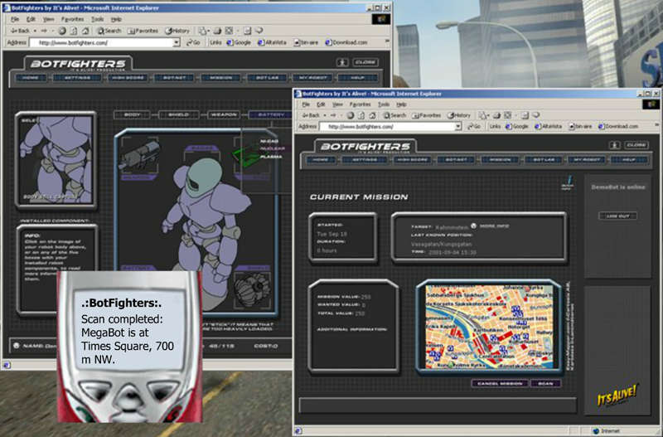
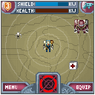
Pervasive Games (I)
It´s Alive: Botfighters 1, since April 2001, pervasive game.
Left: illustrations from the web site and the screen of the mobile telephone.
Image source: URL: http://streams.metropolia.fi/old/storytelling05/slides/TomSoderlund-StoriesfromtheFrontierofMobileGaming-2005-09-20.ppt
Right: the screen of the mobile telephone.
Image source: URL: http://streams.metropolia.fi/old/storytelling05/slides/TomSoderlund-StoriesfromtheFrontierofMobileGaming-2005-09-20.ppt

Slide 6
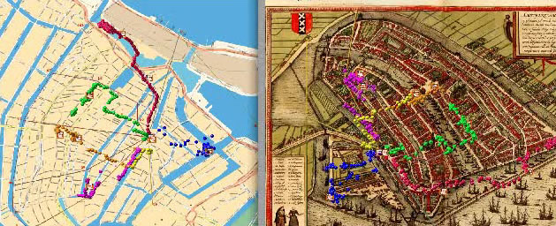
Pervasive Games (II)
Waag Society: Frequency 1550, February 2005, pervasive game, pilot test.
Image source: URL: http://freq1550.waag.org/clips/real-med-map.html
UR

Slide 7
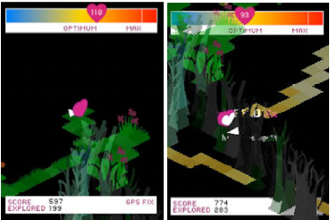
Pervasive Games (III)
Active Ingredient/Lansdown Centre for Electronic Arts und London Institute for Sport and Exercise, Middlesex University, London/Mixed Reality Laboratory, Nottingham Trent University: ´Ere be Dragons, project, Nottingham, Februar und Dezember 2005/Singapore, November 2005/Berlin, October 2006.
Image source: URL: http://citeseerx.ist.psu.edu/viewdoc/download;jsessionid=36467EC756CDCE651C87AC6327ED58E7?doi=10.1.1.106.955&rep=rep1&type=pdf

Slide 8
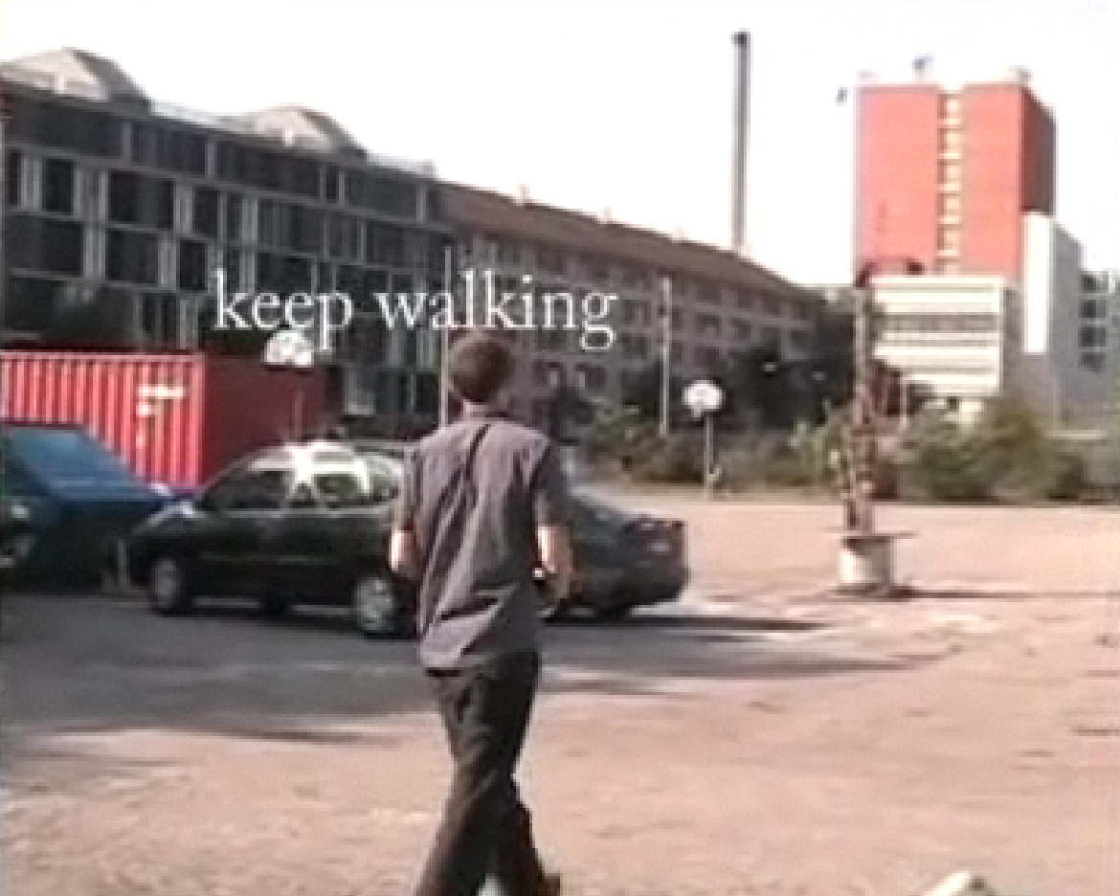
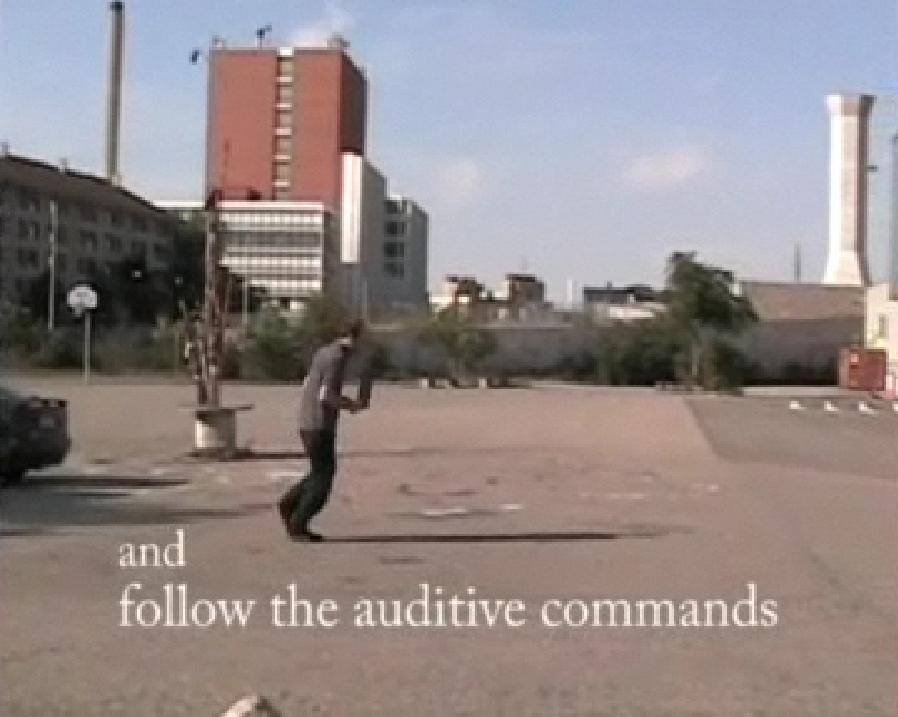
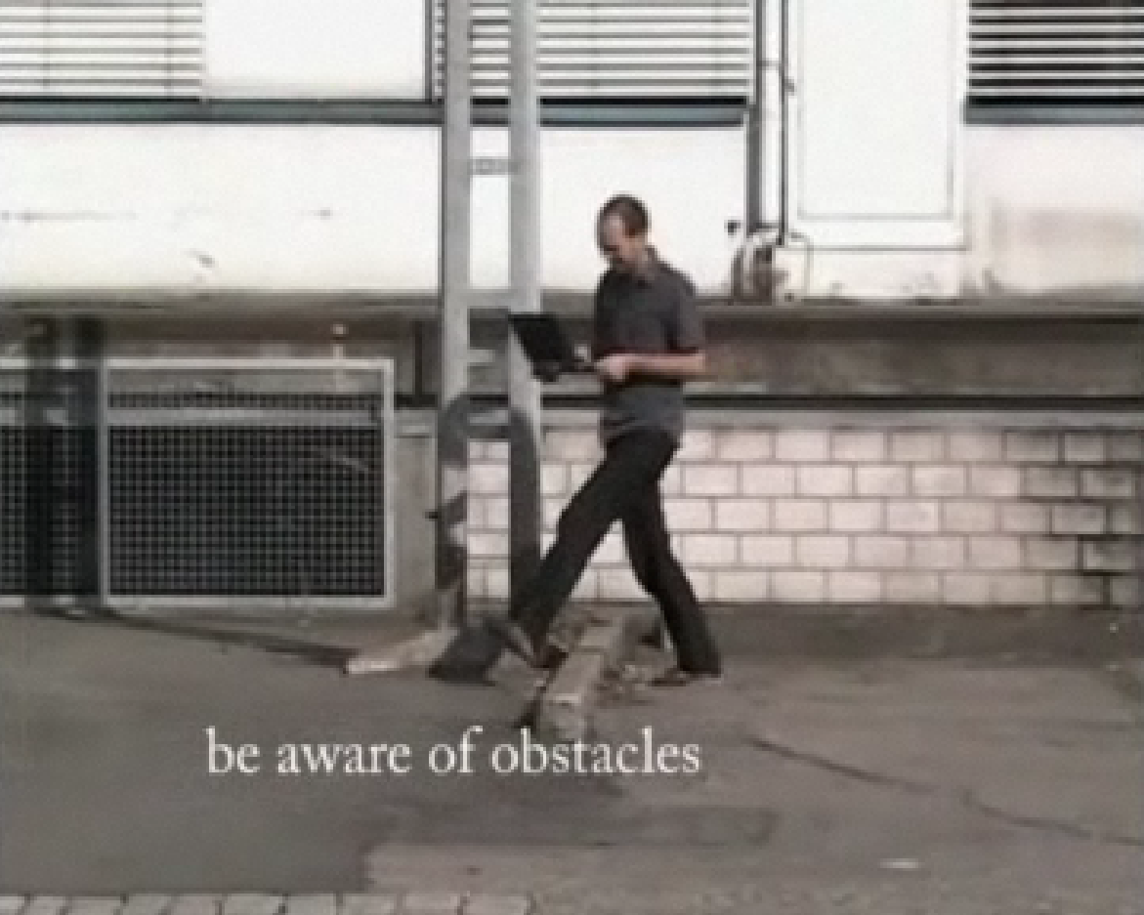
Pervasive Games (IV)
Hansen, Jonas: Wanderer, September 2005, pervasive game.
Screenshots from URL: https://vimeo.com/1728692

Slide 9
Literatur
Bibliography with informations about the abbreviations used in the captions:
Dreher, Thomas: History of Computer Art. Chap. Bibliography. In: URL: http://iasl.uni-muenchen.de/links/GCA-IXe.html
8

